Slide 1


Slide 2
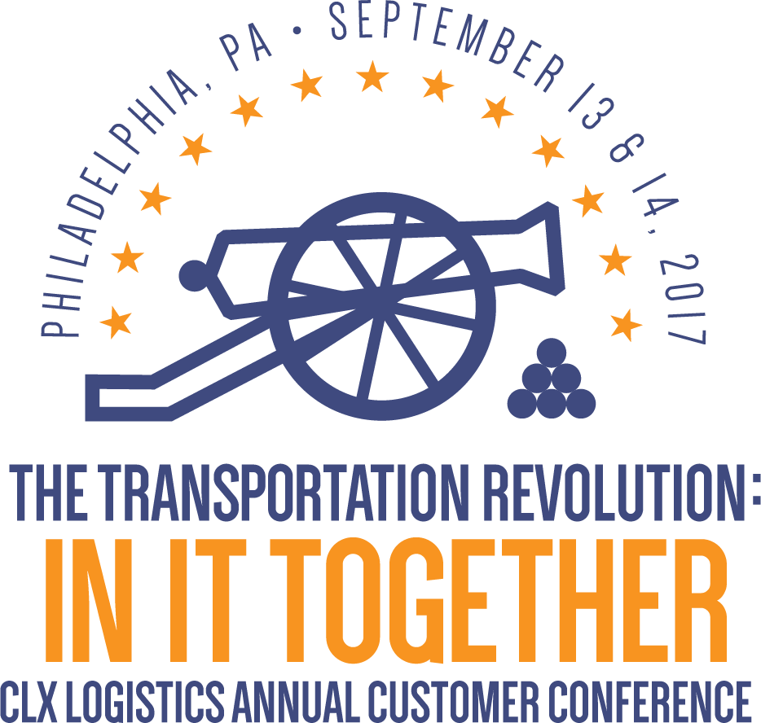

Slide 3
Supply Chain Insights
With Lora Cecere
September 13, 2017
9:15 AM

Slide 4


Supply Chain 2030
September 2017
For the Supply Chain Leader Who Wants to Rise Above

Slide 5

I Am A Social Scientist

Slide 6

A Skeptic

Slide 7

A Bit of a Curmudgeon…

Slide 8

A Fortune-teller of Sorts….

Slide 9

I Write for the Supply Chain Leader

Slide 10

Today’s Reality

Slide 11
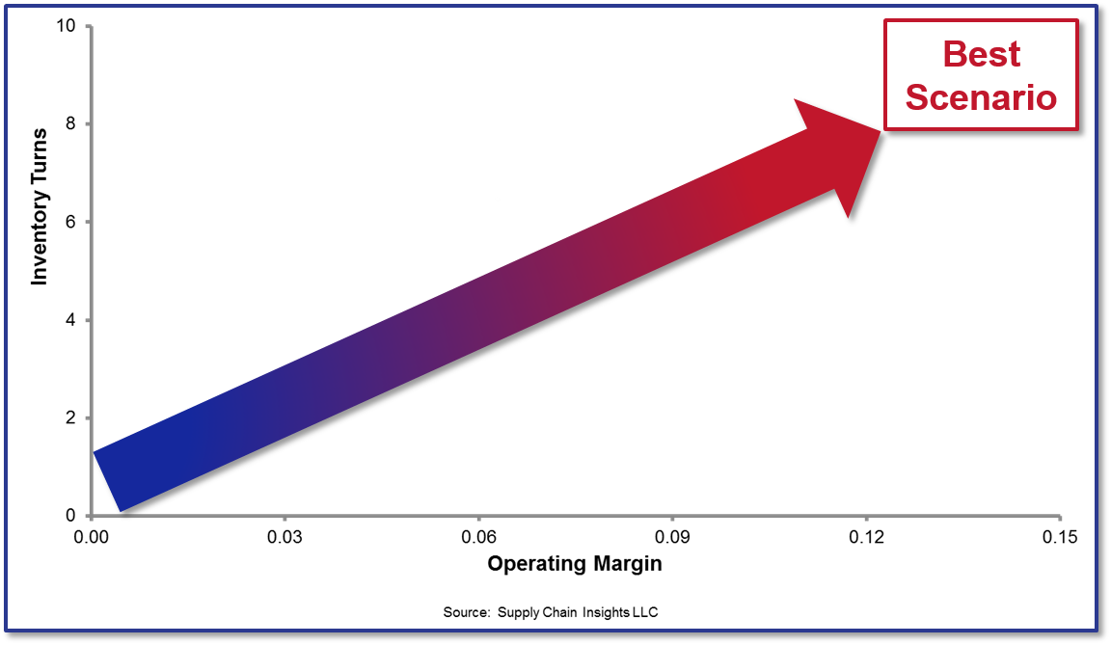
What I Believed

Slide 12
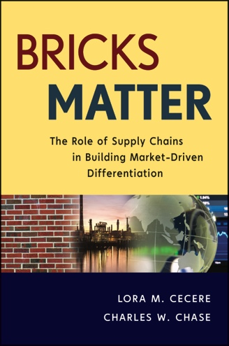

Slide 13

Only 12% Of Companies Are Driving Improvement and Performance Better Than Their Peer Group at the Intersection of Operating Margin and Inventory Turns.

Slide 14

The Supply Chain Is a Complex System with Increasing Complexity.
Each Supply Chain Operates on an Effective Frontier

Slide 15
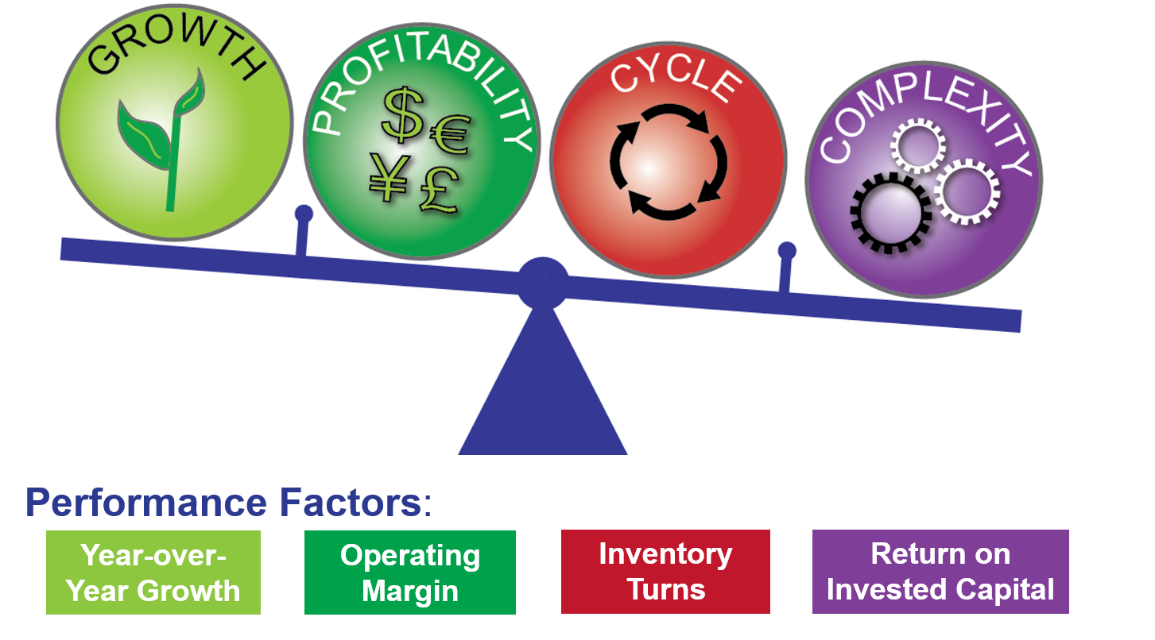
The Supply Chain Is a Complex System with Increasing Complexity. Each Supply Chain Operates on an Effective Frontier

Slide 16
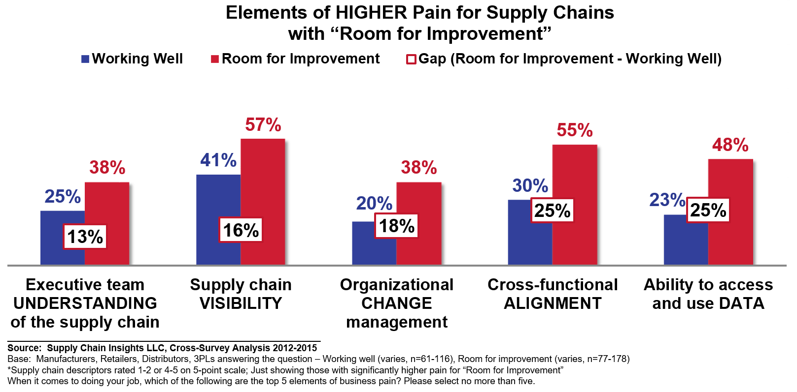
What Makes a Difference?

Slide 17
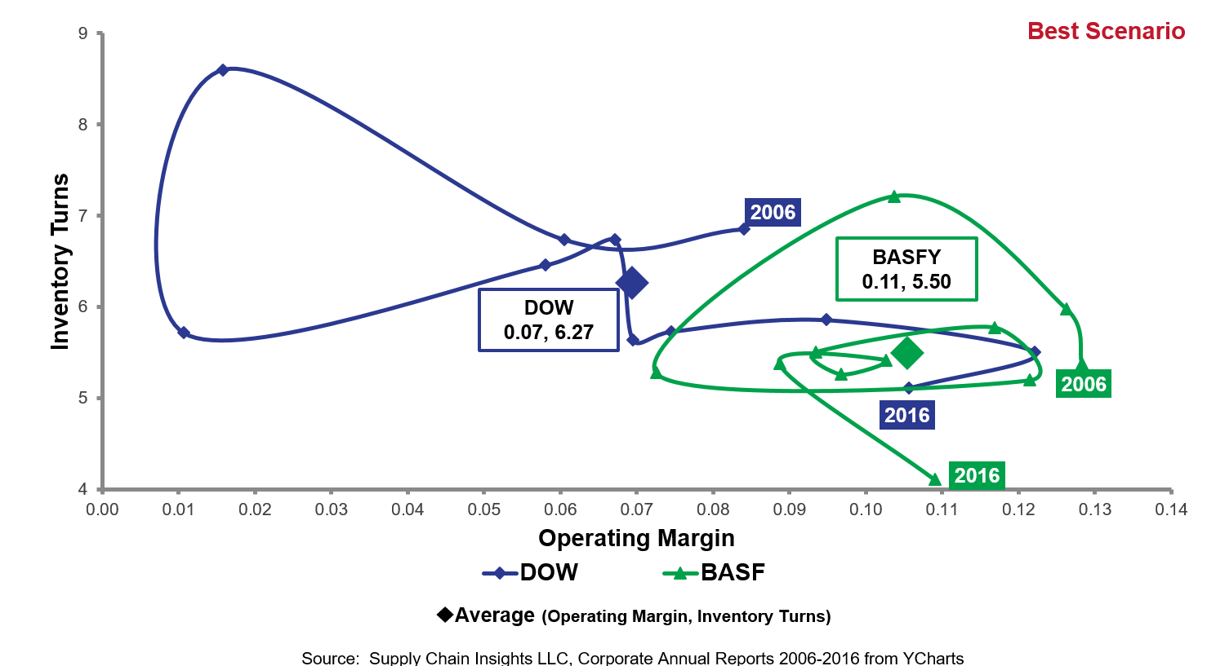
Dow and BASF

Slide 18
Toyota and Honda
Operating Margin vs. Inventory Turns (2004 – 2016)

Slide 19
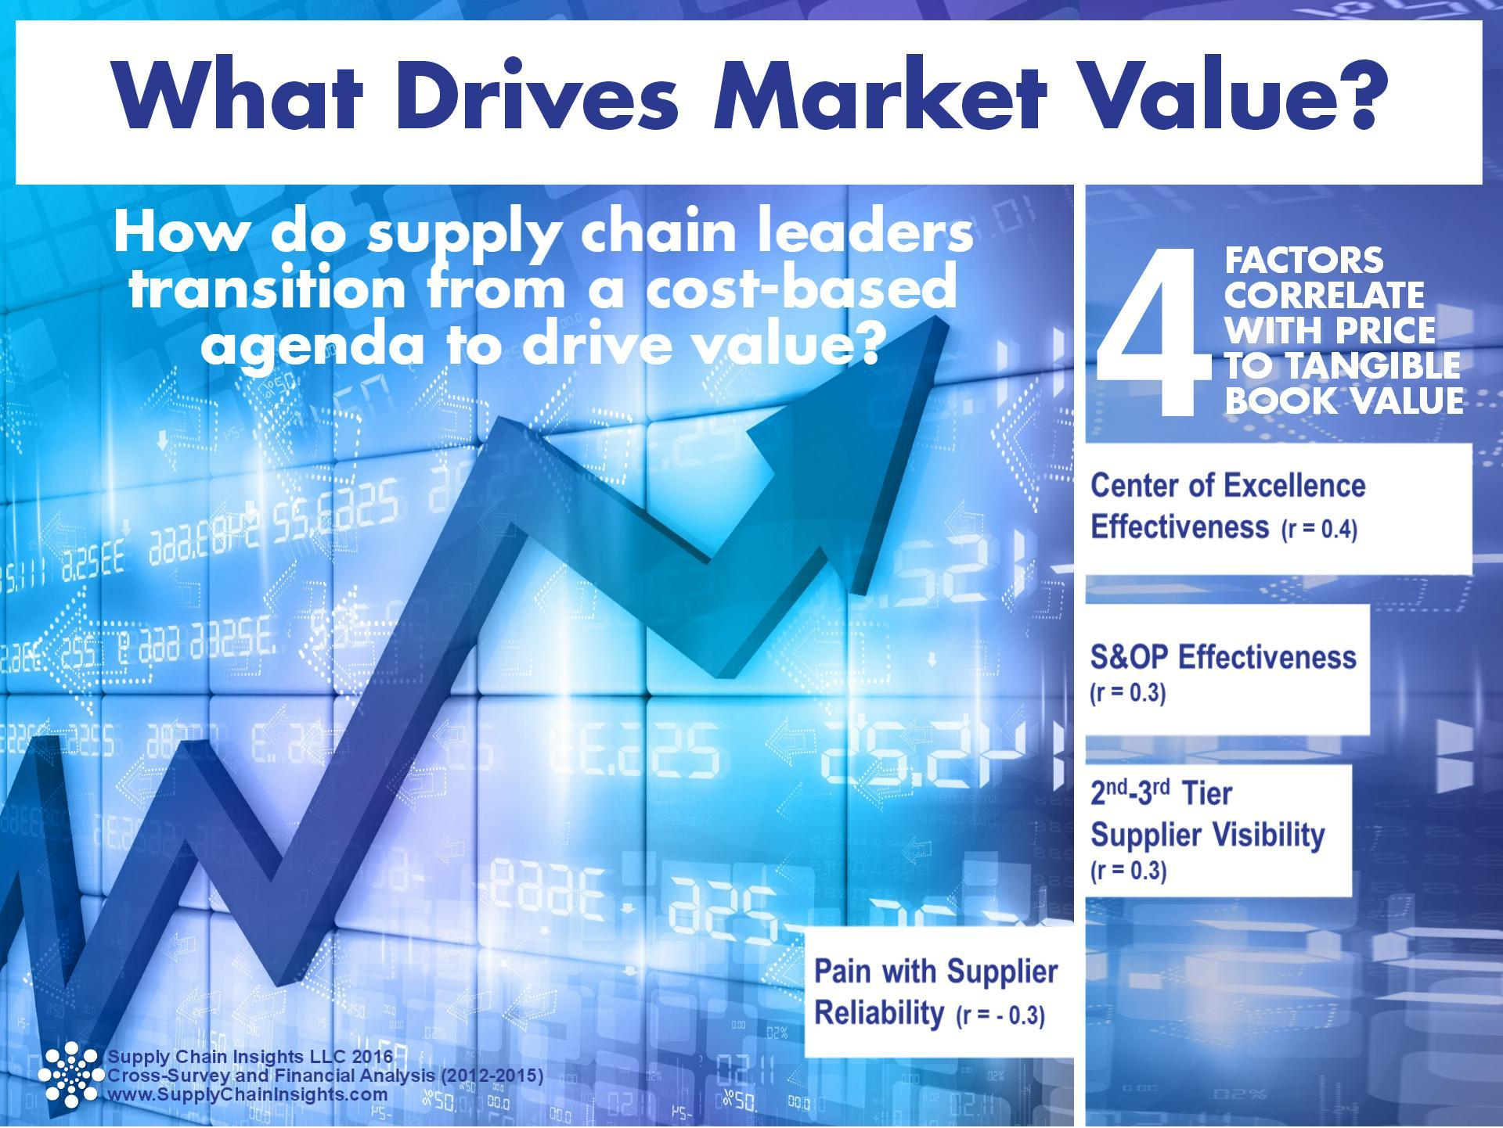
What Drives Value?

Slide 20
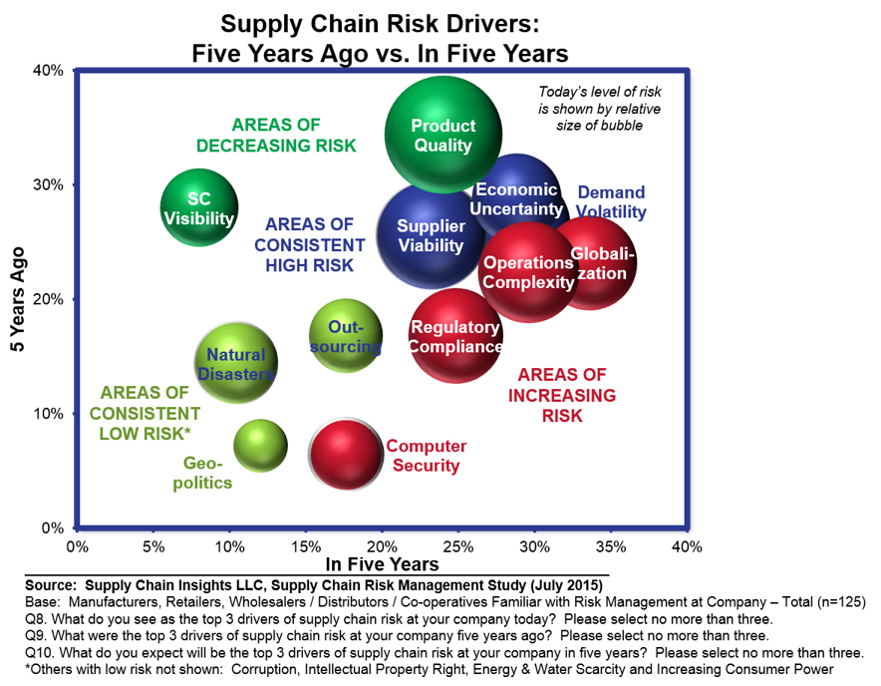
Managing in a Complex World

Slide 21
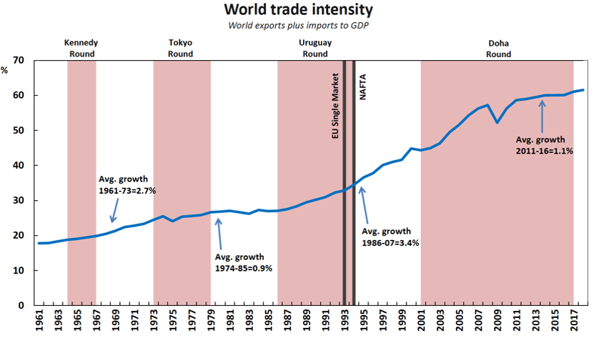
Trade is Growing While Growth is Slowing

Slide 22

Supply Chains to Admire:
2017 Winners

Slide 23
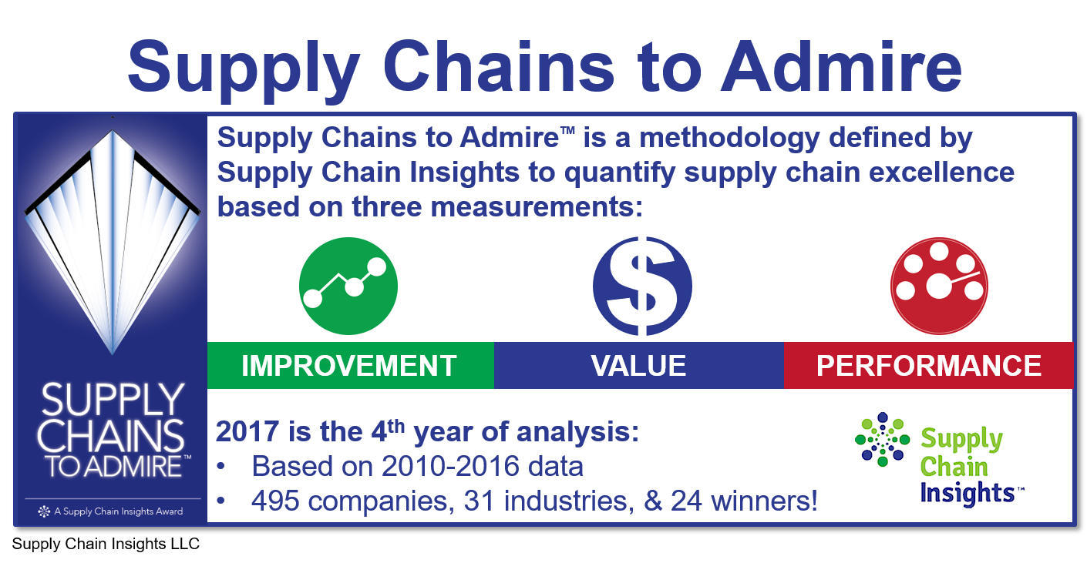

Slide 24
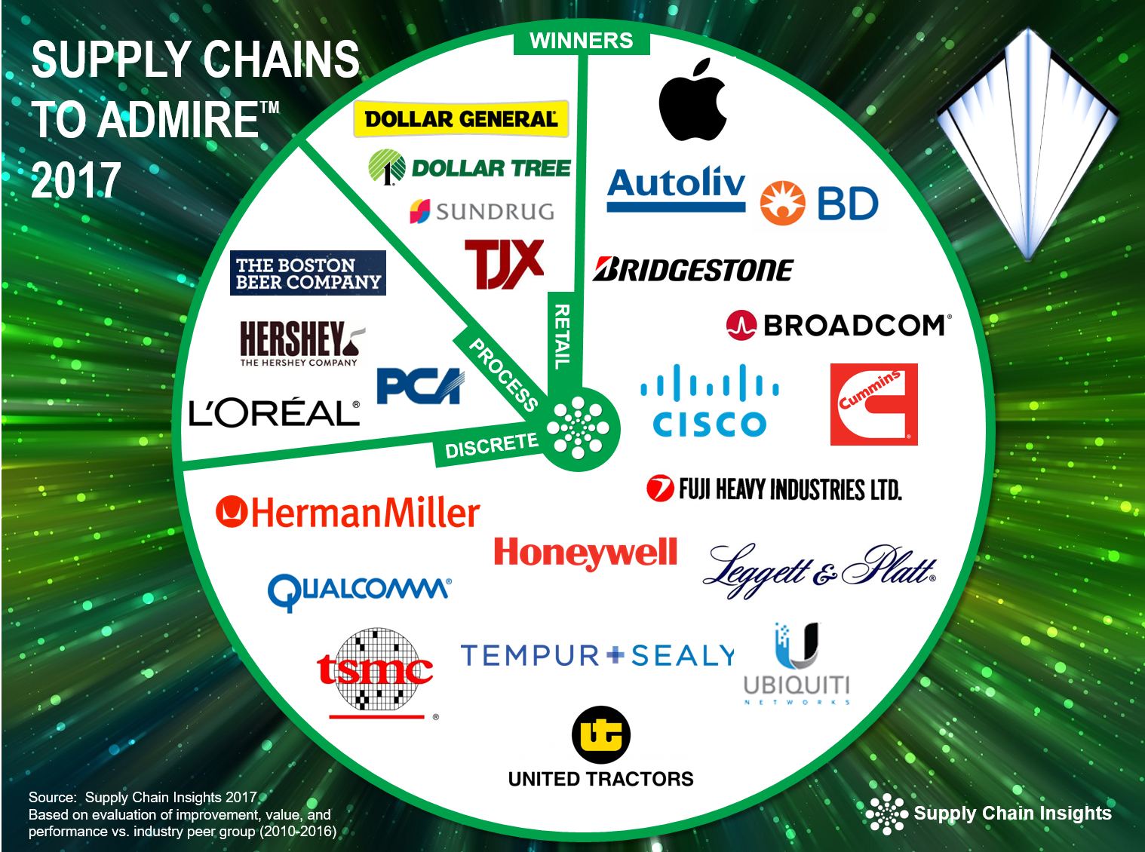

Slide 25


Slide 26

What Did I Learn?

Slide 27

Improvement IS Fast When You Have a Lot to Lose

Slide 28

Manage Costs Like a Decathlete

Slide 29

Efficient Is Usually Not Effective

Slide 30

Fads Get Us Nowhere

Slide 31


Best Transformations Require Wings and Feet
Aspirational Leadership and Process Innovation
Grounded in Goals

Slide 32
Moving Forward: Supply Chain 2030

Slide 33
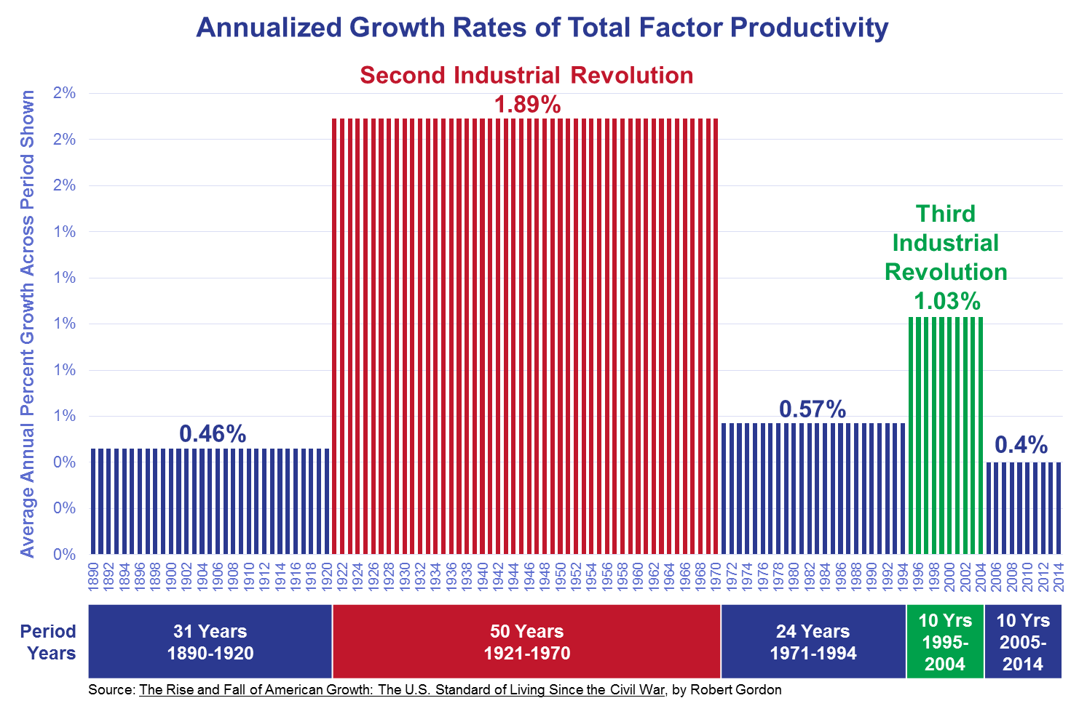
Productivity From the Third Industrial Revolution Stopped in 2004

Slide 34
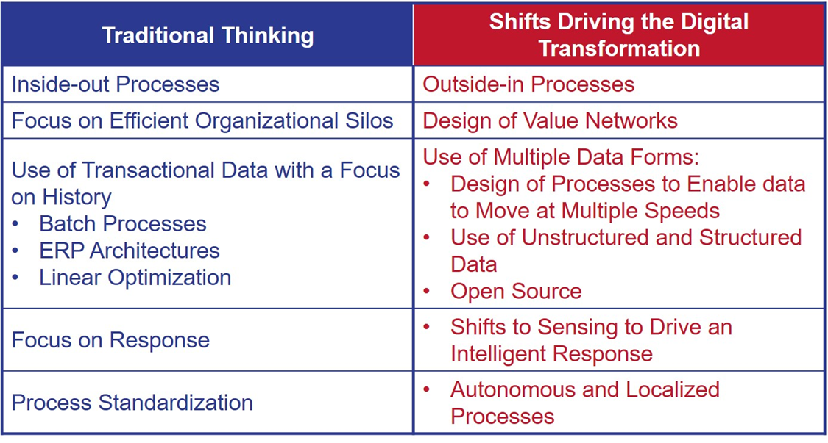
What Is Next-Generational Thinking?

Slide 35
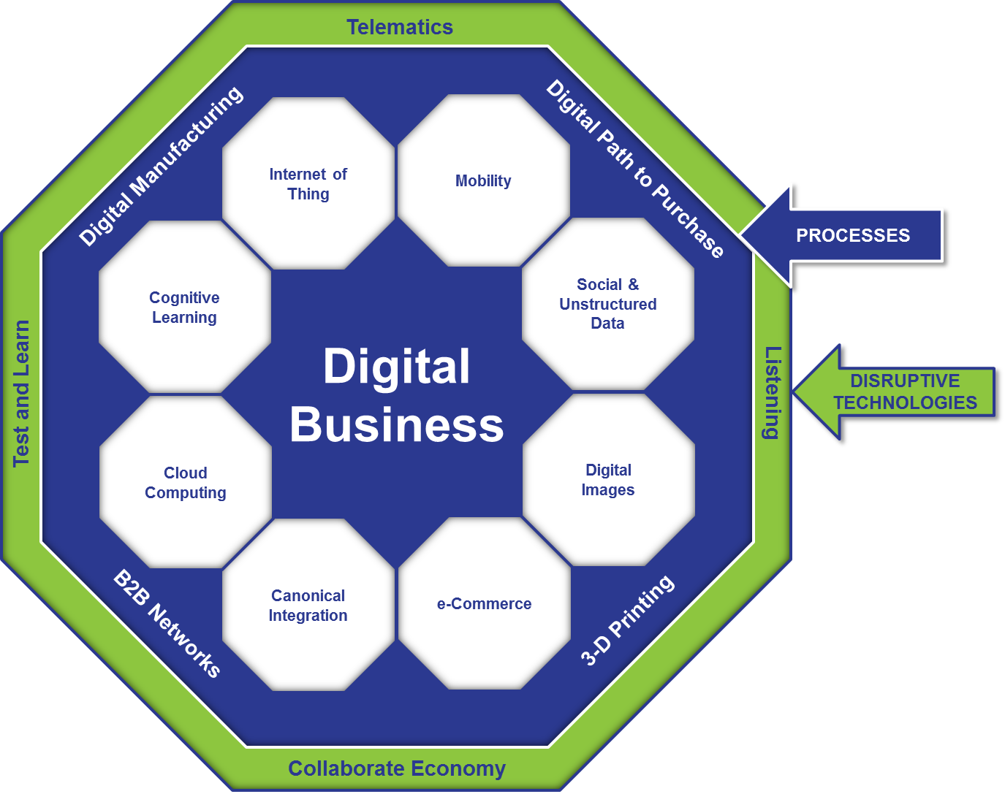
The Move to Digital Business
Telematics

Slide 36
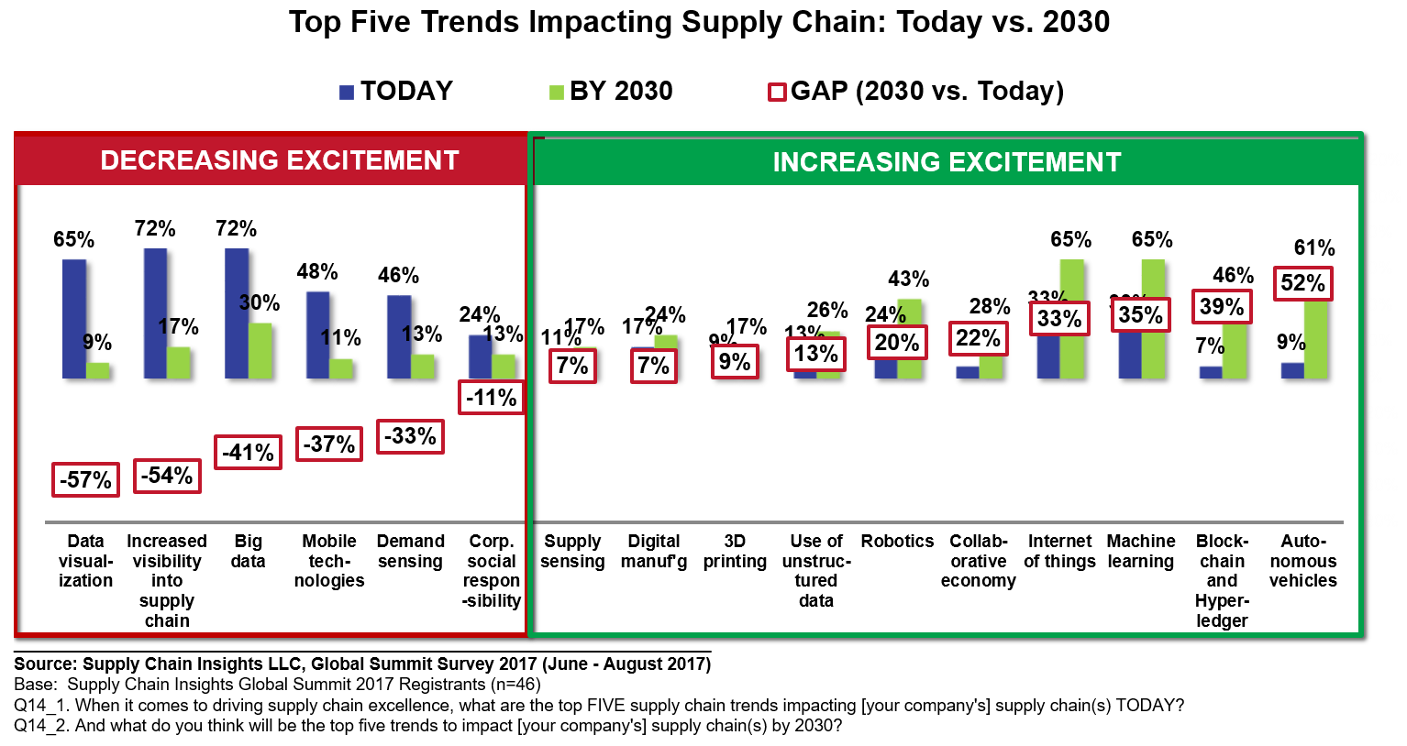
Shifts for 2030

Slide 37

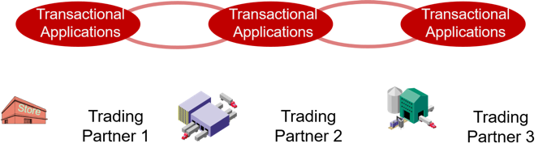
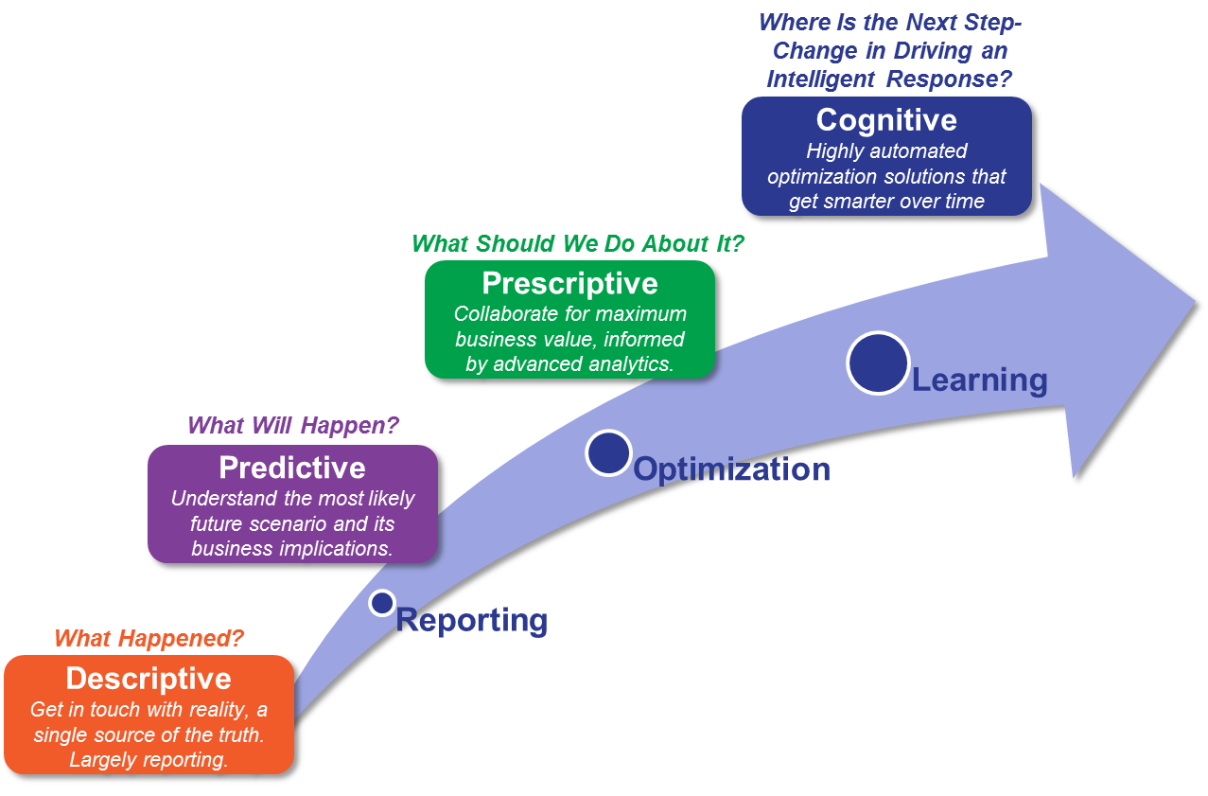
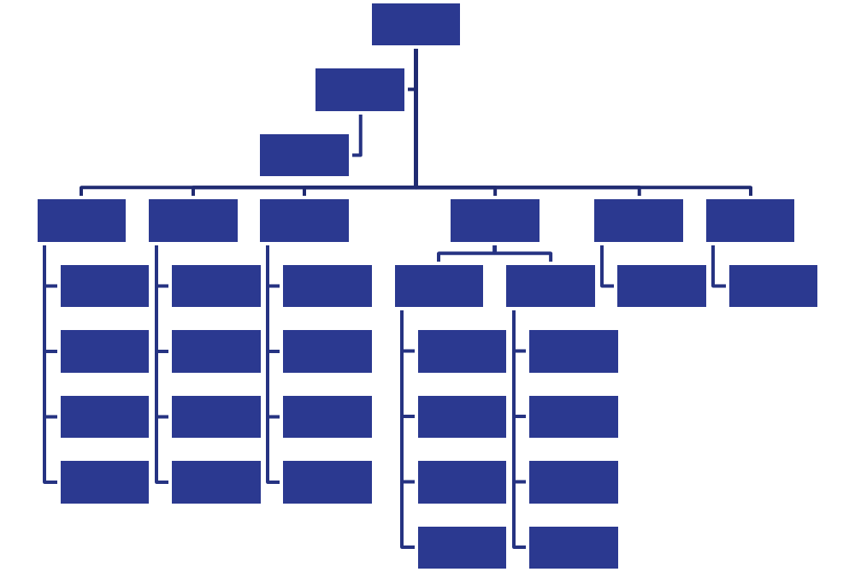
Current Supply Chain Process Thinking
Rows and Columns: Transactional Data
One-to-One Enterprise Linear Flows
Fixed Hierarchies with Structured Data
Descriptive and Predictive Analytics

Slide 38
What Does Digital Transformation Mean for You? There Is No One Definition
Autonomous Supply Chain: Automation of supply chain processes through cognitive learning and artificial intelligence eliminating labor and reducing the need for people to touch data.
Value Chain Uberization: A platform to enable shared resources across a community.
3D Printing: Localization of manufacturing through the sharing of digital images using additive manufacturing.
Internet of Things: The use of machine-to-machine streaming data to improve supply chain outcomes.
Multi-Tier Networks and Redefinition of B2B: The building and execution of multi-tier networks for data sharing, collaborative workflows, and improved decision making. This includes a discussion of blockchain, network canonicals, and interoperability.
Cloud-Based Computing. The promise of cloud is federation and democratization of data, in both private and public clouds, with the promise of lower cost of ownership.
Listening: The use of unstructured data–social sentiment, warranty, and quality data–to improve organizational productivity and outside-in processes to be market-driven. Market-Driven Value Networks is a more mature definition of demand-driven.

Slide 39

Trend #1: Outside-In Processes

Slide 40
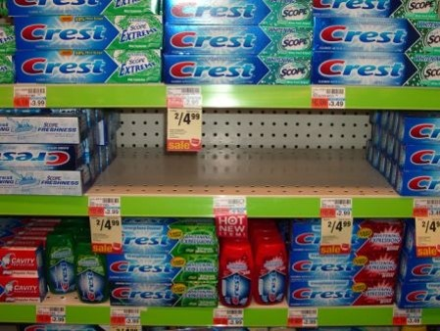
Today’s Reality

Slide 41
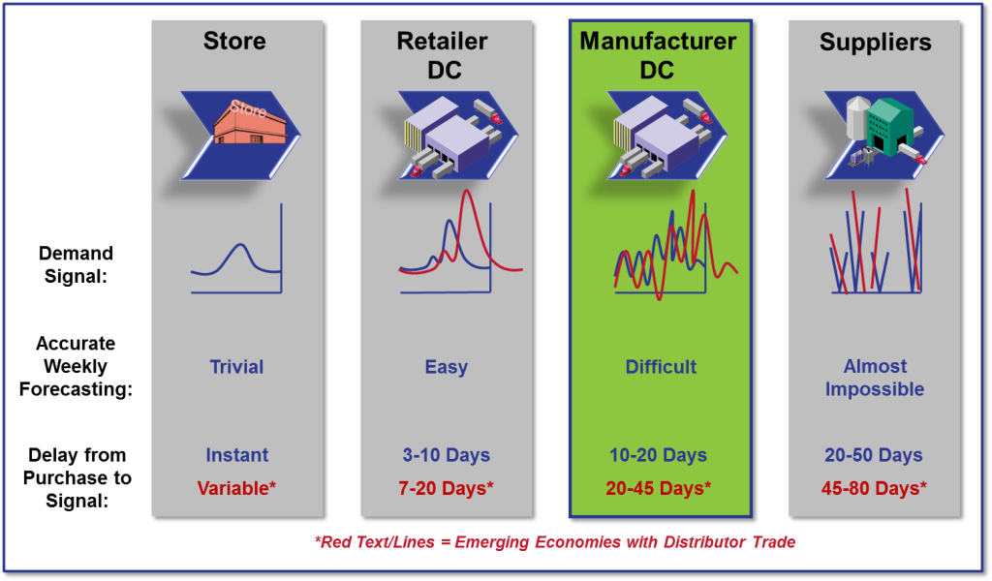
Traditional Approaches of ERP/MRP/DRP Amplify the Bullwhip Effect

Slide 42
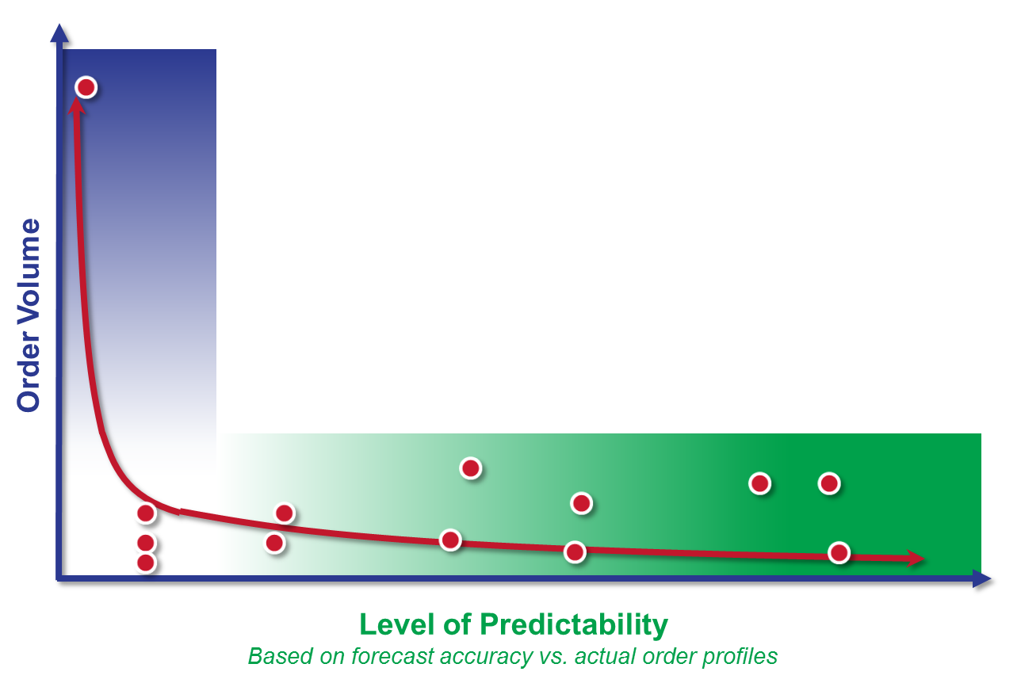
The Long Tail of the Supply Chain. The Impact of Outside-In Processes

Slide 43
Claritin Case Study: Spring and Allergies
40% of Annual POS done in 16 spring weeks
Every Year the Season Flows Essentially the Same In Aggregate
  WM Store and DC build strategies the same across the country
Source: IRI

Slide 44
Wal-Mart Allergy Regional Inventory Flow
Utilized store level data to develop 5 regional profiles based on average 5 year POS
  Worked with Walmart to develop Store and DC Build and Exit Strategies Based on Profiles
  Implemented Throughout Entire Allergy Category at Walmart

Slide 45
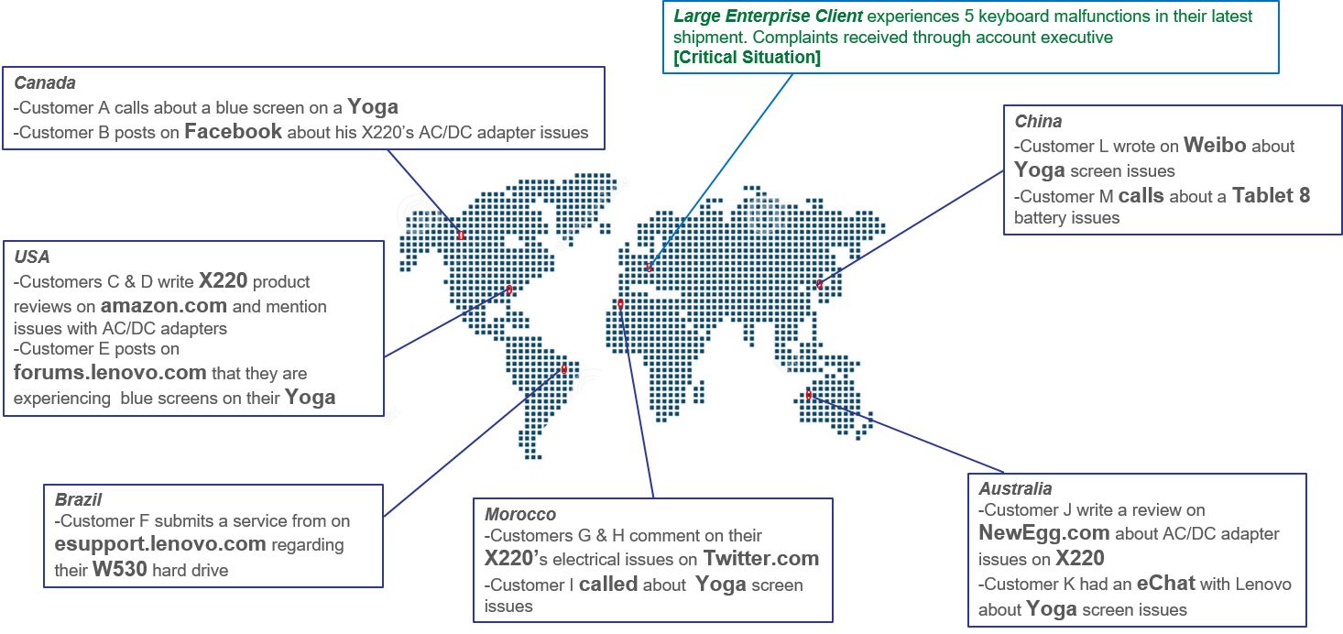
The Need to Listen

Slide 46

Trend #2: The Autonomous Supply Chain

Slide 47



Data Needs to Move Securely Through Value Networks In…
Clouds | Streams | Pools

Slide 48
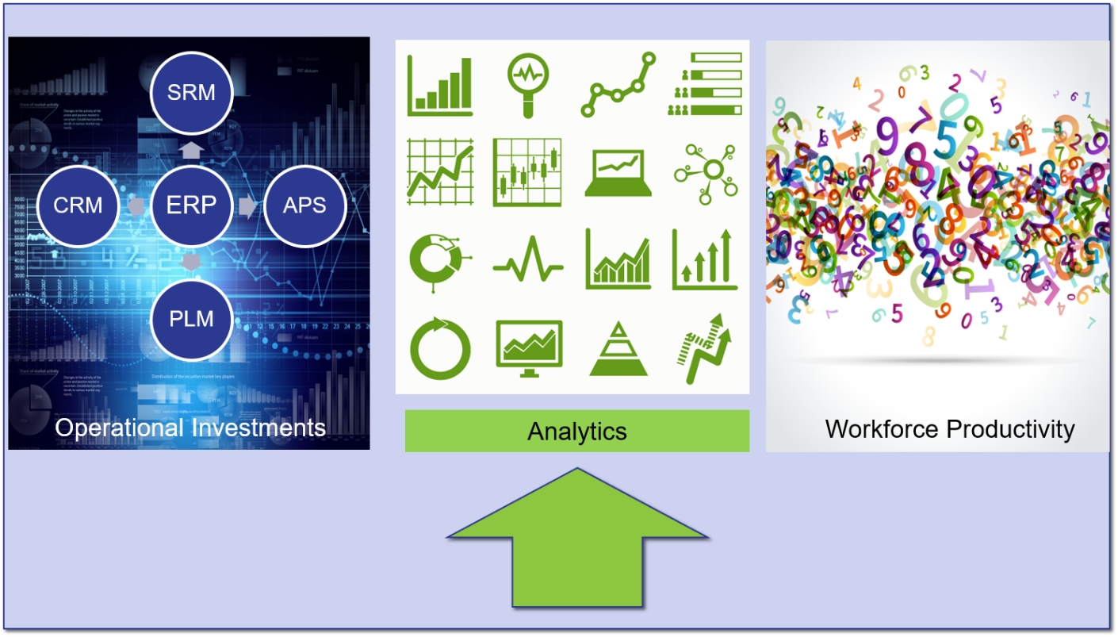
Need for New Forms of Analytics

Slide 49
Building the Autonomous Supply Chain
Autonomous Supply Chain
Cognitive Computing
Machine Learning
Text Mining and Pattern Recognition
Predictive and Prescriptive Analytics

Slide 50
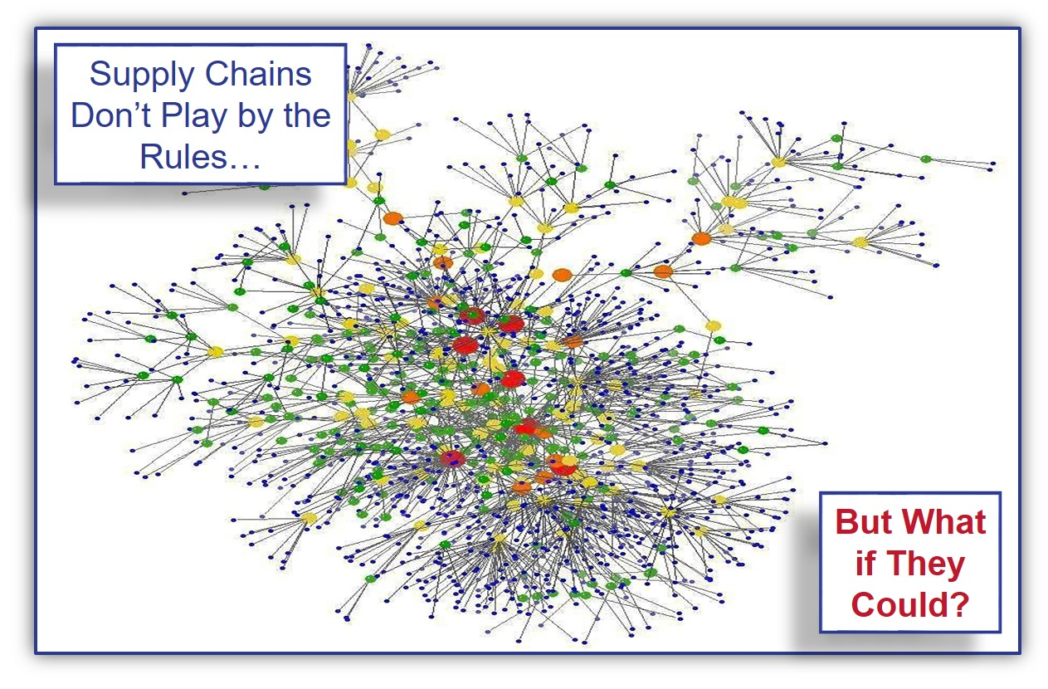
Evolution of Cognitive Computing

Slide 51
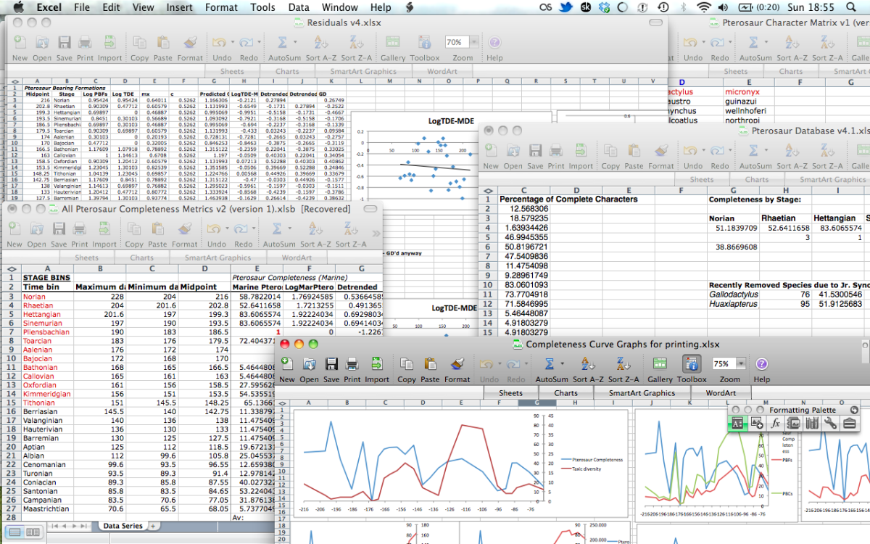
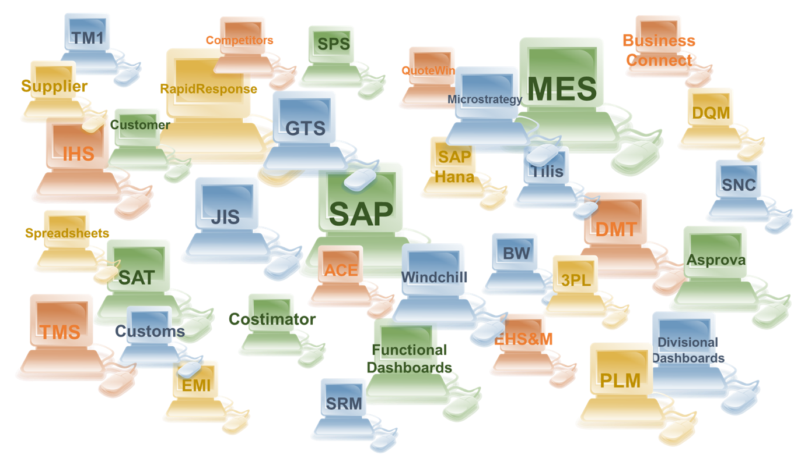
SILO VISIBILITY LEADS TO INEFFICIENT AND UNPRODUCTIVE WORKFORCE
More than 80% of network activity resides outside the four walls of an organization

Slide 52
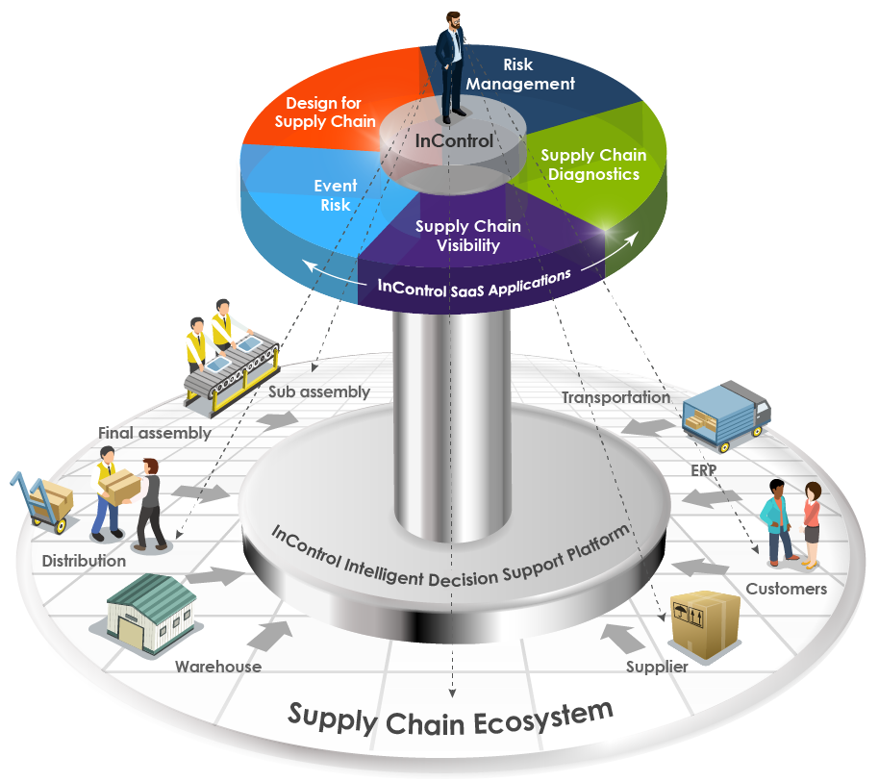

JABIL’S INTELLIGENT DIGITAL SUPPLY CHAIN SOLUTIONS
Advanced Analytics, Visibility, and Orchestration tool set

Slide 53

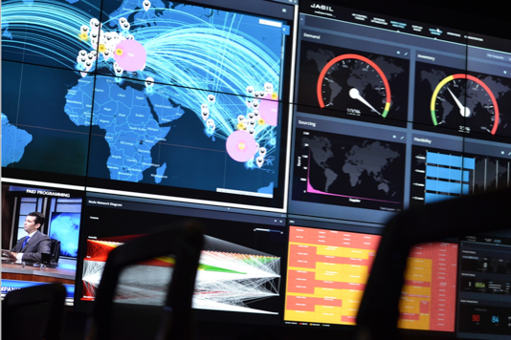



JABIL’S APPROACH TO DIGITAL SUPPLY CHAIN
CONTROL TOWER CENTERS. WHERE CUSTOMERS SEE VALUE™
VISIBILITY
EMBRACING COMPLEXITY
CROSS-FUNCTIONAL INTELLIGENCE
CLOUD AND MOBILITY
Because it continues to be the foundational supply chain challenge
Because supply chains are evolving into complex ecosystems
Because supply chains operate in silos
Because supply chains
are dynamic

Slide 54

Trend #3. Real-Time Data

Slide 55
Redefining Time

Slide 56
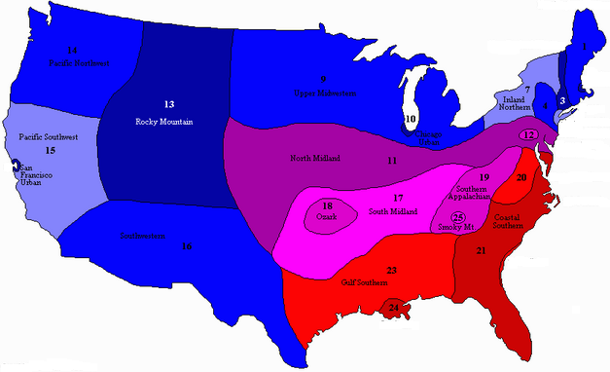
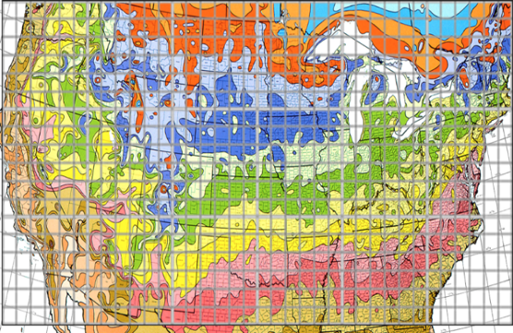
1.5M sku locations
~ 95% slow or intermittent
Lennox International
Seasonal demand (at the item level) is identified down to a specific location.
Simplified for clarity
In reality, looks more like this
365 days
150+ local climates
Avg 3,000 items / location (165M)
15 year lifecycle changing amplitude
Notes:
With the cognitive engine the seasonal demand is identified down to the specific location within a region
Know that micro-climates can make the demand index different as little as 30 miles away
On the left we’ve made it easy to understand hot and cold and different locations
On the right is a better emulation of the real picture

Slide 57




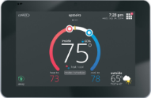
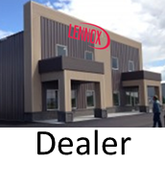



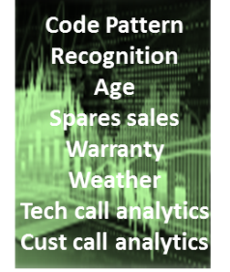

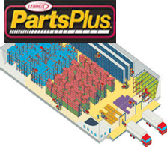
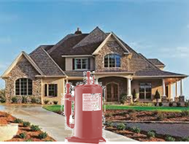


Redefining Service
Your compressor shows that it will fail within the next 30 days. What day would be good for us to come replace it?
Engines
Replace
Compressor
Dealer gets service event
We get parts sales
Customer has non-event
Customer - Dealer & Brand loyalty

Slide 58
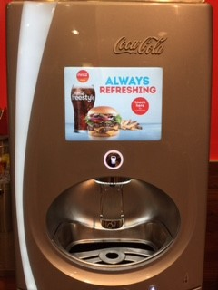
Internet of Things

Slide 59
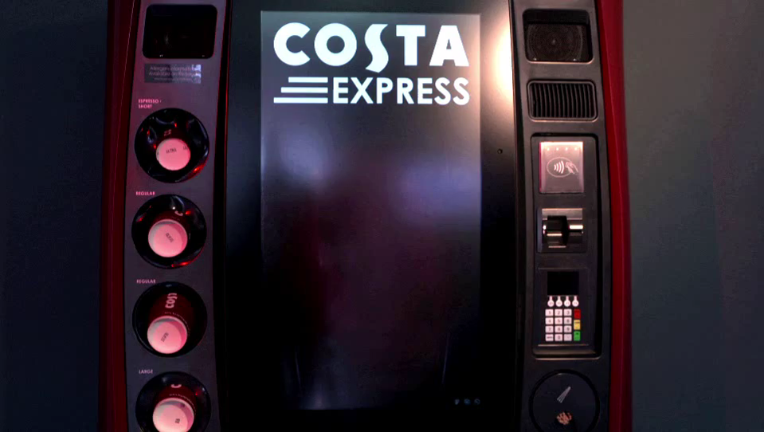

Slide 60

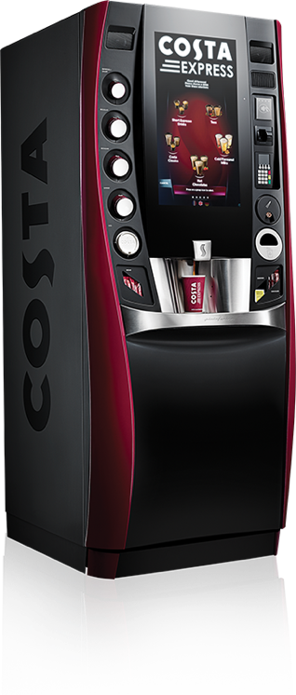






Redefining Replenishment
Cutting edge reliable /
ultra efficient computer
processing hardware
Rich user interface in full HD
Evocative sound track with
burring grinder and tinkling
of spoons
Irresistible aromas of Costa’s coffee shops
Stunning curved design by
Italian automotive designers
Memorable flavours and
fragrances
Innovative coffee-making
system providers
Notes:
Introduction of new model (machine type) – keeps us ahead of the curve and revolutionises once again the category

Slide 61


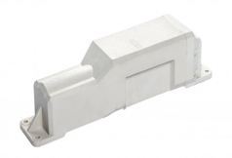
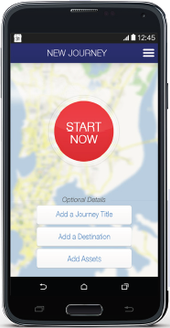
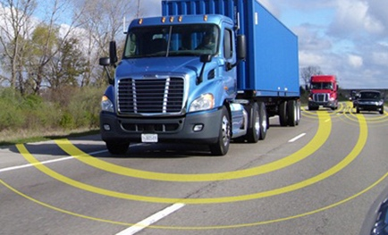
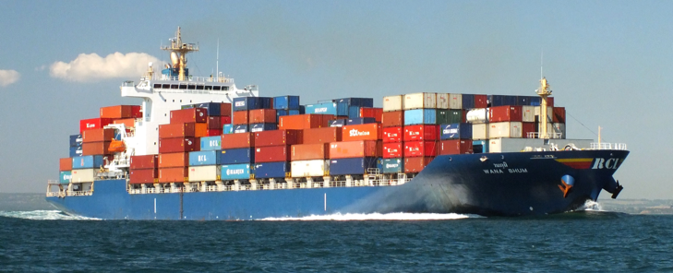
Transforming Inbound Logistics
Sensors
Mobile Device Apps
AIS Vessel Location

Slide 62
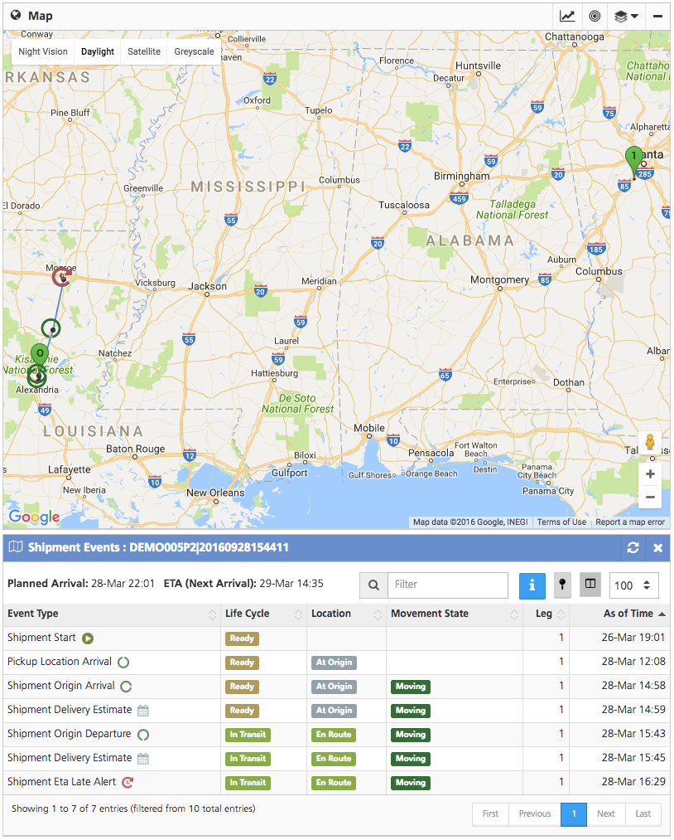
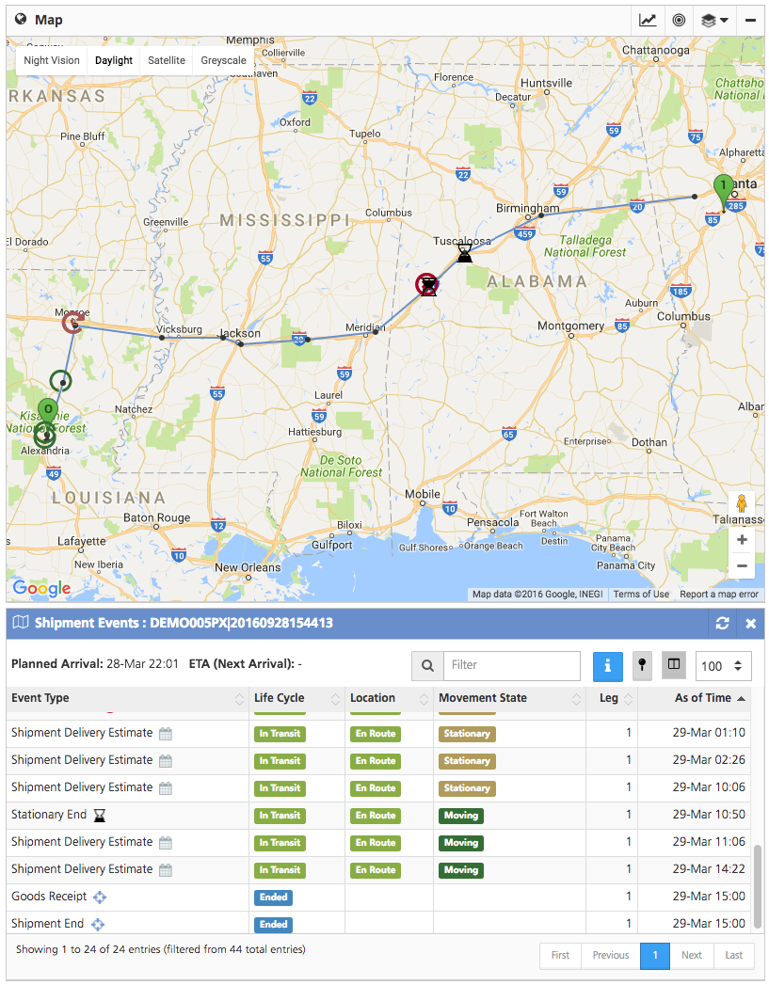
Improved On-Time Delivery

Slide 63
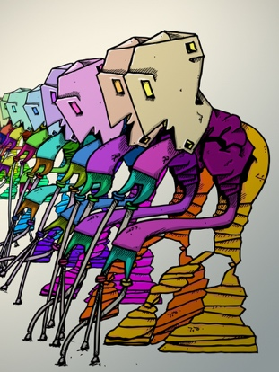
Trend #4. Digital Manufacturing

Slide 64

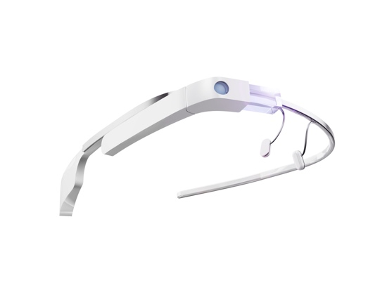
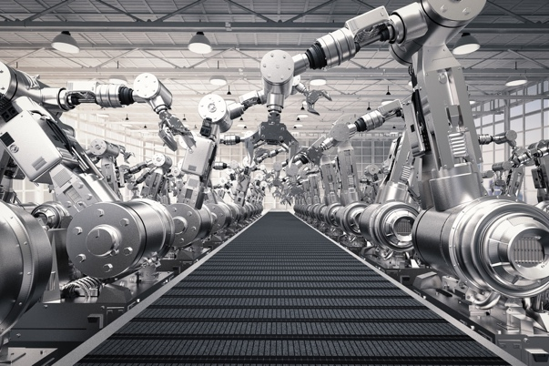
What Is Digital Manufacturing?
Additive Manufacturing | Paperless Processes | Robotics

Slide 65
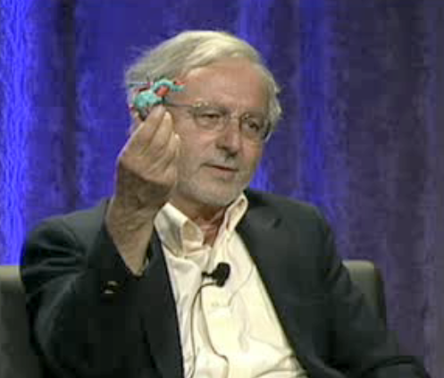
Evolution of 3-D Printing Organs

Slide 66

Ultimate Ear

Slide 67
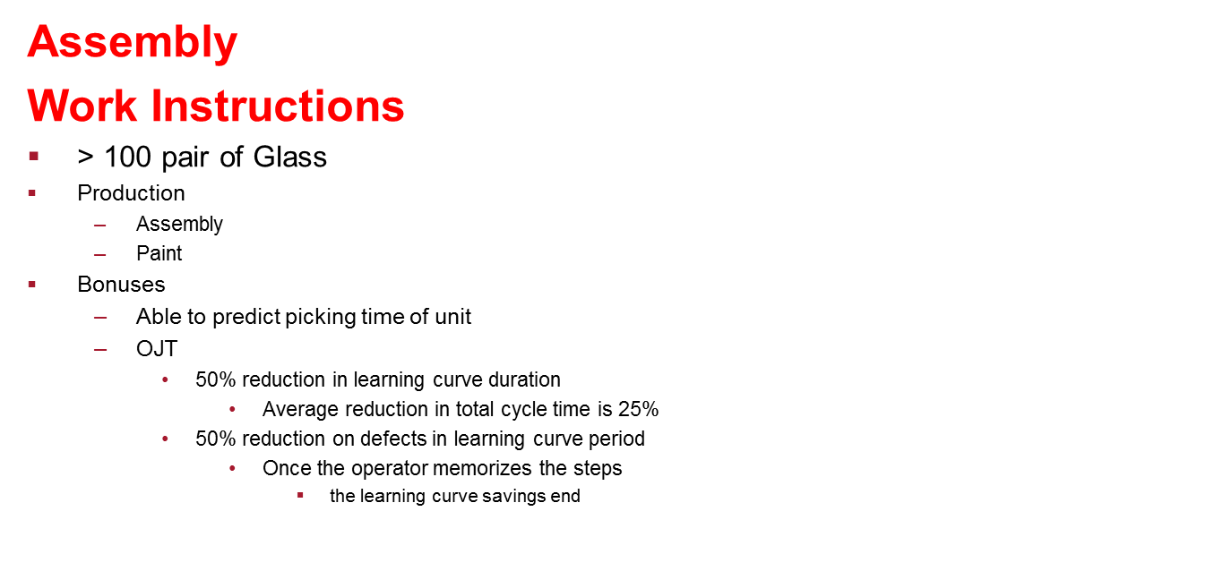
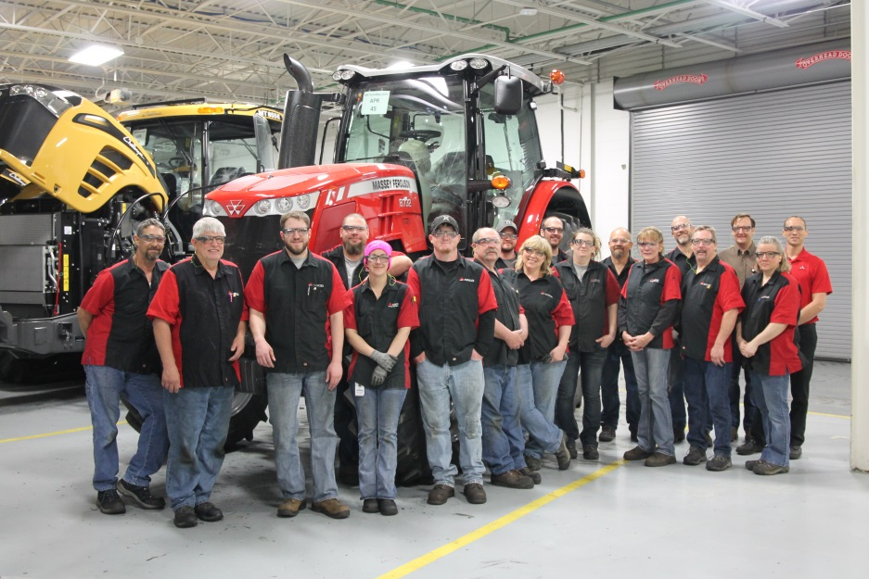



Slide 68






The AH-HA moment…AGCO Jackson Strategic Internet of Things (IoT)

Slide 69

Trend #5: Network of Networks

Slide 70
What Is the Network of Networks?
The adoption of distributed and open technology by the ecosystem of technology providers and business users to drive inter-operability in value networks to improve business outcomes.

Slide 71

Current State of Visibility

Slide 72

What Did Not Work

Slide 73

The View in 2016

Slide 74
Network and Company Nodes
Blockchain
Blockchain
Blockchain
Business Network A
Company A
Company B
Business Network B
Company C
Company D
Community Directory of Supplier Data

Slide 75
What Could Change?
Traceability
Blockchain redefines visibility and track and trace.
Confluence of Blockchain and Spark/Internet of Things Redefine Lineage.
Supply Chain Finance
Bitcoin and Blockchain disintermediate traditional banking.
Emergence of the supply chain digital wallet
Interoperability
Cognitive computing eliminates the need for master data management and standards.
Data is mined through patterns and translated for context through cognitive computing. Shift from standards to process canonicals.
Community Directory
Write once and use company and contact information many times.
Reduce onboarding through once source of data.
An alternative to EDI

Slide 76

Moving Forward

Slide 77


Slide 78

Have the Talk with Your CFO
Remove the handcuffs. Eliminate the expectation of well-defined ROIs.
Develop a stage-gate process for process innovation.
Embrace small scrappy teams.
Partner with technology innovators.
Manage the hype cycles.

Slide 79

Wrap-up
Adopt new technologies and challenge current thinking.
Manage the supply chain as a complex system.
Build with the goal in mind outside-in.

Slide 80

Time to Take a Different Path?

Slide 81

Questions?

Slide 82
Engage with Us
Visit Us Online
www.supplychaininsights.com
www.supplychainshaman.com
www.beetfusion.com
www.linkedin.com/company/supply-chain-insights
www.slideshare.com/loracecere
Follow Us on Twitter
@scinsightsllc
@lcecere
Attend a Live Event
www.supplychaininsightsglobalsummit.com
www.supplychaininsights.com/the-shamans-circle

Slide 83







About Lora Cecere
Founder of Supply Chain Insights
  “LinkedIn Influencer”
  Guest blog for Forbes
  Author of 5 books: Bricks Matter (2012), Shaman’s Journal (2014),
  Supply Chain Metrics That Matter (2014), Shaman’s Journal (2015),
  Shaman’s Journal (2016), Shaman’s Journal (2017)
Partner at Altimeter Group (leader in open research)
7 years of Management Experience leading Analyst Teams at Gartner
and AMR Research
8 years Experience in Marketing and Selling Supply Chain Software at Descartes Systems Group and Manugistics (now JDA)
15 Years Leading teams in Manufacturing and Distribution operations for Clorox, Kraft/General Foods, Nestle/Dreyers Grand Ice Cream and Procter & Gamble.
Contact Information:
Email: lora.cecere@supplychaininsights.com
Blog: www.supplychainshaman.com (15,000 pageviews/month)
Forbes: www.forbes.com/sites/loracecere
Twitter: twitter.com/lcecere (8,200 followers)
LinkedIn: www.linkedin.com/in/loracecere (215,000 followers)
LinkedIn Influencer: www.linkedin.com/today/author/446631

Slide 85
Thank You

