Slide 1


Slide 2
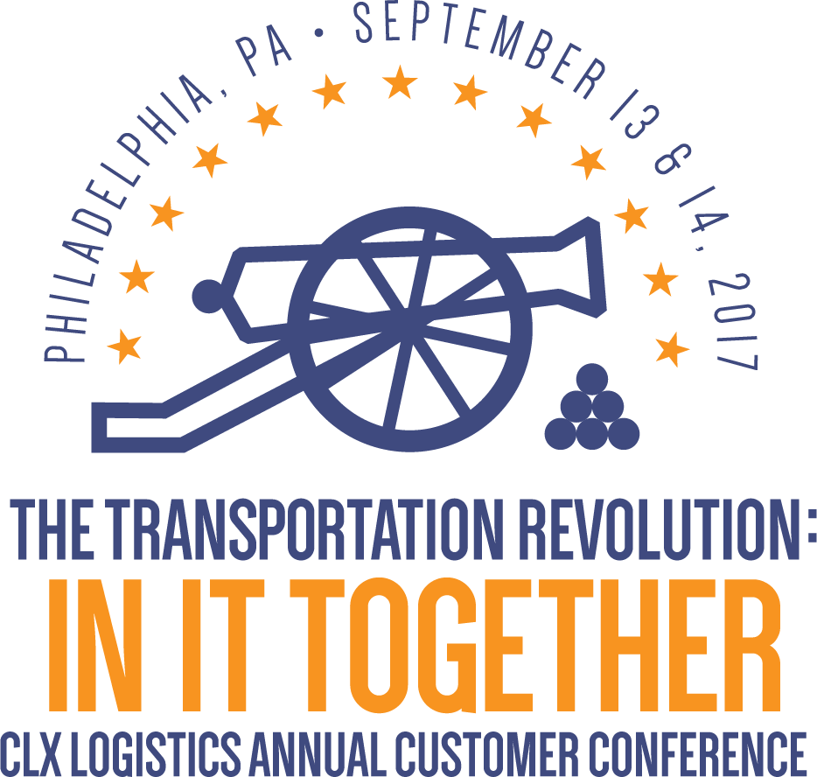

Slide 3
Delivering Value Through Advanced Design Analytics
With Dale McClung, Director of Design Solutions
September 14, 2017
9:45 AM

Slide 4

Discussion Topics
01
The Design Solutions Team
02
Creating Economic Value For Customers
03
Excelling in Innovation

Slide 5
01
The Design Solutions Team

Slide 6

What We Bring to the Table
Best practices from other implementations
Advanced benchmarking capabilities
BPR to leverage TMS capabilities
Network Simulation
Partnerships with academia
Performance optimization models

Slide 7
02
Creating Economic Value For Our Customers

Slide 8
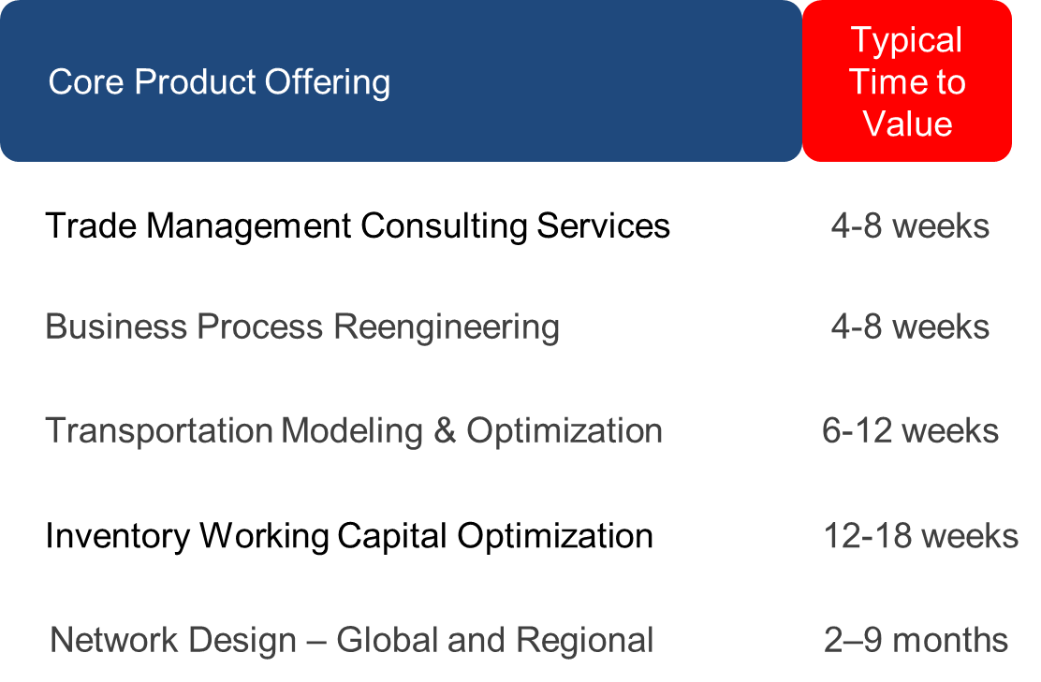
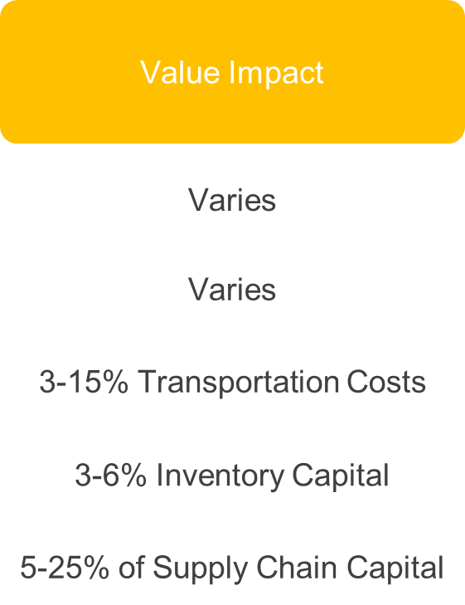
Design Solutions Product Offering Overview

Slide 9
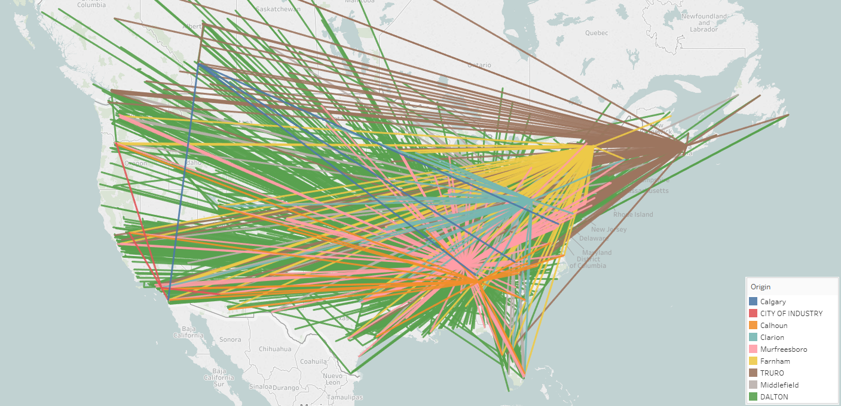
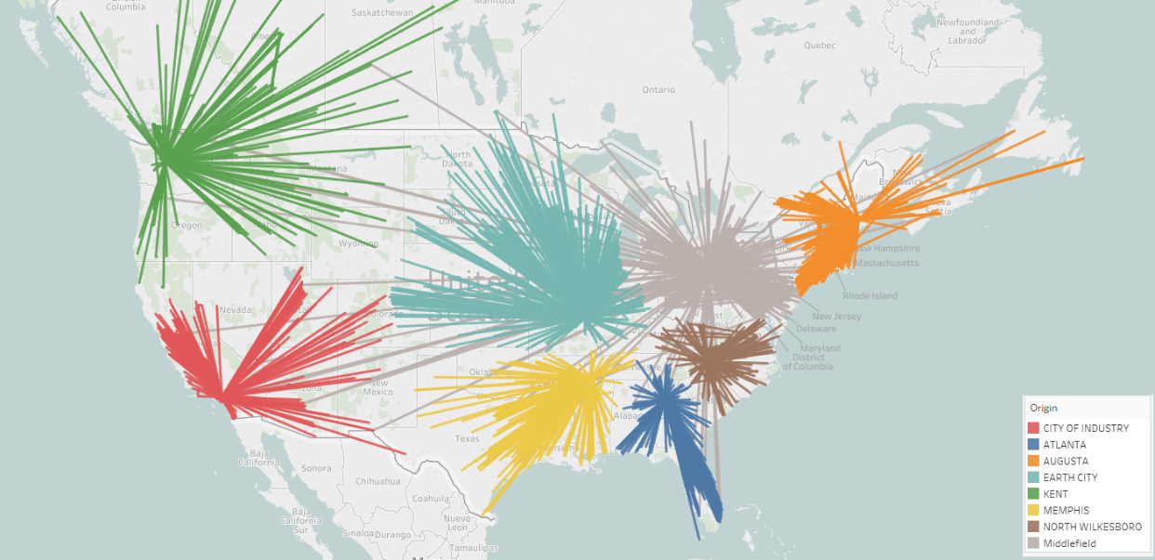
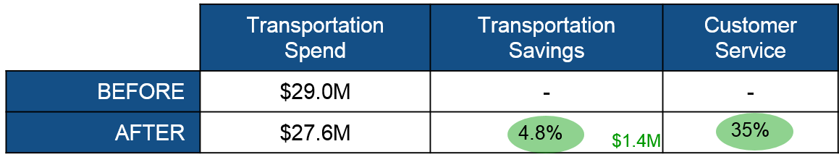
Network Optimization
BEFORE
AFTER

Slide 10
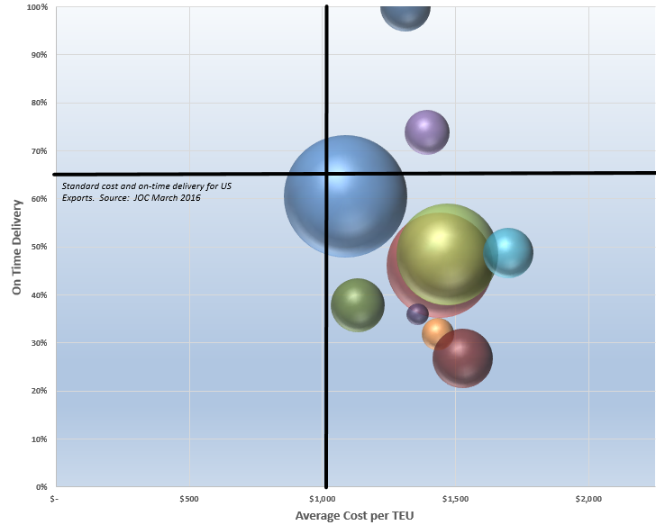
Value of Carrier Performance
On time delivery performance verses spend benchmarking for a client on one of their most heavily used ocean lanes

Slide 11
Warehouse Network Optimization
Current # of Warehouses
Optimal
Total Estimated savings $11M!

Slide 12
03
Excellence in Innovation

Slide 13
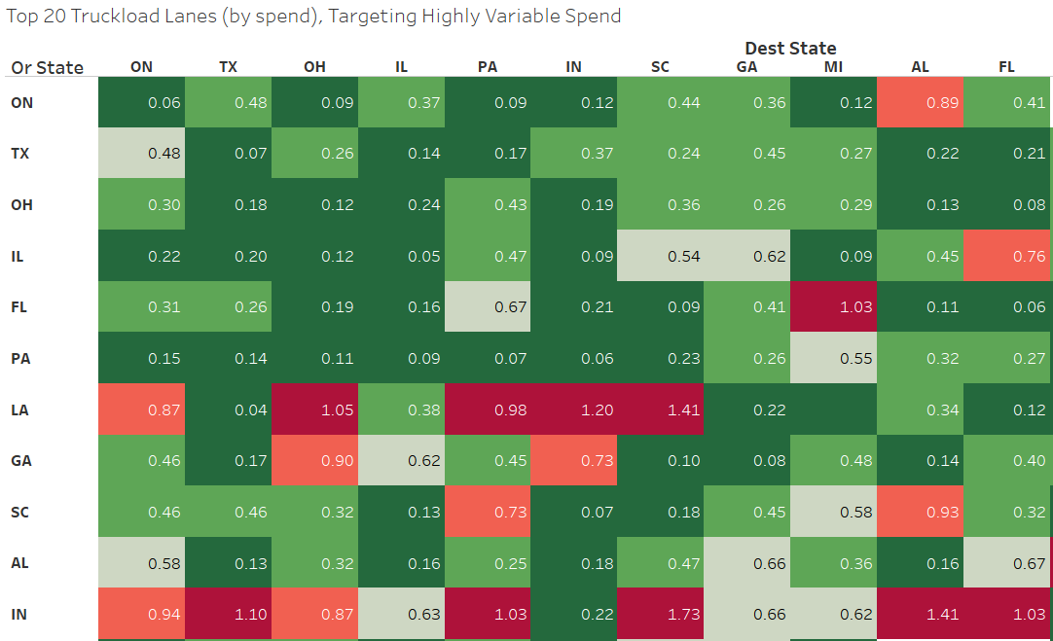
Coefficient of Variation in Spend
Example of transportation spend CoV Analysis

Slide 14
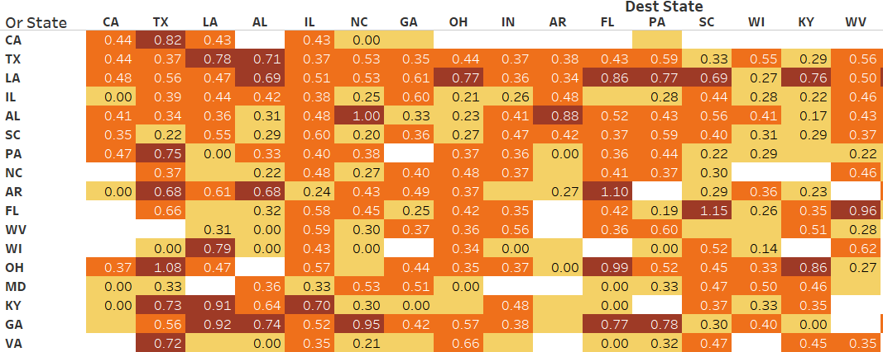
Demand Sensing Through Data Intelligence
Understanding shipment demand levels and variation across clients in the same lanes to begin forming collaborative transportation opportunities

Slide 15

Partnerships with Academia
Collaborative supply chain research with Penn State’s Supply Chain Masters and PhD Programs beginning this month.
Optimizing transportation spend for our clients who act as a supplier for other clients.
US Gulf Coast manufacturing expansion - impact on logistics for small- to mid-size shippers in the area
Integration of external data sources into our data warehouse

Slide 16
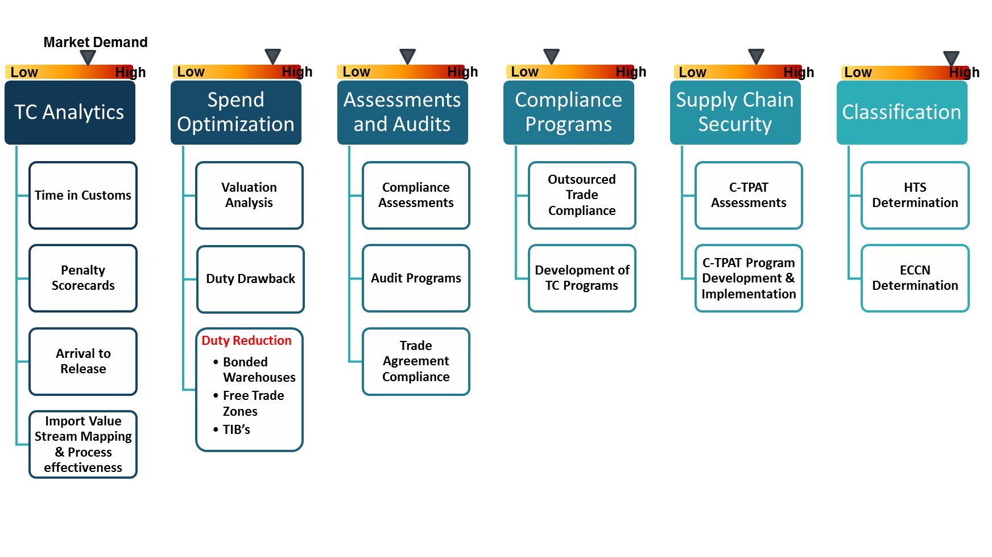
Trade Management Consulting Services

Slide 17
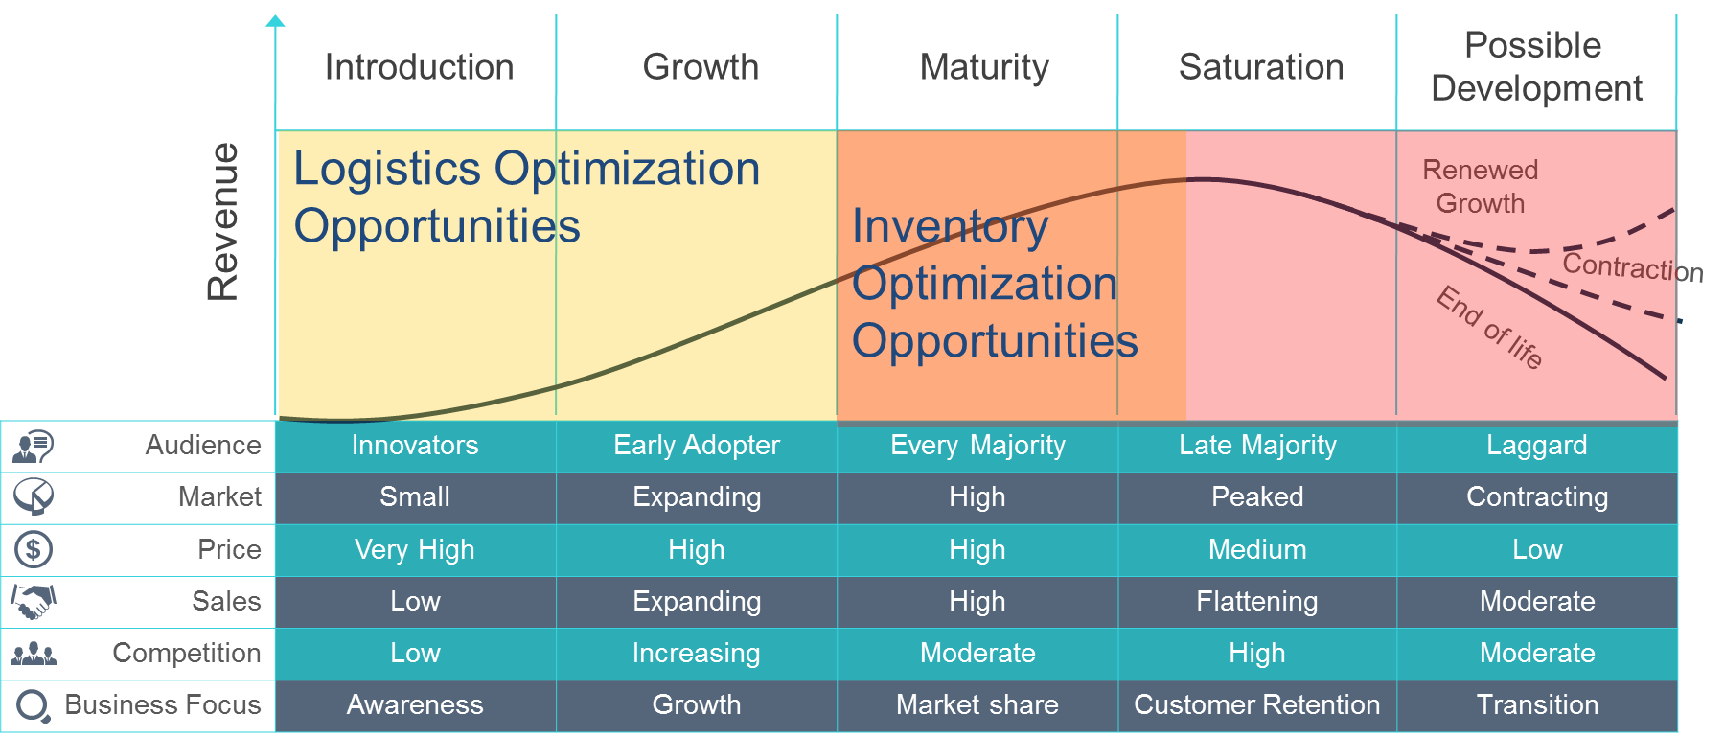
Inventory Stocking Strategy for Warehouses

Slide 18
Recap
Creating Economic Value for Customers
  Deep experience in supply chain network modeling, simulation and optimization both in the US and in Europe.
  We already have much of the information required to perform benchmarking, network optimization, business process re-engineering, performance efficiency, and much more!
Excelling in Innovation
  Exciting new capabilities to identify cost and efficiency savings with our Data Warehouse
  Partnering with academia to add sophisticated tools to help you be more efficient and effective with your transportation network

Slide 19
Thank You

