Slide 1


Slide 2
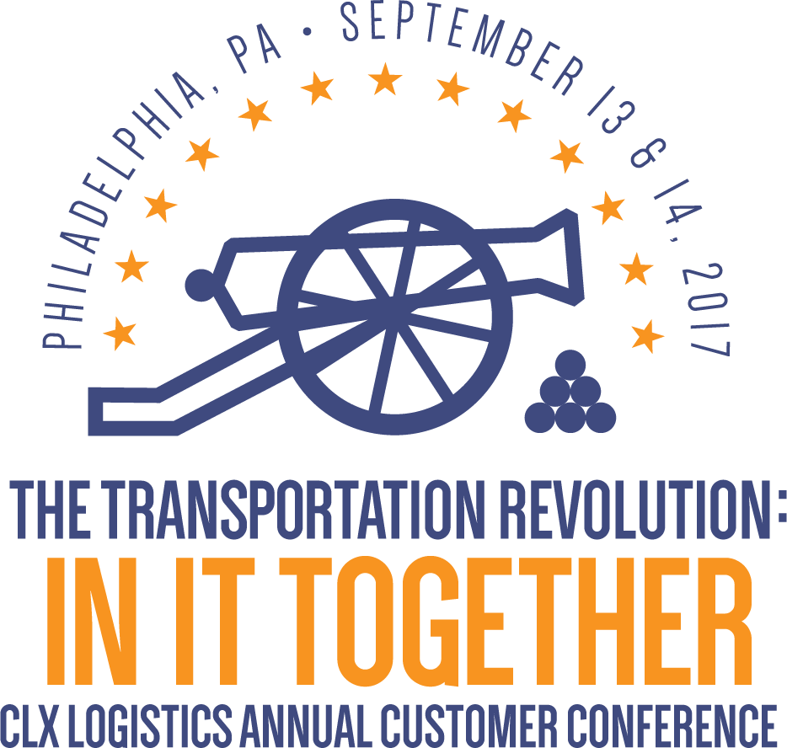

Slide 3
Unlearning Supply Chain Management:
The First Step to Becoming a Successful Company of Tomorrow
With Adrian Gonzalez
September 13, 2017
11:00 AM

Slide 4
Unlearning Supply Chain Management
CLX Customer Conference
September 13, 2017
Adrian Gonzalez
President, Adelante SCM
adrian@adelantescm.com

Slide 5

Supply Chain Blizzard
“The Amazon Effect”
Drones
Cyber Security
Driverless Trucks
Keeping Up with The Rapid Pace of Change
Changing Regulations
3D Printing
New Competitors
IoT & Mobile
Infrastructure Constraints
Blockchain
Mergers & Acquisitions
AI / Machine Learning

Slide 6
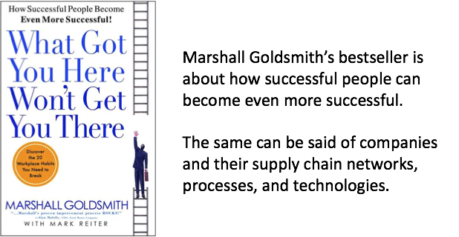
“Past Performance is No Guarantee of Future Results”

Slide 7

Are You Working for Company of Yesterday or Company of Tomorrow?
How do you become a Company of Tomorrow?

Slide 8
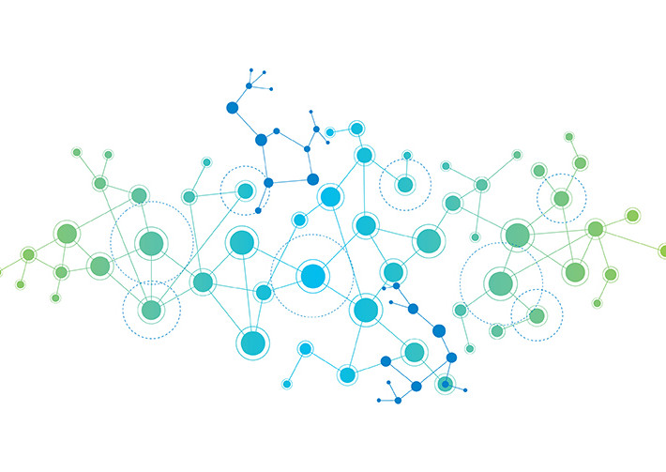
1. Unlearn “The Way We’ve Always Done It”
We have to unlearn “supply chain management” — that is, unlearn the terminology and concepts we continue to use.
The term “chain” implies fixed, linear, rigid — things that are the exact opposite of today’s operating reality, where trading partner networks, business processes, and customer expectations (among many other things) are more fluid and constantly changing.
From Chains to Network Effects

Slide 9
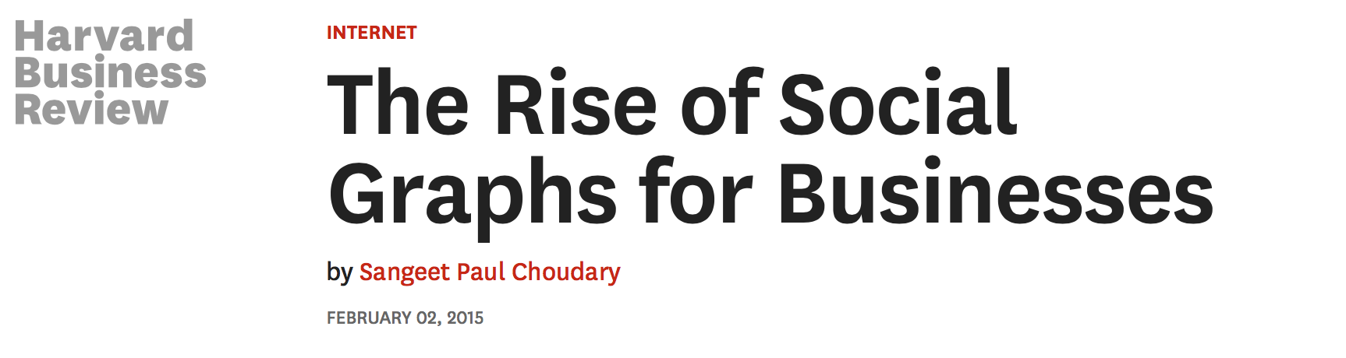

Take a ‘Network Effects’ Perspective
“Commercial graphs depict relationships between businesses, based on their actual interactions as they are captured digitally…
...will help businesses manage their own partner relationships better...
...can help companies assess the performance of their business relationships…can help managers identify new partners and suppliers who are likely to outperform current ones. And they help companies benchmark their performance against peers.”

Slide 10
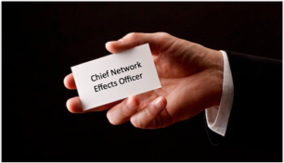
Here Comes the
Chief Network Effects Officer
How do we make it easier for our users to participate and create 'connections' they see as valuable?
How do we make it easier for ourselves to identify value from user participation, contributions, and links?
How should we (re)organize ourselves to best harvest the value of 'network effects' to measurably boost the quality, opportunity, and 'user experiences' of our offerings?

Slide 11
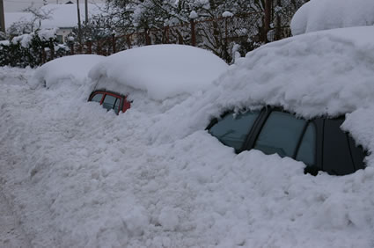
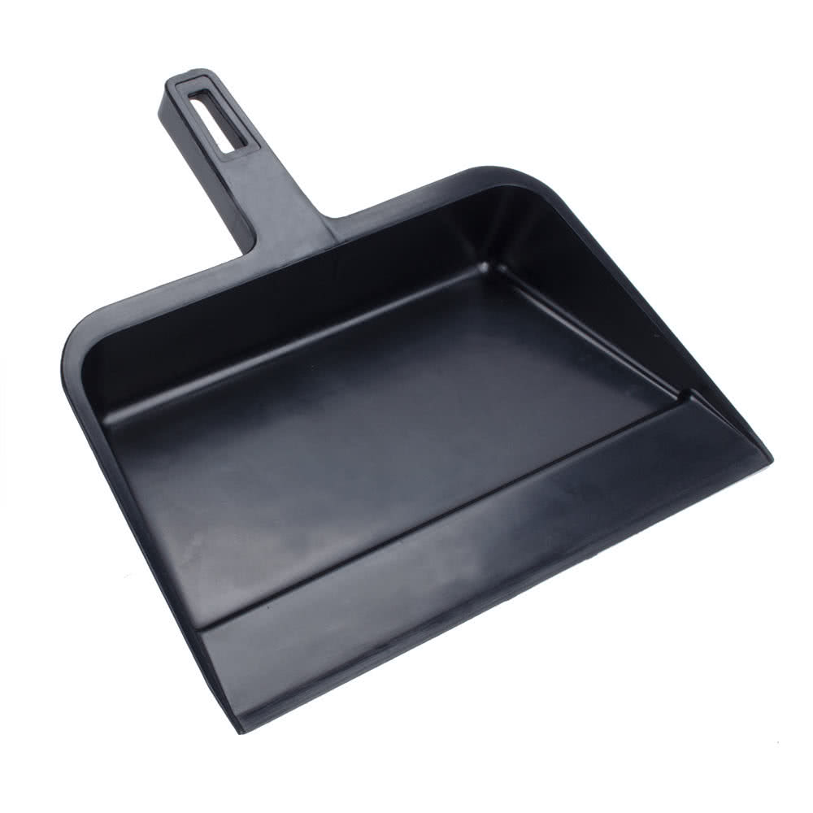
2. Stop Shoveling Snow with a Dustpan
April Fools Day Blizzard (Boston, 1997)
21 inches of snow
My “shovel”

Slide 12
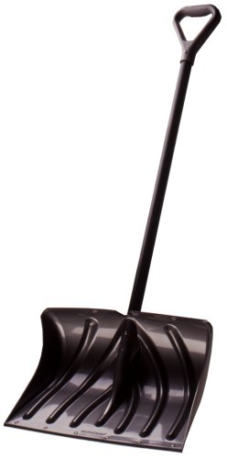
Yesterday’s Supply Chain Tools & Processes...
Takes more time
Takes more effort
Not as effective
Not as user friendly
≠
…are becoming today’s dustpans

Slide 13
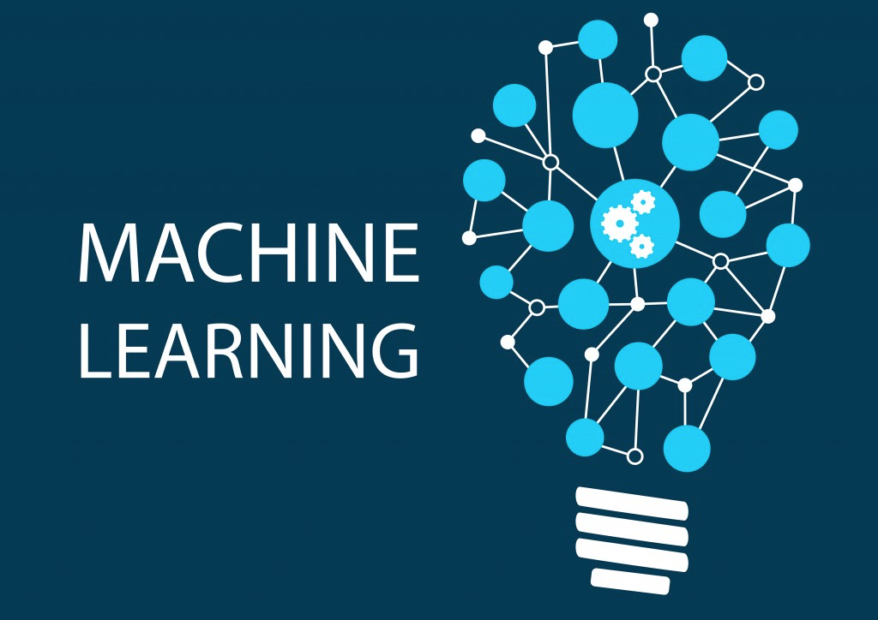
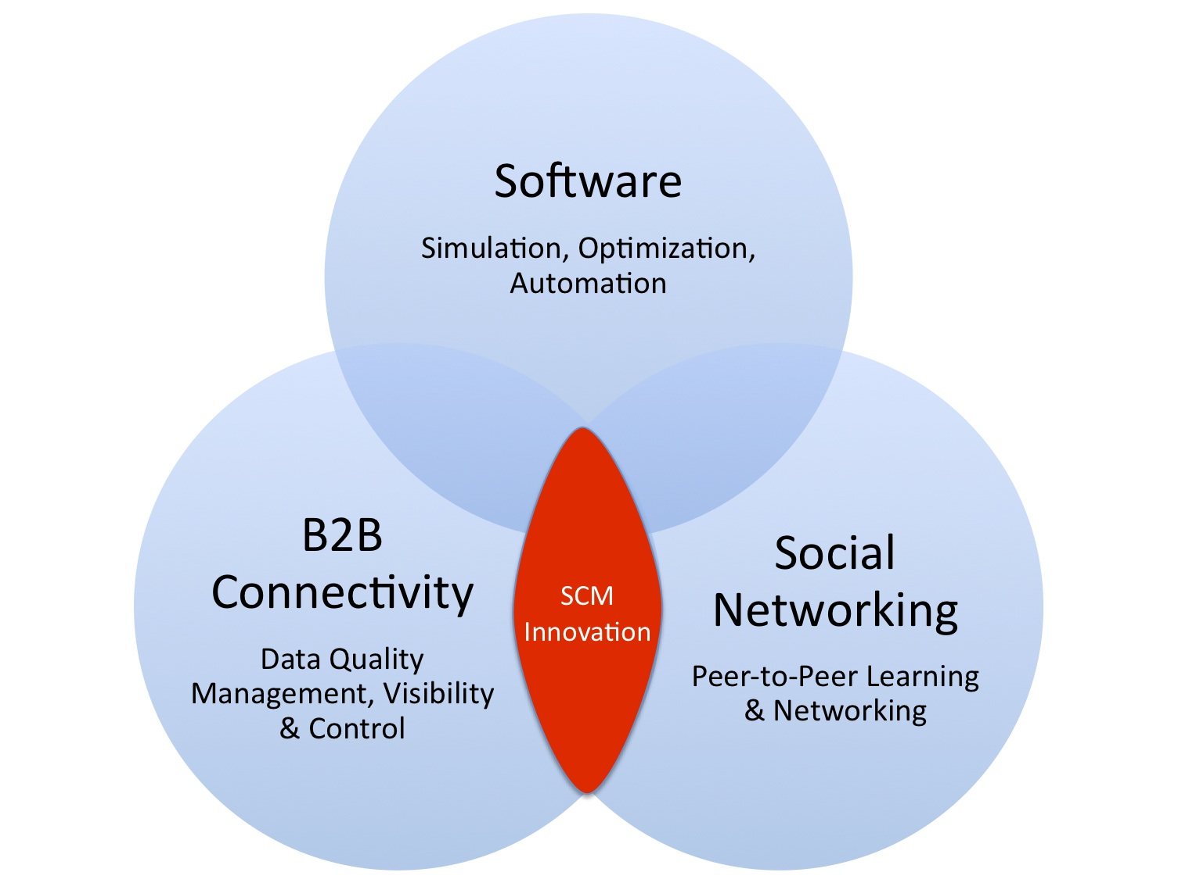
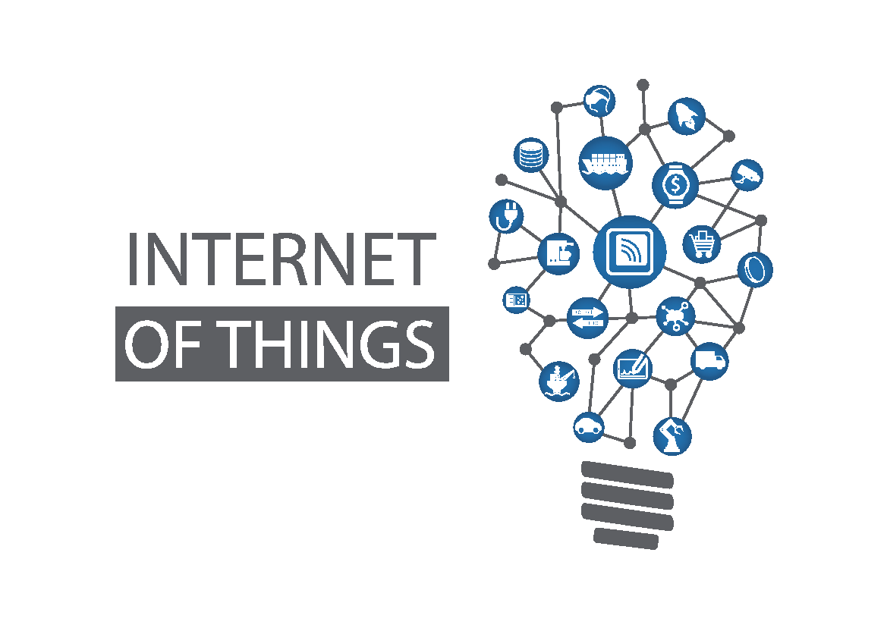
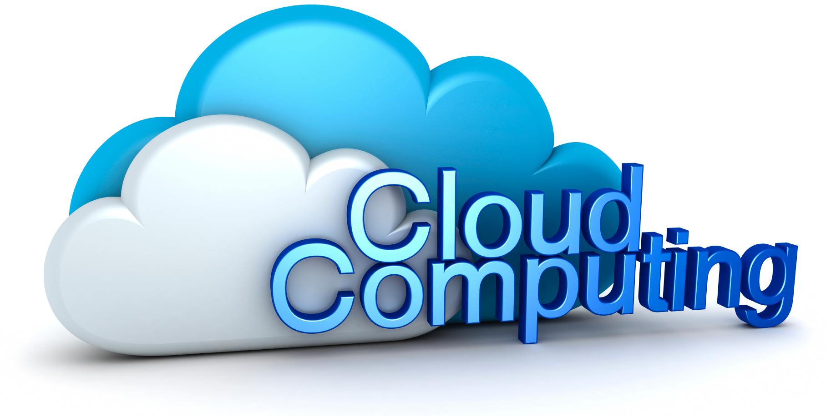
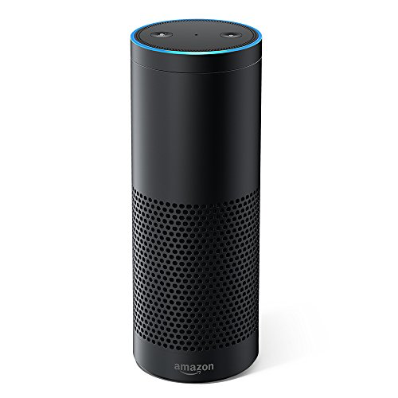
Where to Find Supply Chain Innovation
Alexa, where’s my shipment?

Slide 14
Are you still using a dustpan?
Companies of Yesterday
Companies of Tomorrow
Connect and manage thousands of individual trading partner connections (EDI heavy) | Connect to a single network to manage and discover new trading partner relationships (APIs, mobile)
Dependent on IT department and consultants to adapt systems and enable new capabilities, which often takes weeks or months or years | Front-line users able to configure solutions and enable new capabilities themselves, in minutes, hours, or days
Analytics based on Excel macros | Analytics based on sophisticated algorithms, leveraging cloud computing for speed and scalability, and moving toward machine learning and predictive analytics
Nobody owns data quality management | Everybody owns data quality management and understands importance and financial impact
Focus on Data Integration | Focus on Intelligence Sharing
Decision-making process very hierarchical, analysis paralysis and CYA ("cover your ass") | Empowered employees make fast & informed decisions, leveraging social tools for communication & collaboration
Cooperation - "What's in it for Me?" approach to business relationships | Collaboration - "What's in it for We?" approach to business relationships

Slide 15
3. View Supply Chain as Your Business Plan
“We’re seeing a dynamic shift in the relationship between business plans and logistics, a shift from the perception of our industry as a back-end process to a front-end strategy that informs and supports the entire business plan.
Your supply chain strategy in effect becomes your business plan.”
– Michael Eskew, former Chairman & CEO, UPS
at CSCMP Annual Conference 2002

Slide 16
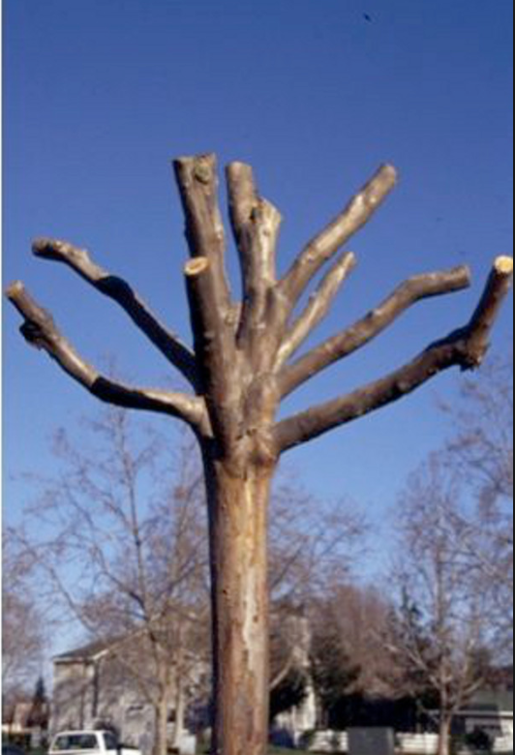
Cost Management remains important…
Quality
Efficiency
Safety
Customer Satisfaction
Employee Satisfaction
Innovation
… but it’s not a GROWTH strategy

Slide 17

How to Cross the Chasm?
Logistics as a Cost Center
Logistics as a Competitive Weapon

Slide 18
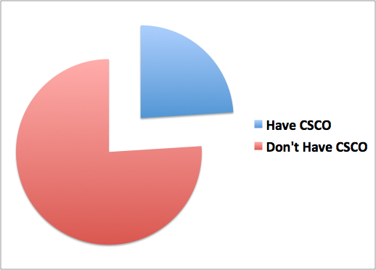
Provide a Seat for SCM at the C-Suite
24%
Does your company have a Chief Supply Chain Officer?
76%
Source: “State of the Global Supply Chain: A Research Report on the Top Issues Facing Industry Executives,” GT Nexus, February 2016

Slide 19
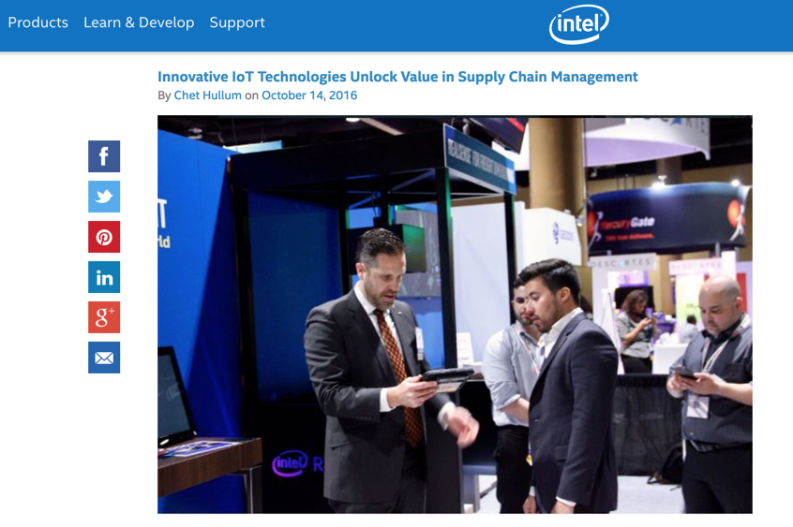
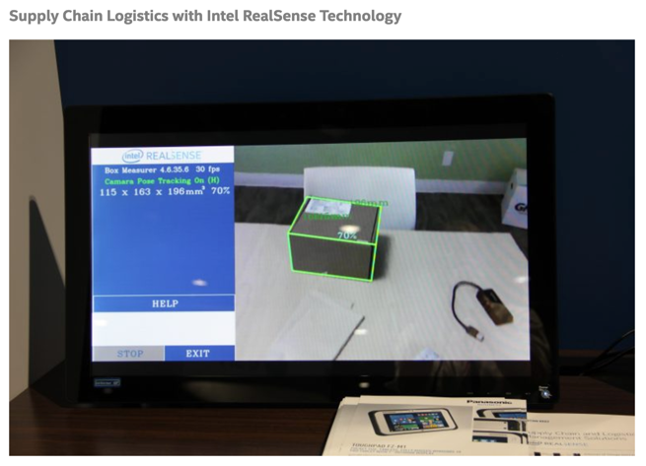
SC@Intel: Supply Chain as Expert Resource for Customers & R&D
50+ customer engagements
6 deal wins
7 proof-of-concepts launched
$30 million in new revenue

Slide 20
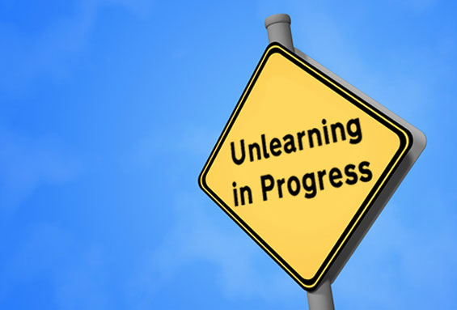
The Bottom Line
The Clockspeeds of every industry are accelerating and what got you here won’t get you where you need to be.
To become a Company of Tomorrow, you have to unlearn “the way we’ve always done things” with respect to yesterday’s processes, technologies, and business models.

Slide 21
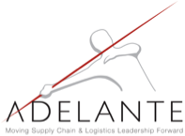

Thank You!
Adrian Gonzalez
President
Adelante SCM
adrian@adelantescm.com
www.talkinglogistics.com

Slide 22
Thank You

