Slide 1


Slide 2


Slide 3
Miller Transporters Inc.
With Lee Miller
September 14, 2017
8:45 AM

Slide 4


09.11.17 | Philadelphia, PA

Slide 5

www.millert.com

Slide 6
Mission
Provide our customers with reliable transportation solutions by investing in our people, in our processes, and encouraging innovative thinking.

Slide 7
Core Values
SAFETY
INTEGRITY
PEOPLE

Slide 8
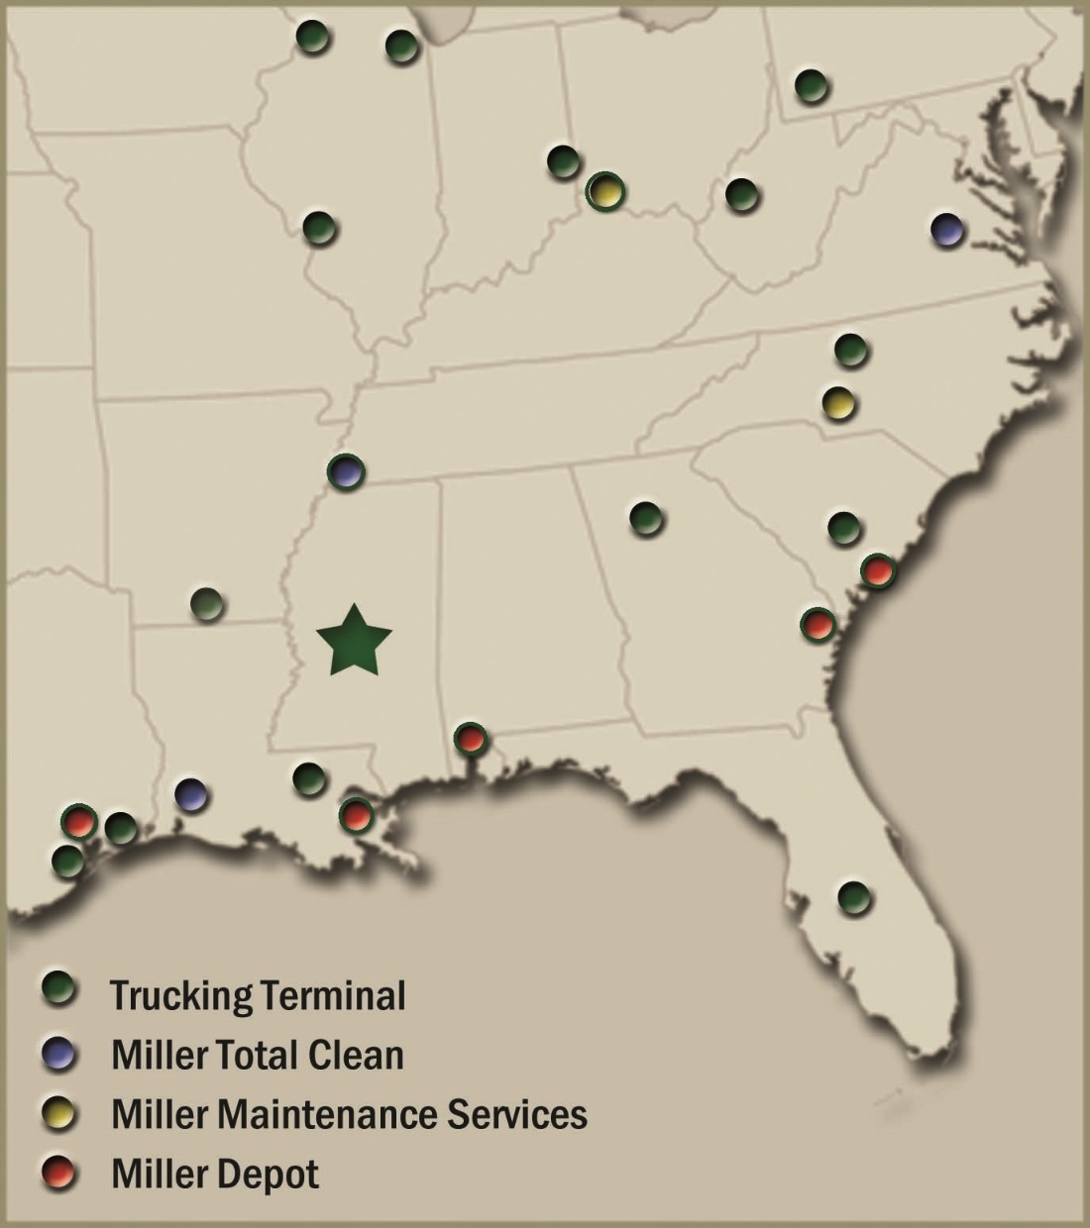

Slide 9
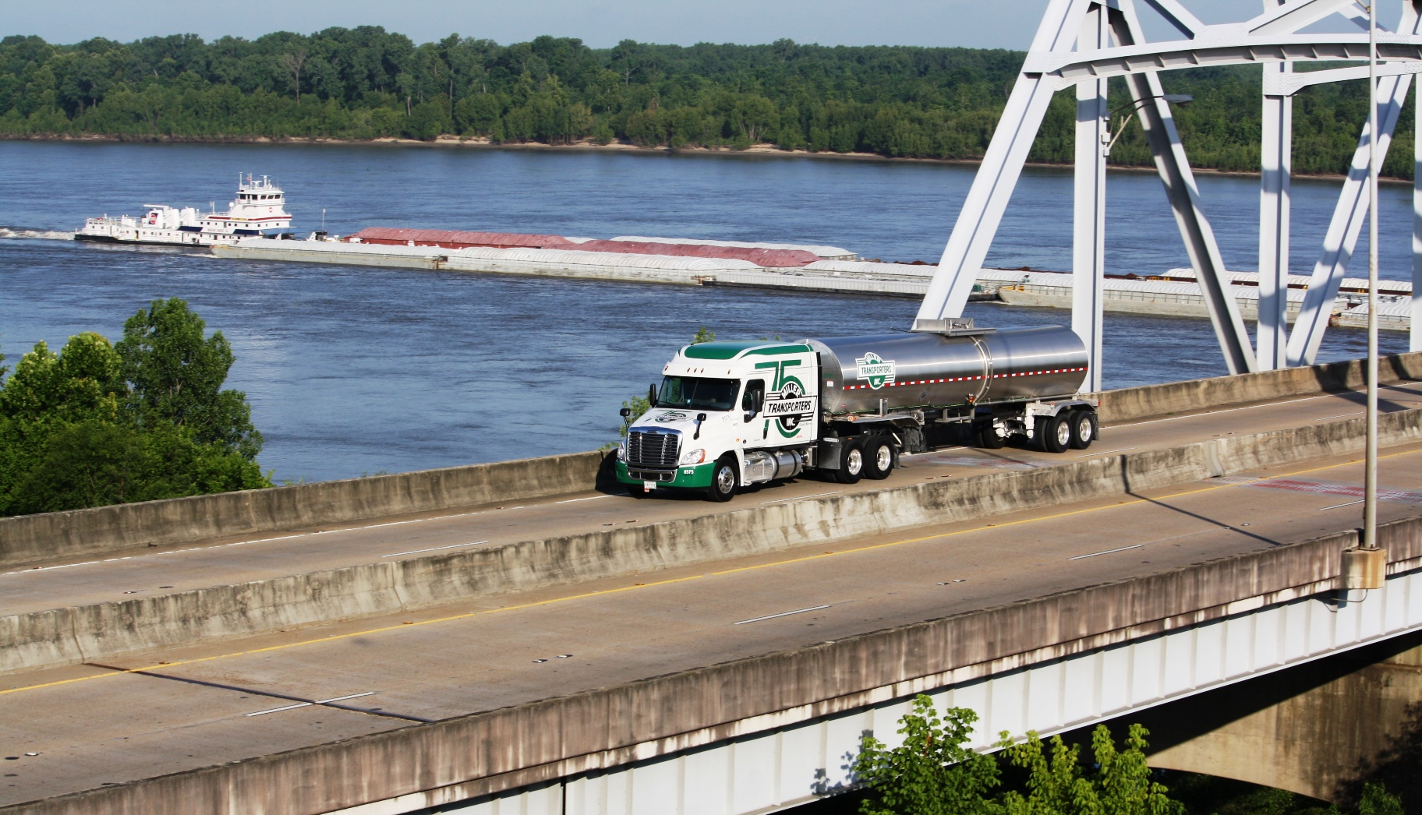
What We Do – In Theory
Point A to Point B

Slide 10
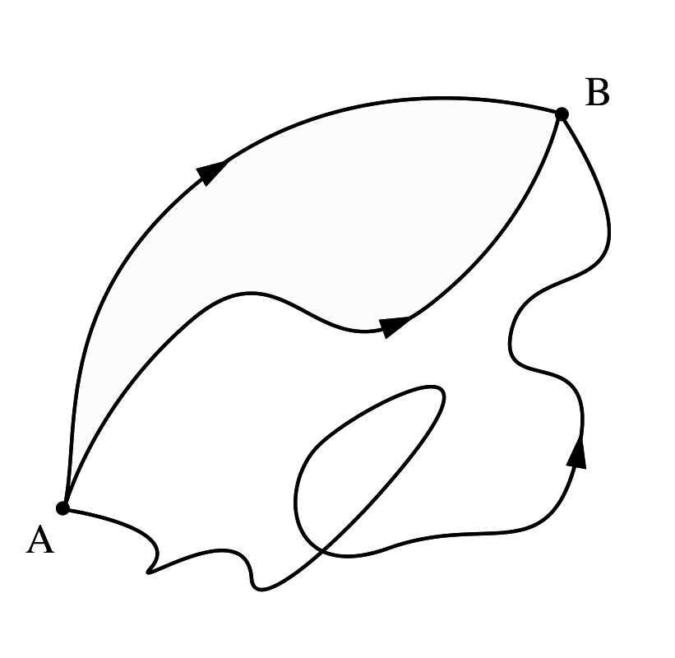
What We Do – In Reality
What Could Possibly Go Wrong?

Slide 11
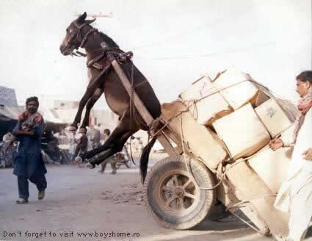

Slide 12
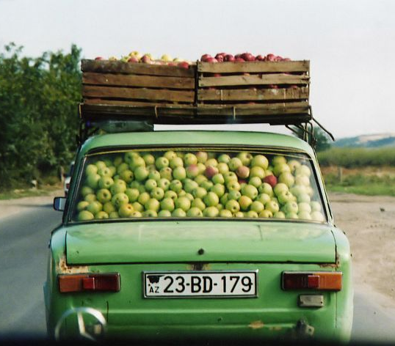
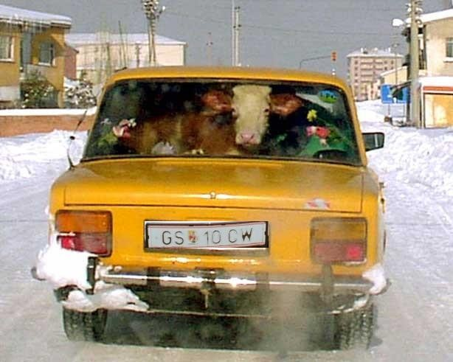

Slide 13
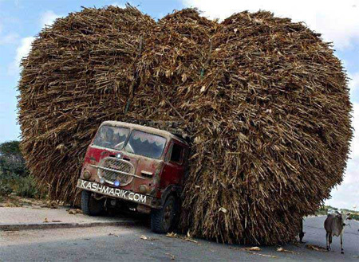

Slide 14
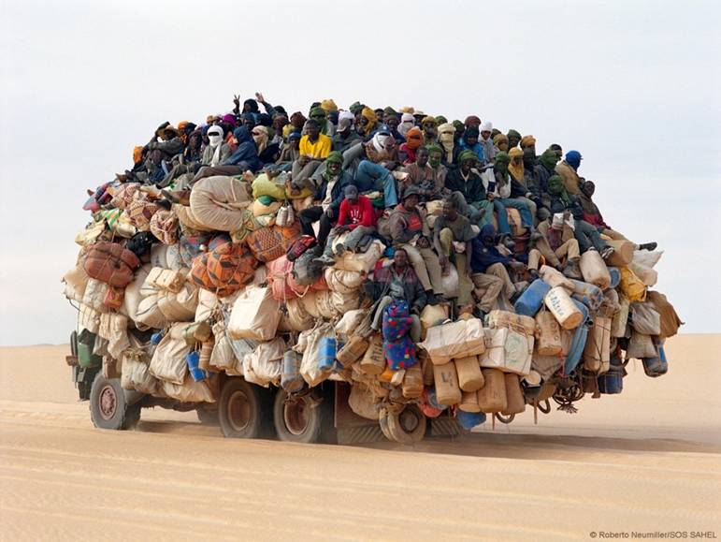

Slide 15
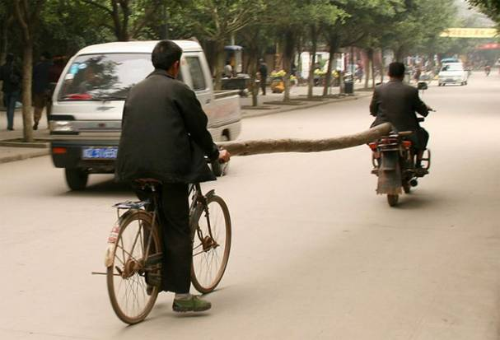
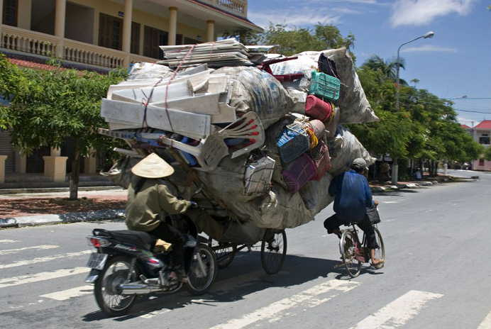

Slide 16
Solutions: Other Services
Tank Cleaning
Maintenance Services
Depot Services
Equipment Leasing
Logistics Services

Slide 17

About Me…
Current Chairman of National Tank Truck Carriers
Previous Chairman of American Chemistry Council’s Partner Initiative

Slide 18
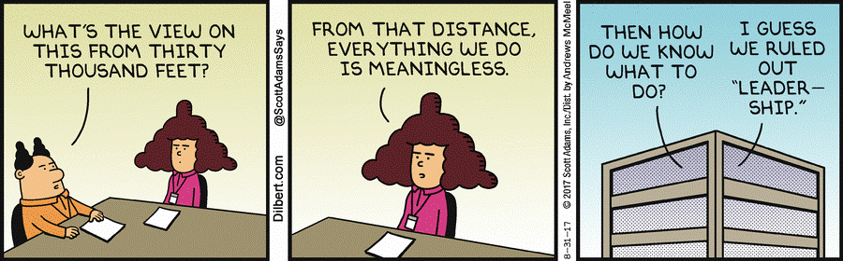
30,000 foot view

Slide 19
Economy
Chemical Industry
Trucking
Game Changers
Let’s talk About:

Slide 20
GDP Growth
Unemployment
Interest Rates
Economy

Slide 21
Expanding
Various Reports:
PWC
ACC
US Petro
Freightwaves
Chemical Industry

Slide 22
The driver shortage is REAL.
Capacity is tight.
The trends will continue.
Trucking

Slide 23


But wait…there’s MORE!!!

Slide 24
ELD
CSX
Harvey
Irma
Next?
Game Changers

Slide 25
CLX + MTI + YOU = What to do?
(Your Provider)

Slide 26
Collaborate

Slide 27
Collaborate
But How?

Slide 28
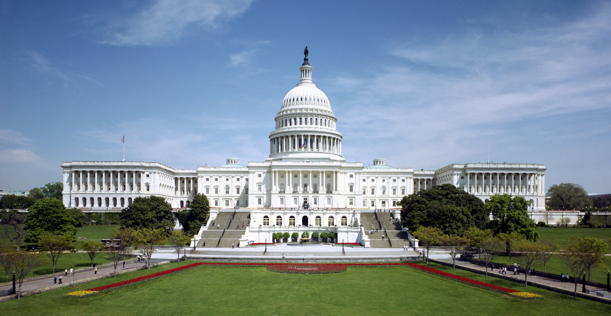

Slide 29
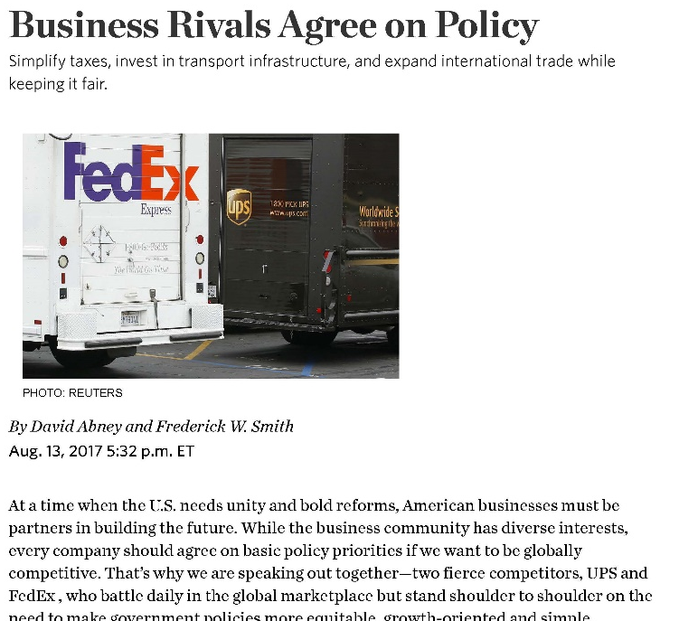

Slide 30
What can
we affect?

Slide 31
The most critical component:
The Drivers

Slide 32
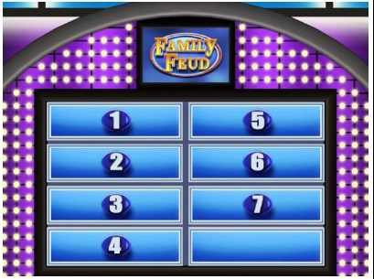
Top 7 Answers are on the Board:
What is the one thing you dislike most about your job today?

Slide 33
What Drivers Dislike Most
2016 Survey by Overdrive & Trucker News
Regulations (45.0%)
It’s a thankless job (19.5%)
Not making enough money (13.3%)
Nothing (9.1%)
Not enough home time (6.2%)
Bad for my health (5.0%)
Not enough miles/loads (1.9%)

Slide 34
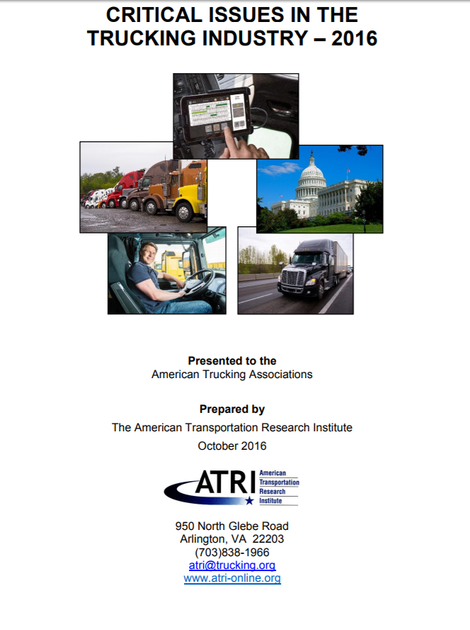
ATRI’s Top 10 Trucking Concerns
ELD Mandate
Hours-of-Service (HOS)
Cumulative Impact of Regulations
Truck Parking
Economy
CSA
Driver Shortage
Driver Retention
Infrastructure/Congestion/Funding
Driver Distraction

Slide 35
Regulations (45.0%)
It’s a thankless job (19.5%)
Not making enough money (13.3%)
2 + 3 = 32.8% of drivers polled

Slide 36
Do what you can about what you can.

Slide 37
Thank You
Lee Miller
lmiller@millert.com

