Slide 1


Slide 2


Slide 3
Market Update
With Mark Chrencik
September 13, 2017
8:30 AM

Slide 4
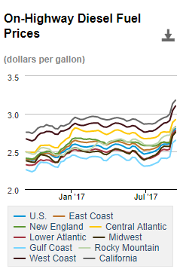
Outlook for Fuel Prices
Current Fuel Today – Hurricanes Harvey and Irma Effect
Houston represents 30% of the US refining capacity
DOE Fuel Prices: up 6% nationally in after Harvey, 8% locally
Source: https://www.eia.gov/petroleum/gasdiesel/

Slide 5
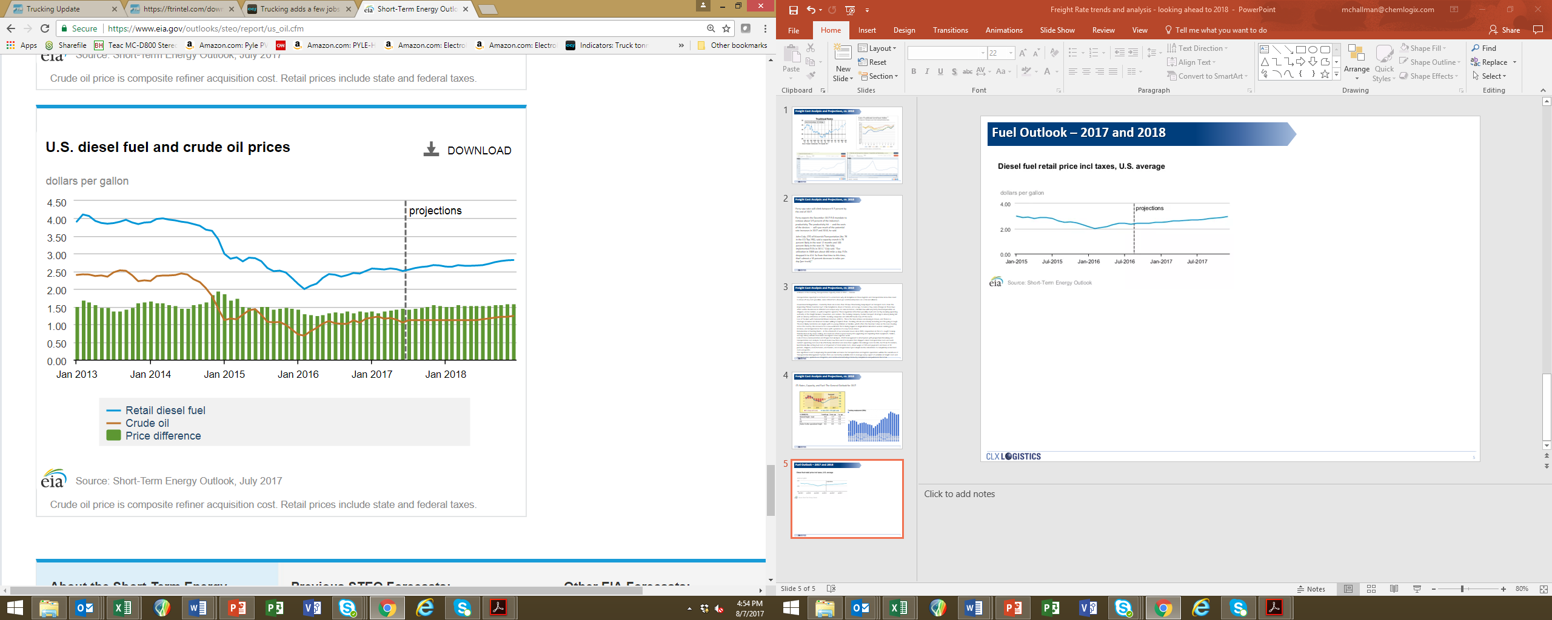
Fuel Outlook – 2017 and 2018
2.55 Jan 2017
2.63 Jan 2018
2.82 Dec 2018
+ 3.13%
+ 7.22%

Slide 6
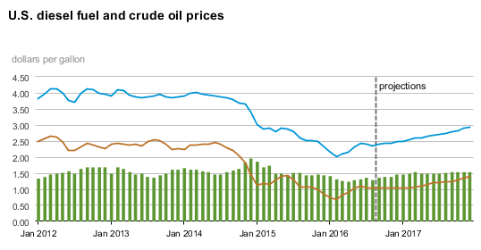
Fuel Outlook – 2016 vs 2017
Q2 - 2016
Q2 - 2017
Notes:
EIA was projecting more aggressively for $3 fuel. Not like to see now until late 18 / early 19.

Slide 7
Industry Updates

Slide 8
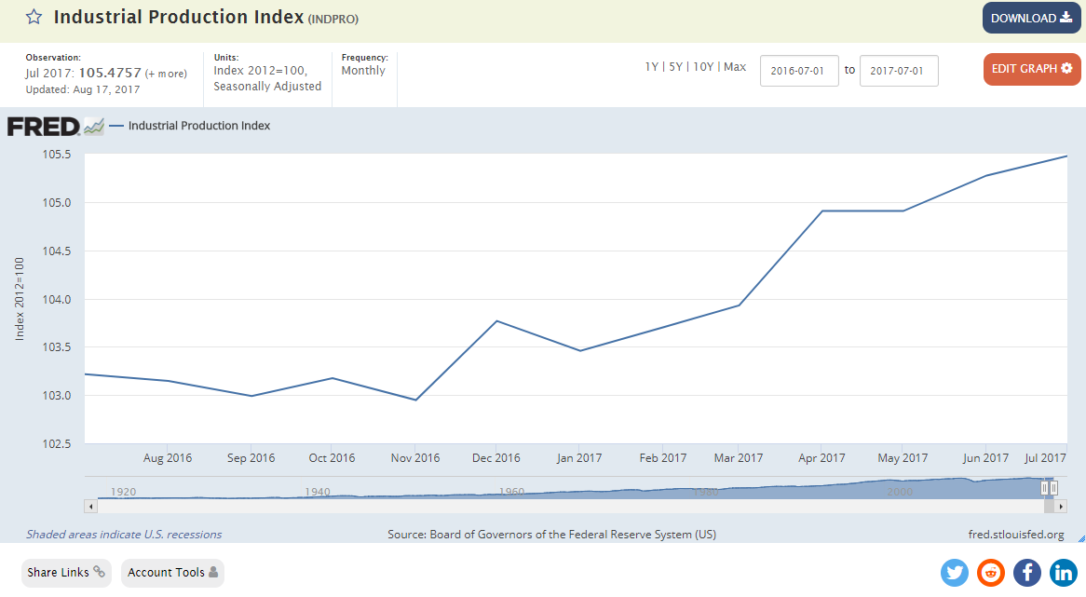
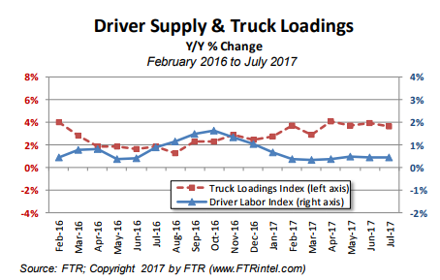
Industrial Production and Trucking Capacity
US production continues to increase…
widening the gap between driver supply and demand.
Notes:
Industrial Production Index – economic indicator that measures real output for all facilities located in the US manufacturing, mining, electric and gas utilities. Index measures movements in production output and highlights structural developments in the economy.

Slide 9
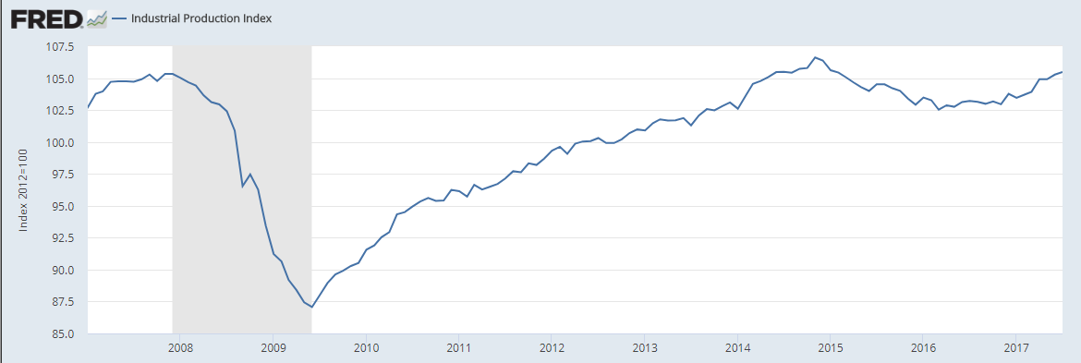
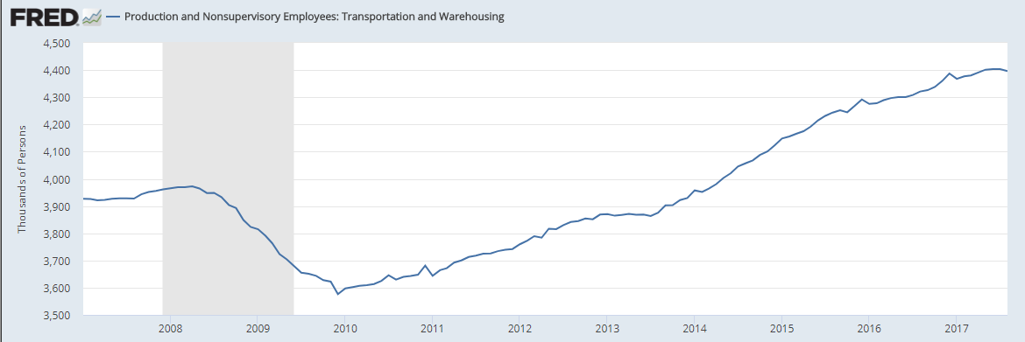
US Industrial Production Index & Transportation Industry Capacity
US Industrial Production Index
US Transportation Industry Capacity
Positive News…
2017 growth of 1.6%
Negative News… 2017 actual capacity growth of only 0.8%
Notes:
Carriers are following the growth only after it’s real
Top graph, same but longer view
Bottom graph nonwupervisory employees including drivers and warehouse workers

Slide 10
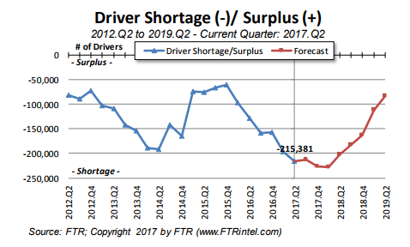
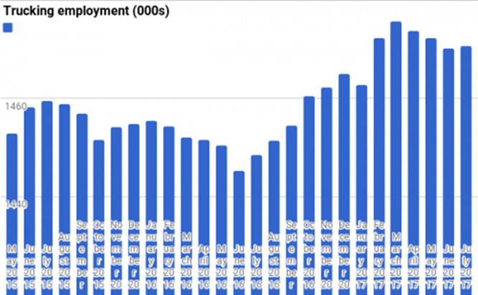
Driver Shortage Estimates & Current Hiring Trend
The driver shortage continues to grow – with a forecasted approach towards (although not reaching) equilibrium in late 2018/early 2019.
Real trucking employment has increased from the low point of June 2016.
Notes:
FTR Driver supply and Truck Demand.
Noel Perry – widely regarded transportation economist looking at many economic factors and predicts less of a shortage or an increase in drivers from a potential recession/economic slow down in 18/19 – Which will be good for shippers.
Just over 200K drivers short and will continue through most of next year.

Slide 11
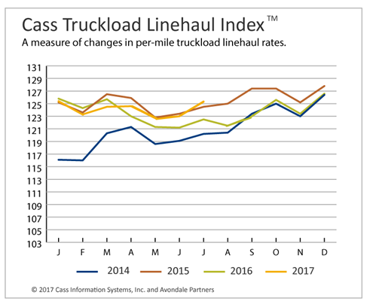
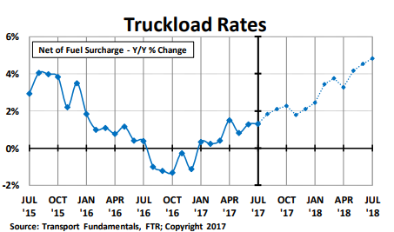
Freight Rate Analysis and Projections
Truckload rates have been tracking around 2015 rates this year – surpassing July 2015 rates in July 2017.
Truckload rates are forecasted to increase over the next year – currently above 2015 levels.
Notes:
You can see in the blue 2014 line vs other years a large increase that has really become the new norm.
Noel Perry shows another 3-4% increase in rates

Slide 12
Rate Outlook and ELD Impact
Noel Perry (FTR Transportation Intelligence)
1 - Rates will climb between 5% and 7% from early 2017 to end of 2017
2 - Dec 2017 ELD mandate will impact productivity by -3% to -5% entering 2018
John Culp (CFO, Maverick Transportation)
1 - Significant capacity crunch is 70% likely in 2017 and 100% likely in 2018
2 - ELD impact (implemented in 2011) – pre-ELD utilization ~ 480 miles/day post-ELD utilization ~ 414 miles/day
16% decrease
Notes:
ELD Enforcement begins 4/1/18 – JOC – drivers will not be able to drive away from roadside inspections

Slide 13
Transportation Capacity Challenges
Governmental Regulations:
  20+ recent/pending legislation efforts will impact transport capacity and costs
  Driver Coercion Law, CSA Compliance, Hours of Service, e-Logs (ELDs), etc
  Impacts include - hefty financial penalties for infractions; revoked operating authority
Driver Retirement, No Replacement:
  Average driver age now in late 50’s
  Trucking schools actively recruiting with limited success
  Possible new sources are women and ex-military
Deterioration of Existing Fleets:
  Credit tougher to come by than before; fleets running trucks longer
  Also occasional issues with extension of Preventive Maintenance schedules
Hurricane Recovery:
  In 2005 Hurricane Katrina led to a 7 point increase in annualized pricing nationally for subsequent five month period.
  One month after Harvey:
    2% of national trucking will be affected
    25% of Gulf trucking will be affected
Notes:
While Irma was not a materially large impact, we can expect to see rate increases from carriers.

Slide 14
What It All Means

Slide 15
What To Expect Over the Next 18 Months
Linehaul Rate increases of at least 3% to 4%...perhaps as high as 6% to 8%
Fuel Price increases on the order of >3% in 2017…and another >7% in 2018
Overall productivity (miles per truck per day) to decline industry wide by about 3% to 4% in the coming year
Non-dedicated trucks to have as many as 4-6 loads available on any given day
Notes:
FUEL – this is a % change in fuel rates, NOT the FSC which is typically mitigated to ½ via fuel programs.

Slide 16
What you can do…
Be a good Shipper or Consignee
Private Fleets – invest in owned and operated fleet
Dedicated Fleets – partner with an asset-based carrier for long-term, guaranteed capacity
Modal Changes – Intermodal options
Longer term relationships with core carriers

Slide 17
Thank You

