Slide 1


Slide 2


Slide 3
Gulf Coast (and Florida) Transportation Recovery
With Dale McClung, Director of Design Solutions
September 13, 2017
1:15 PM

Slide 4
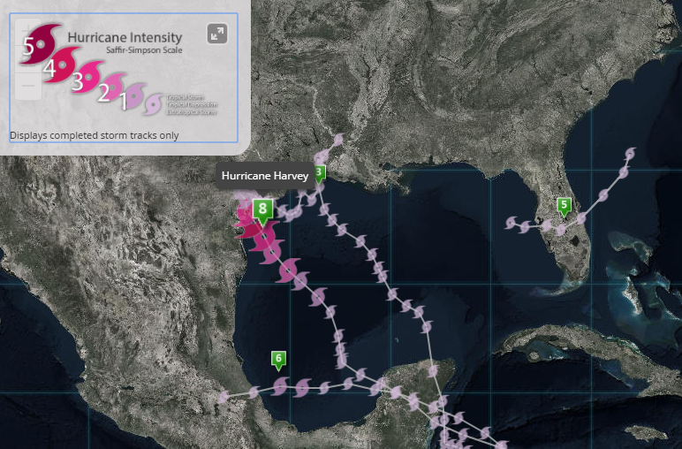
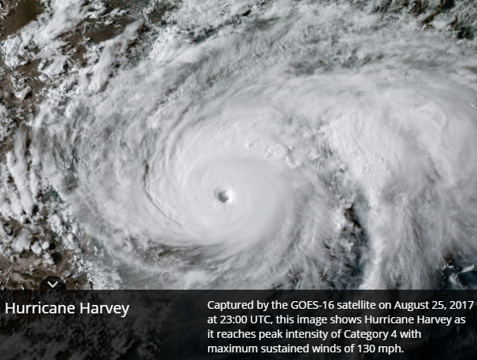
Hurricane Harvey
Hurricane Harvey was the 8th Atlantic Basin storm for the 2017 Hurricane Season

Slide 5
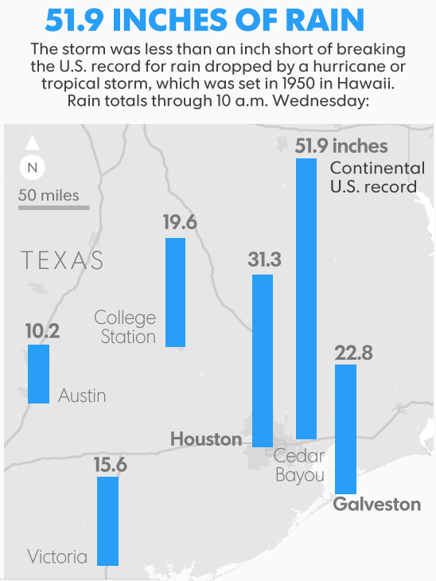
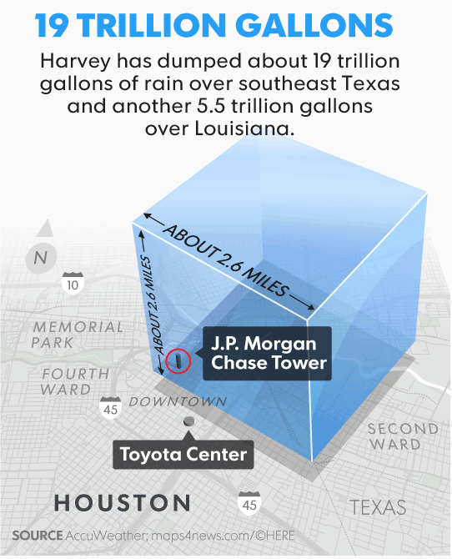
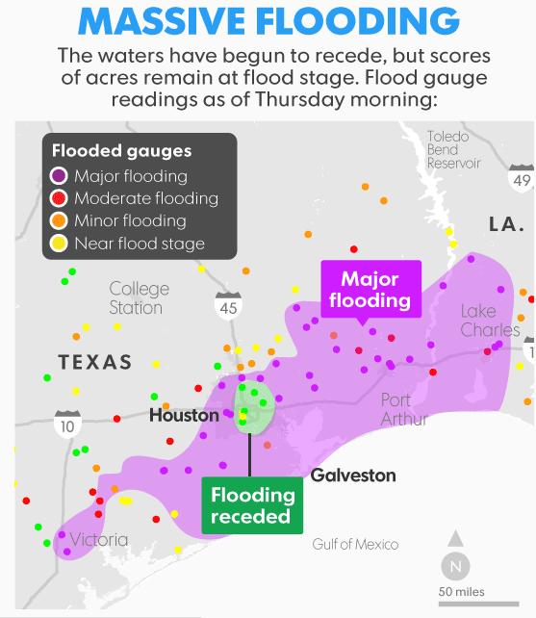
Hurricane Harvey Statistics

Slide 6
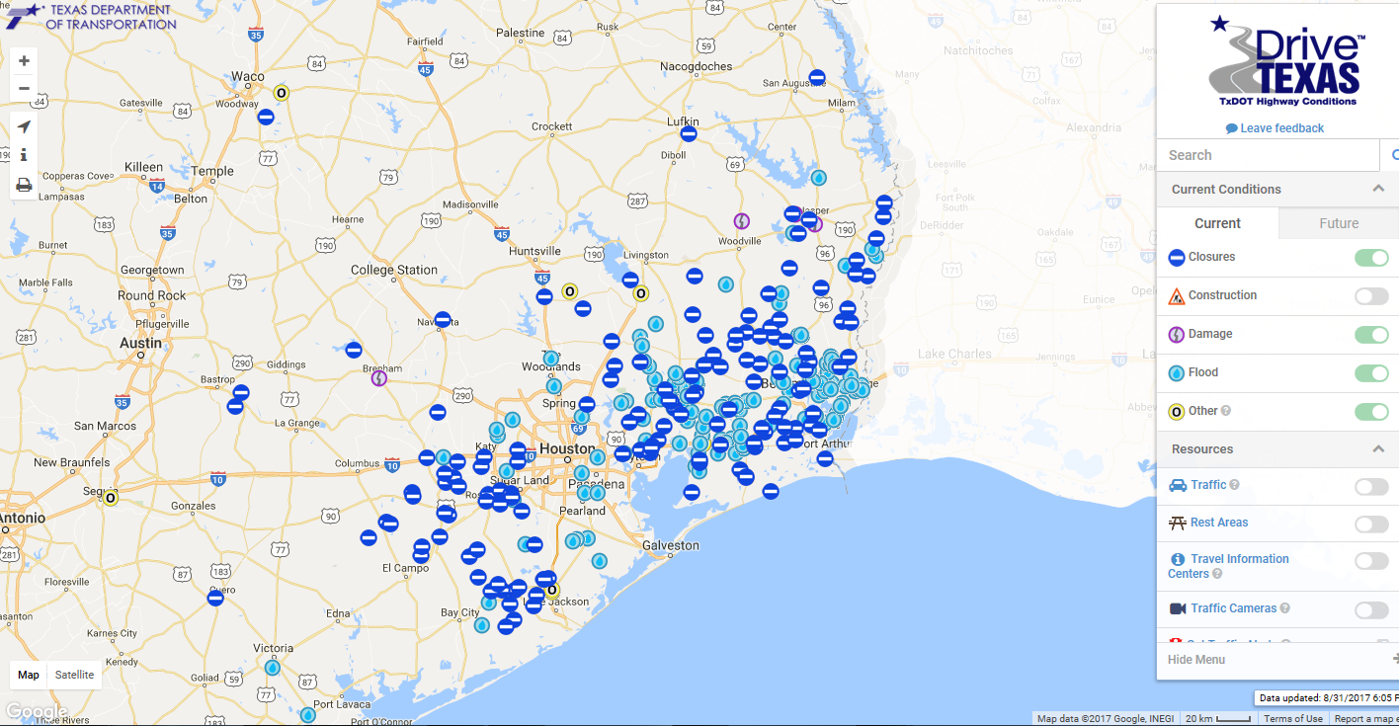
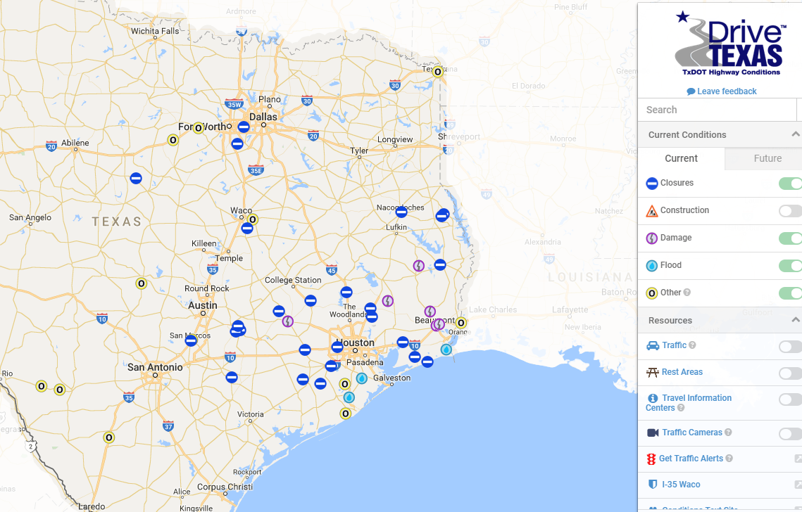
Roadway Recovery
September 12
25 roads closed, 3 flooded
August 31
350+ roads closed and/or flooded

Slide 7
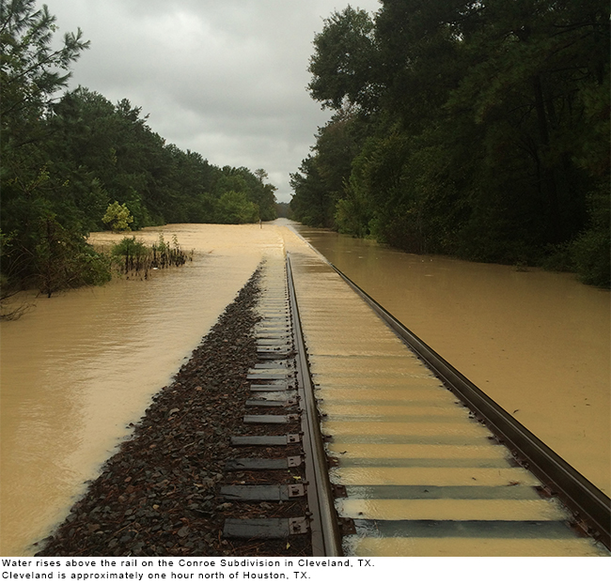
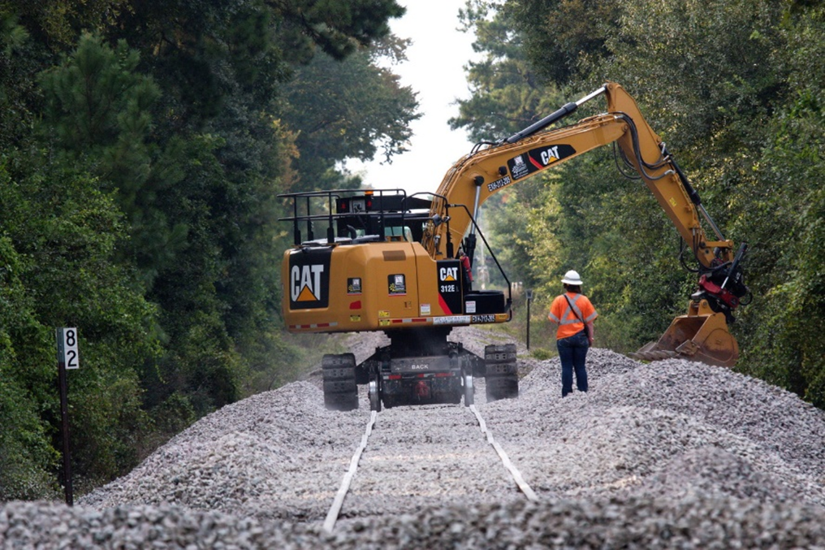
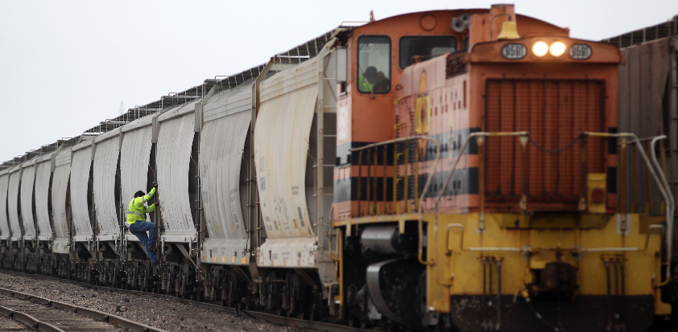
Rail Recovery
September 1st
September 6th
September 12th
Embargoes in the Houston area
Cars and tracks under water
Repairs and inspections already underway
Class 1 railroads make significant progress on repairs
Delays still exist on routes
Some embargoes still in place
Majority of services restored
145 locomotives added to handle surge in traffic
Delays continue

Slide 8


Ocean and Air
September 1st
Very limited flights in / out of the region
Air cargo embargo in place
Some ships re-routed to other ports
Ocean terminals assessing flood damage and beginning to re-start port facilities
Additional free time provided to shipping lines for containers
September 6th
Airports lift cargo embargoes, progresses toward normal operations
All port facilities open
Normal free time policies resume
Some delays in loading / off loading

Slide 9
Harvey Demand Recovery Model
Tank Trucks
Actual rate of recovery 25% per week*
Revised Forecast
Original Forecast
Anticipated rate of recovery 14% per week
Week of Aug. 27th
Forecast based on statistical recovery models generated by CLX Logistics Engineering Team and interviews with major chemical producers in the Baytown and Houston area.

Slide 10
Harvey Demand Recovery Model
Rail & Intermodal
Actual rate of recovery 21% per week*
Revised Forecast
Original Forecast
Anticipated rate of recovery 14% per week
Week of Aug. 27th
Actual Demand
Forecast based on statistical recovery models generated by CLX Logistics Engineering Team and interviews with major chemical producers in the Baytown and Houston area.

Slide 11
CLX Logistics Disaster Recovery Services for Hurricane Harvey
Webinars with latest information on transportation infrastructure conditions (recorded)
Review of available transportation capacity
Forecasting the demand recovery to both shippers and carriers
Opening disaster recovery phone and email lines
Identifying reserve transportation capacity for short-term needs

Slide 12
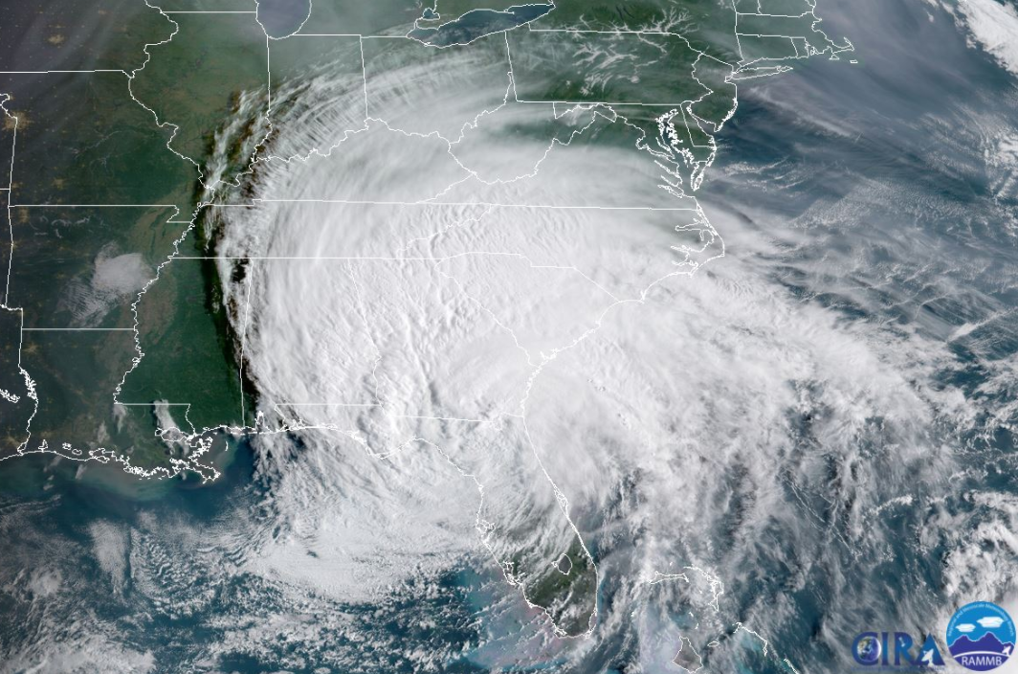
Hurricane Irma

Slide 13
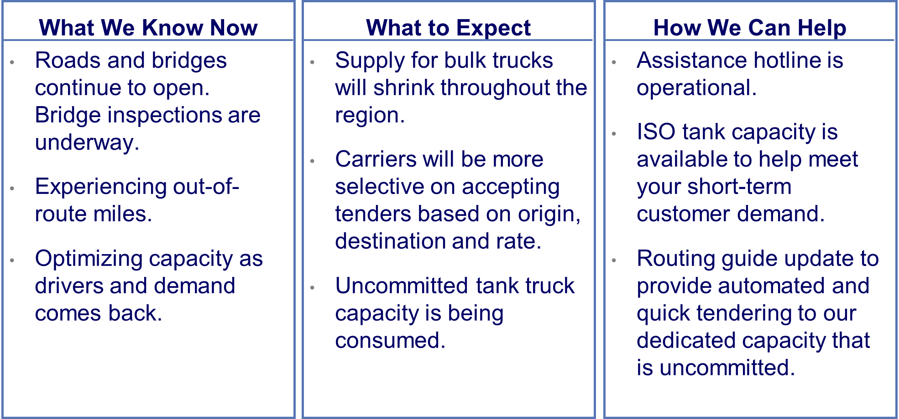
Hurricane Irma – Bulk Trucks

Slide 14
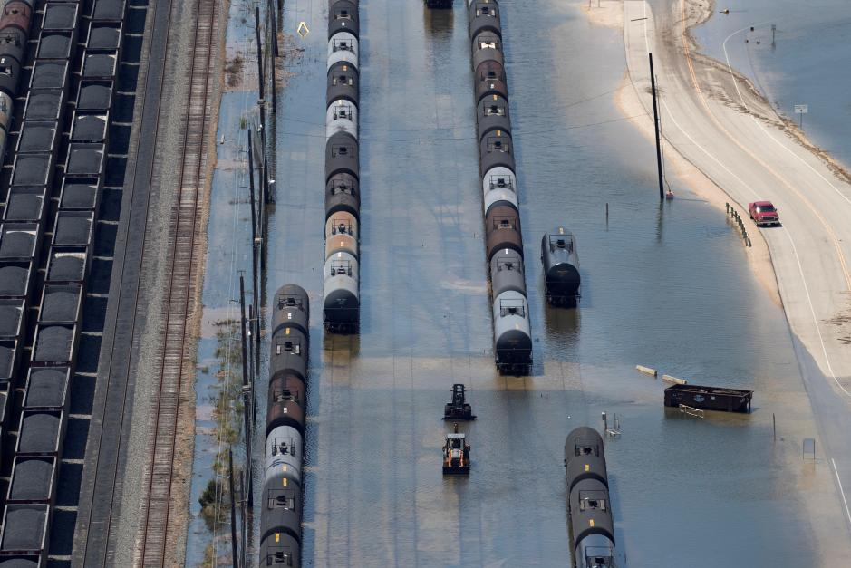
Hurricane Irma – Rail & Intermodal
Rail congestion continues due to temporary embargoes and increased volumes. Expect delays.
CSX local gates in Savannah, Tampa and Jacksonville are closed and expected to stay closed until the end of this week.

Slide 15
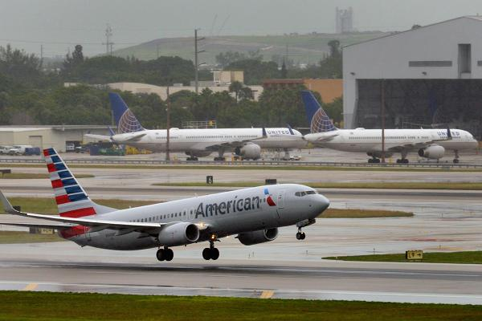
Hurricane Irma – Air
Miami International Airport is expected to resume limited operational status. Some cargo and passenger flights will resume but the airlines and terminals aren’t operating at full staff so delays and limitations will remain.

Slide 16
Irma Demand Recovery Model
New recovery model based on revised Harvey forecast information
Tank Trucks
Original Forecast
Anticipated rate of recovery 25% per week

Slide 17
Harvey Demand Recovery Model
New recovery model based on revised Harvey forecast information
Rail & Intermodal
Original Forecast
Anticipated rate of recovery 21% per week

Slide 18
CLX Logistics Disaster Recovery Services for Hurricane Irma
Webinars with latest information on transportation infrastructure conditions (recorded)
Review of available transportation capacity
Forecasting the demand recovery to both shippers and carriers
Opening disaster recovery phone and email lines
Identifying reserve transportation capacity for short-term needs

Slide 19

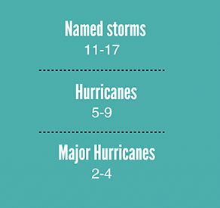
2017 Hurricane Season Forecast
Forecasters predict a 45 percent chance of an above-normal season, a 35 percent chance of a near-normal season, and only a 20 percent chance of a below-normal season. - NOAA

Slide 20
Thank You

