Slide 1


Slide 2
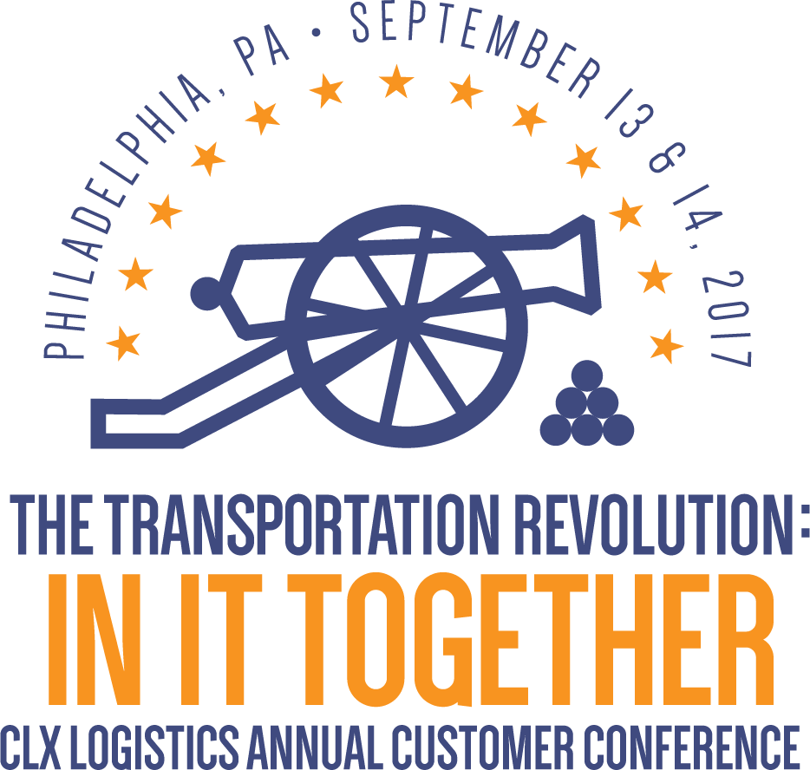

Slide 3
Defining Your Own Logistics Competitive Weapon
With Adrian Gonzalez
September 13, 2017
2:15 PM

Slide 4
Supply Chain is Your Business Plan
“We’re seeing a dynamic shift in the relationship between business plans and logistics, a shift from the perception of our industry as a back-end process to a front-end strategy that informs and supports the entire business plan.
Your supply chain strategy in effect becomes your business plan.”
– Michael Eskew, former Chairman & CEO, UPS
at CSCMP Annual Conference 2002

Slide 5
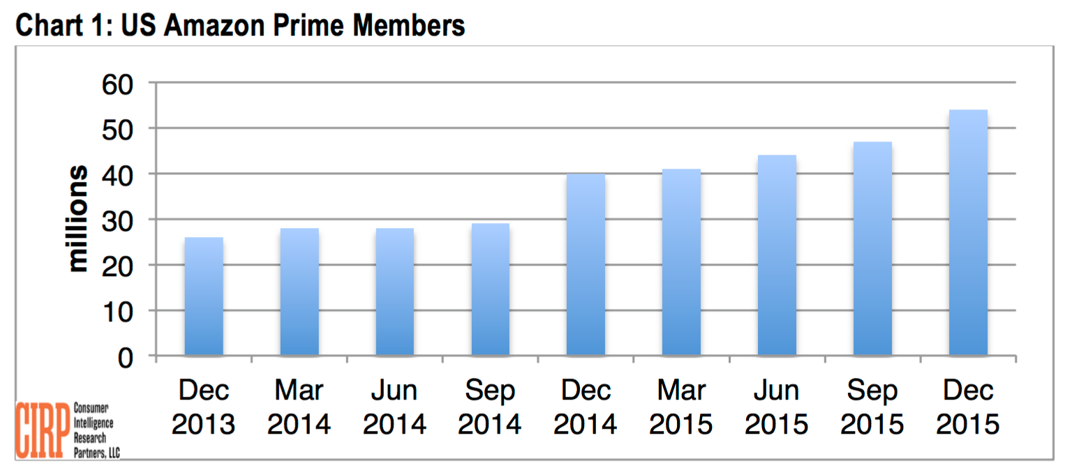
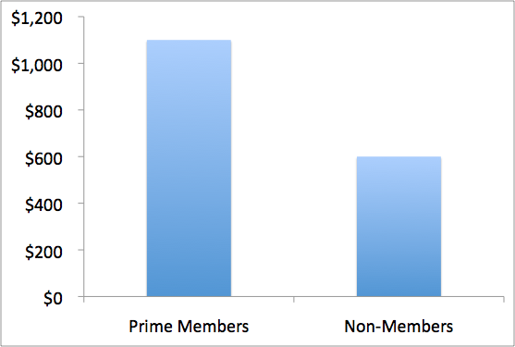
Prime: Amazon’s Killer Weapon
Average Spend Per Year
We’ve grown Prime two-day delivery selection from 1 million items to over 30 million, added Sunday Delivery, and introduced Free Same-Day Delivery on hundreds of thousands of products for customers in more than 35 cities around the world…Prime Now offers members one-hour delivery on an important subset of selection [and serves] members in more than 30 cities around the world.
Amazon Prime members spend on average about $1,100 per year, compared to about $600 per year for non-members.

Slide 6
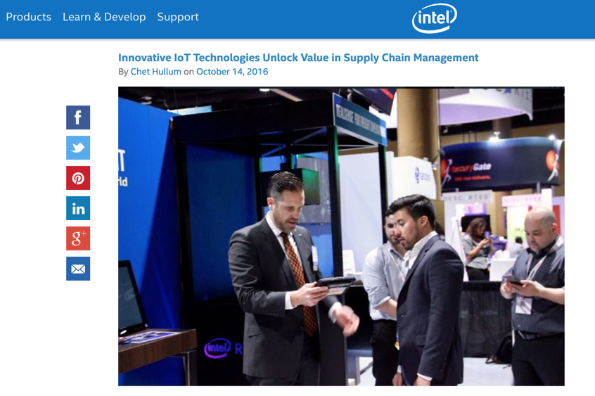
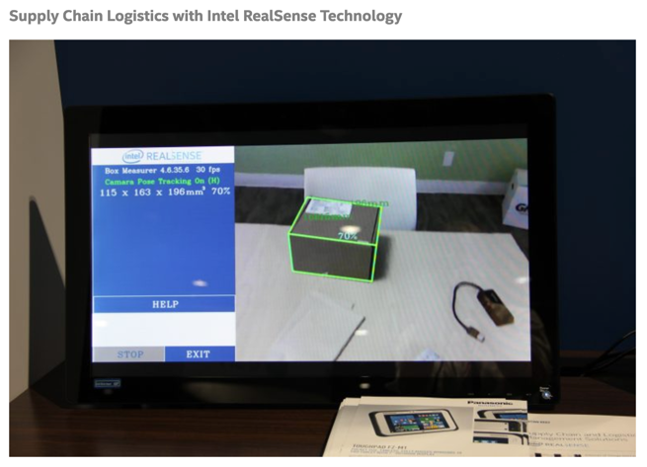
SC@Intel: Supply Chain as Expert Resource
50+ customer engagements
6 deal wins
7 proof-of-concepts launched
$30 million in new revenue

Slide 7
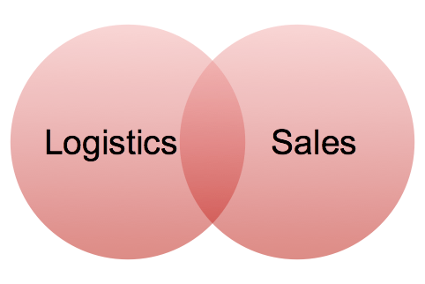
Educating Sales on Power of Logistics
“Our ability to respond quickly and effectively to fluctuations in demand, adjust order sizes and delivery frequency as required, and provide timely and accurate visibility to orders, inventory, and other metrics are all competitive weapons — let’s use them to our advantage!”
-- VP of Logistics, large
food manufacturer

Slide 8

How to cross the chasm?
Logistics as a Cost Center
Logistics as a Competitive Weapon

Slide 9
Discussion Questions
What are the main challenges?
How do you overcome them?
Who needs to be involved?
What is the role of your logistics partners?

Slide 10
How to get started?
Focus on Customers: Understand Their True Requirements and Expectations
Link the Value of Supply Chain and Logistics to the Company’s Strategy and Business Plan
Promote Enhanced Collaboration Between Supply Chain, Logistics, Sales, Marketing, and Customer Service
Leverage the Knowledge, Expertise, and Resources of Your 3PL partners

Slide 11
Thank You

