Slide 1


Slide 2
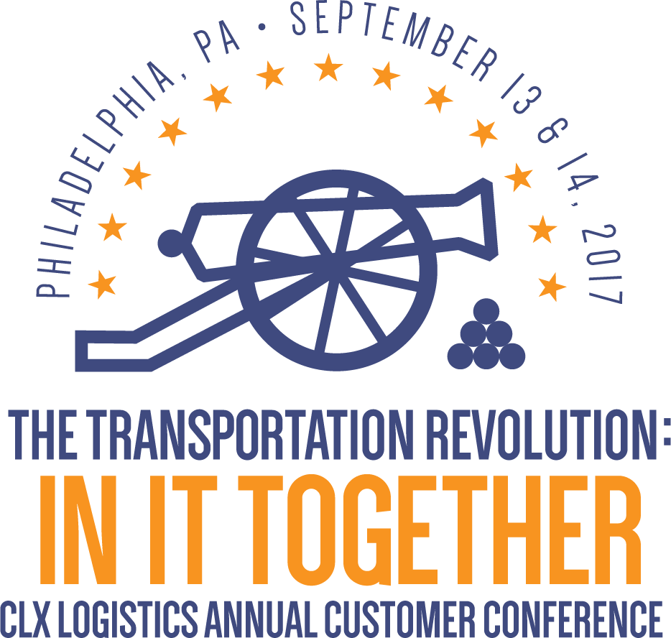

Slide 3
BluJay and CLX Logistics
A Global Trade Partnership
With Doug Surrett
September 13, 2017
10:15 AM

Slide 4
Global Trade Network
Doug Surrett, Chief Product Strategist

Slide 5
The Global Trade Network
Industry Trends
Product Roadmap

Slide 6
The Global Trade Network

Slide 7


The rest of the market is looking at the situation
ALL UPSIDE DOWN

Slide 8

It’s NOT just about multi-modal, omnichannel and booking tools
This misses the point.

Slide 9

It’s really about awakening to a NEW ERA OF BUSINESS
Time is the
new currency
Amazon effect: instant delivery
Lean or no inventory
Fragmented ecosystems
Constrained capacity
Fluctuating demand
Political/trade uncertainty
Disruptive technologies
Customs
complexity
Carbon
footprint
Big Data analytics

Slide 10

Where GLOBAL TRADE moves to the forefront

Slide 11
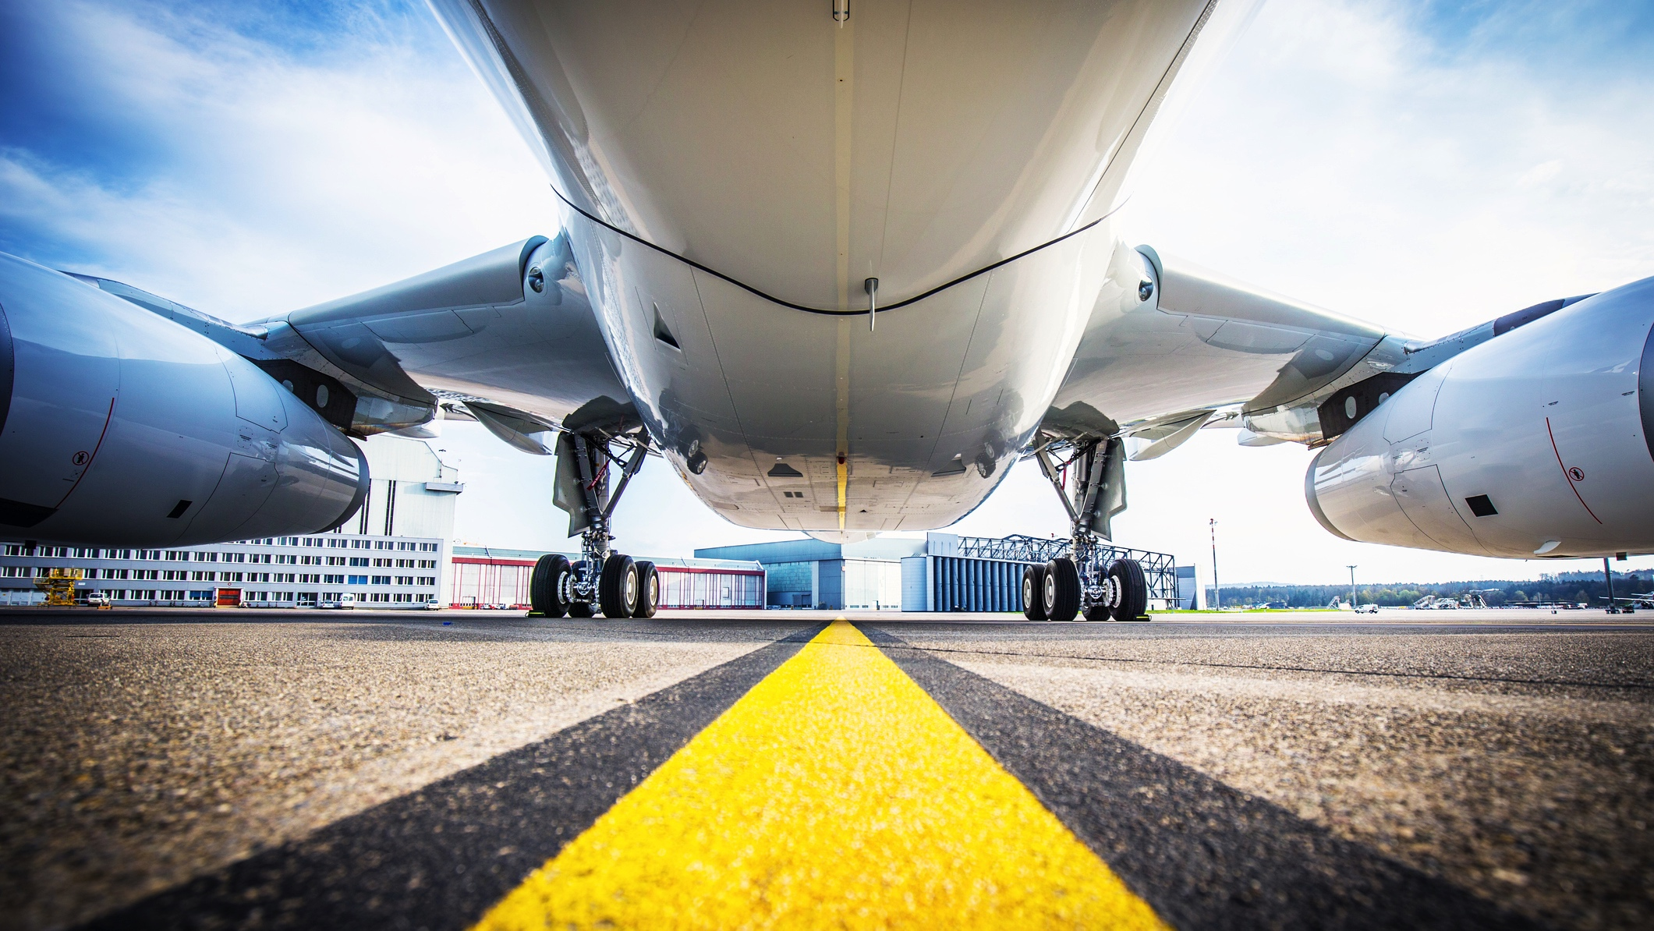
and supply chain becomes today’s BATTLEGROUND

Slide 12

$10B spend in supply chain technology yields only INCREMENTAL improvement
33%
supply chain execs are dissatisfied with their supply chain transformation
Source: Gartner 2015 and Cap Gemini 2016

Slide 13
$10B spend in supply chain technology yields only INCREMENTAL improvement
48%
supply chain execs admit they still rely heavily on email, phone, and fax
Source: Gartner 2015 and Cap Gemini 2016

Slide 14

Winners operate with a
DIFFERENT SET OF RULES

Slide 15

FUTURE SUCCESS IN
GLOBAL TRADE requires transforming to a new supply chain strategy

Slide 16

A NEW REALITY WHERE….
Access to capacity fuels growth
Speed is a competitive weapon
Change is welcomed not just anticipated
Disrupting markets leads to lower cost structure
Borders become friction-free

Slide 17

The DISRUPTIVE OPPORTUNITY is going beyond automation

Slide 18
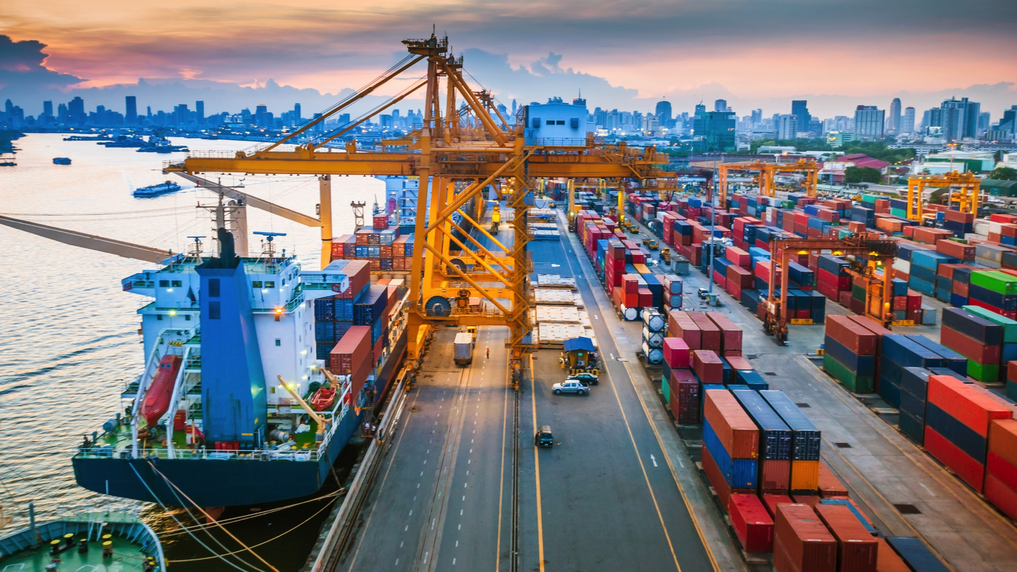
… to a new model that harnesses the FULL POWER of the global supply chain ecosystem

Slide 19
Transform to a new strategy: Global Trade Network Model
from
TRADITIONAL SUPPLY CHAIN LOGISTICS MODEL
to
MODERN GLOBAL TRADE NETWORK MODEL
Managed as a cost center
Focus on internal automation
Static linear processes
Hard-wired
Guesswork and black holes
Micro-optimization
Managed as a strategic, competitive asset
Connecting markets using data and speed
Dynamic living ecosystem
Power of choice
Always know when, why
your world is changing
Macro-optimization: network effect
Notes:
Here is the original list of from/to:
FROM:
Managed as a cost center
Business function
Micro-optimization
Focus on internal automation
Understand the past
Static linear processes
Guesswork and black holes
Hard-wired
TO:
Managed as a strategic asset
Competitive force
Macro-optimization: network effect
Connecting markets using data and speed
Shape the future
Dynamic living ecosystem
Always know when, why your world is changing
Power of choice

Slide 20
But this is really hard to do

Slide 21
Forward-thinking companies have figured it out

Slide 22

What do they all have in common?

Slide 23

The answer
Optimize your future in the Global Trade Network

Slide 24
Why forward-thinking companies choose BluJay
UNLOCK the power of THE NETWORK
TRANSFORM
Your economics
Achieve Greater
Velocity
See
BEYOND
The Horizon
Demonstrated commitment to customer success

Slide 25
Why forward-thinking companies choose BluJay
Network effect: tap the power of the largest global trade network, with 40K+ carriers, shippers, forwarders, suppliers and customers
Universal connectivity: manage goods and services across an integrated global trade network - rapidly onboard services, carriers, customers, business units - collaborate with all trade participants
Optimize trade across the global network
Analyze and operationalize all data streaming across the network
Powered by a cloud platform and portfolio of application services from the leader in logistics technology
UNLOCK the power of THE NETWORK

Slide 26
Why forward-thinking companies choose BluJay
Transform your economics
EXPAND THE TOP LINE:
  Drive growth opportunities through rapid onboarding of new customers, regions, plants, new acquisitions, carriers
  Strengthen competitive position through improved cost structure
  Gain access to new markets through friction-free borders
IMPROVE THE COST FORMULA:
  Wring out operational inefficiencies across all processes – grow your business without increasing the number of resources
  Secure best-fit sources at the best rate, every time
  Optimize fully landed cost while balancing the cost/service equation
MITIGATE RISK:
  Up and running quickly, with a global support and deployment structure to ensure ongoing success
  Continuous access to multiple options across the global trade network
  Preempt disruptions through better carrier visibility and management

Slide 27
Why forward-thinking companies choose BluJay
Achieve Greater Velocity
Frictionless and more efficient movement of goods across any border
Hands-free customs via integration into your existing systems (ERP) for faster time to value
Onboard additional countries you trade to/from quickly
Adapt workflow processes to respond quickly to changing market forces and customer demand
Manage just-in-time delivery model
Rapidly onboard new customers, markets, business units
Make informed decisions faster with real-time data analytics

Slide 28
Why forward-thinking companies choose BluJay
See beyond the horizon
True end-to-end collaborative visibility – always know where things are in transit
Embedded analytics to help you make better decisions
Ability to analyze data and respond proactively in real time
BluDex benchmarking for the best rates, every time
Transportation network modeling: “what if” go-forward scenarios based on historical data and trend analysis
Be ready for surprises: real-time response to unanticipated disruptions
Future proof your workflows: configurable business rules that can be changed on the fly
Be part of a network of excellence: collaborate and innovate together with your trade partners

Slide 29
8 DESIGN PRINCIPLES:
Global Trade Network Model
AUTONOMOUS
CONSUMPTION
expand participation at your own pace
COMPREHENSIVE SECURITY
secure network provides end-to-end integrity
MINIMIZE HUMAN INTERVENTION
fully automated, manage by exception
CONTINUOUSLY IMPROVING
velocity and throughput
DETERMINISTIC
Exactly match
shared resources to fluctuating demand and market forces
COMPLETE OBSERVABILITY
capture every moment, always a known state
DATA-DRIVEN
data drives economics and performance, supply chain is a living organism
FULL INTEGRITY
frictionless borders, always in compliance
Notes:
Examples:
Autonomous Consumption – we enable our clients to consume as many or as few network features as they want to. If a TL carrier in the US only wants to expose their capacity for a single lane with specialized equipment, we can accommodate this. Alternatively, if one of our Freight Forwarding clients wants to expose their service offering to our entire customer base, we can facilitate this.
Full integrity – we continuously monitor trade compliance and customs changes so that our customers are able to move products across border friction free.

Slide 30
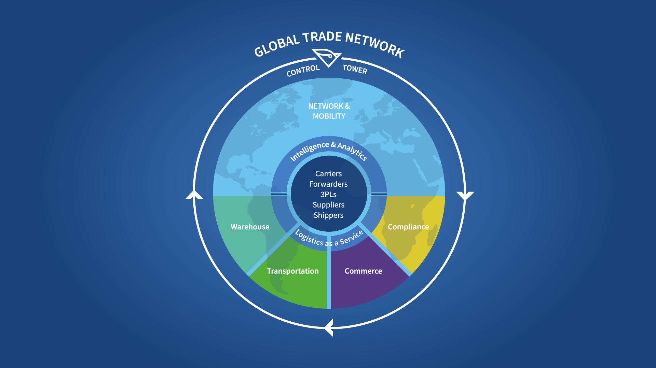
Network GTN
The integration and mobility platform that connects our world.
Control Tower
A birds eye view of the entire supply chain.
Analytics
Providing the ability to make more profitable decisions.
Our Partners
The “secret sauce” core of the GTN.
Warehouse GTN
Warehouse & Yard Management and Cross Dock.
Compliance GTN
Friction free borders.
Transportation GTN
Our industry leading TMS solution and peripheral solutions.
Commerce GTN
Connecting buyers and sellers on the GTN.

Slide 31
Key Trends
How they Impact our product strategy

Slide 32
Key Trends
Move towards non-traditional home delivery options
  Addition of white-label, crowd-sourced delivery options via MobileSTAR
Shrinking order size, increase parcel volume
  Integration of industry leading parcel solution
Continued increase in globalization of trade
  Single platform customs solution supporting 18 countries with target of 47
Thirst for data regarding location/status of shipments
  Integration with smart devices that can transmit data in real time

Slide 33


Mobility
Last mile delivery solution for Android, iOS, Windows Mobile
MobileSTAR now integrated with TMS
Mobile apps to be developed for primary
BluJay products including
  Warehouse Management
  Customs Management
  Control Tower
  Yard Management
  Commerce and more…

Slide 34


Parcel
Based on proven technology powering BluJay’s largest Parcel customer implementations
Future enhancements
  Invoice Reconciliation
  Milestone Tracking
  Optimization
Integrated into TMS and available now!

Slide 35


Customs Management
Single platform solution regardless of Country/Regime
16 Countries in production, growing to 47
Continued focus on country support and
feature development

Slide 36

Control Tower
Integration with leading telematics providers
  Capture location data for real-time tracking
Integration with leading sensor providers
  Capture shock, temperature and location data
  Enables smarter detention/demurrage management
  Enables true proactivity and decision making
Better Data = Better Decisions

Slide 37
Thank You

