Slide 1


Slide 2
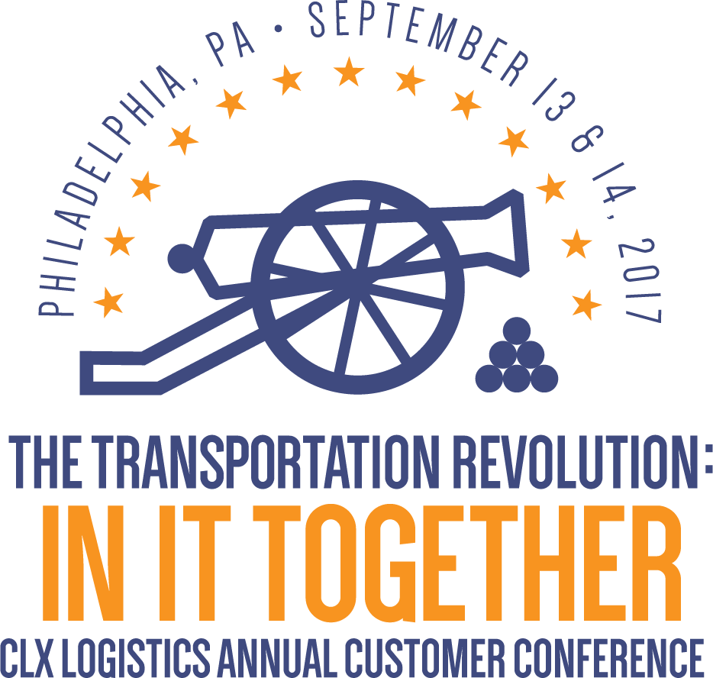

Slide 3
The European Labyrinth
How to optimize your logistics?
Marc Huijgen
VP CLX Logistics Europe

Slide 4
Agenda
Europe
Logistic challenges you have to deal with in EU
European Market situation
Developments impacting European Logistics
Recent CLX project results

Slide 5
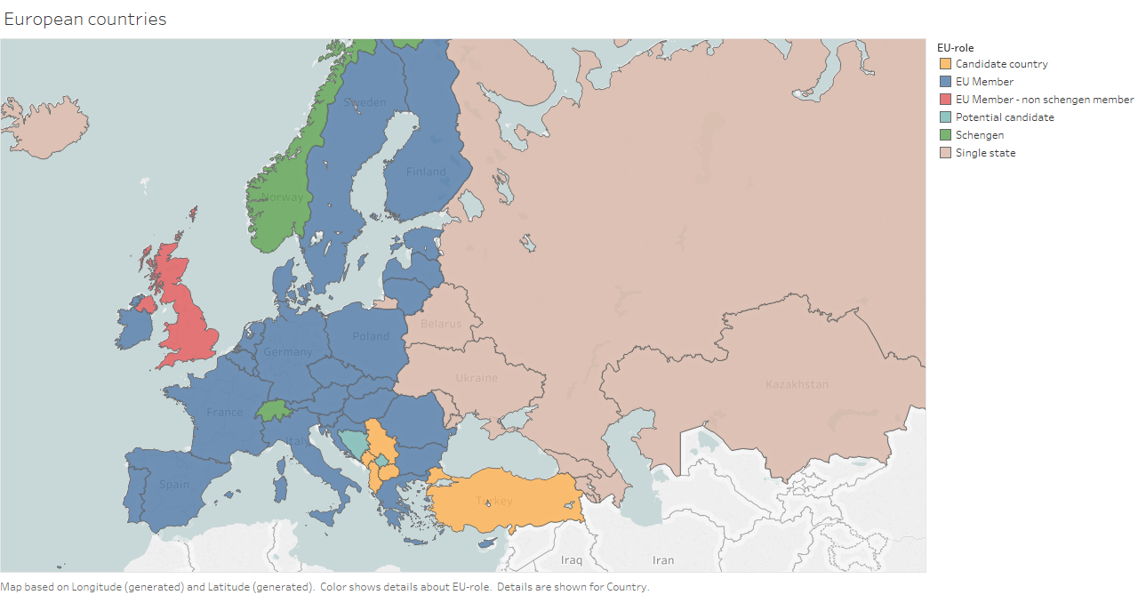
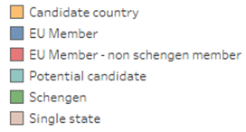
Europe
3.9 mio sq miles
48 sovereign countries
23 official different languages
510 mio people
Euro is formal currency in only 19 countries
Source: Eurostat

Slide 6

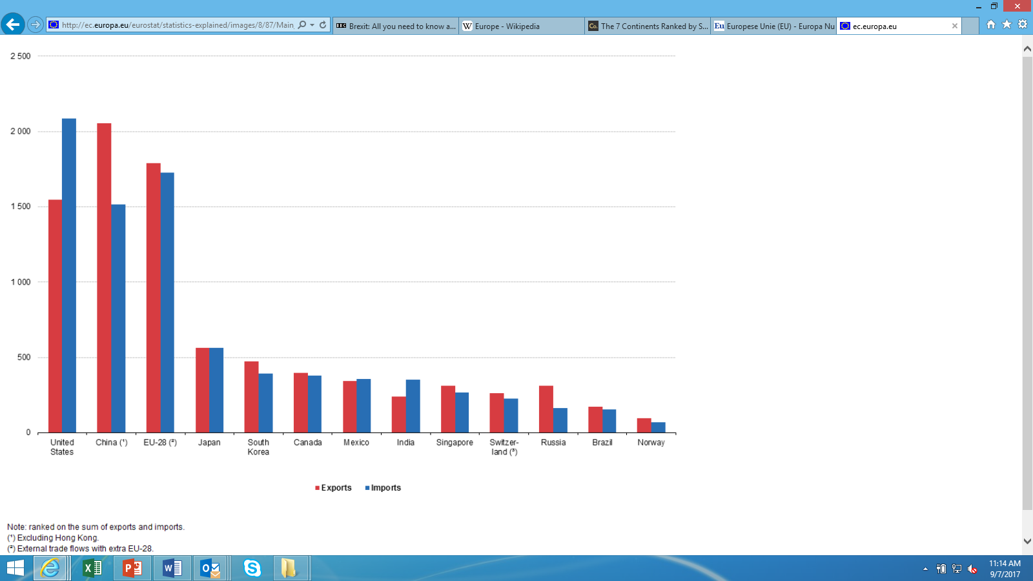
European Union
Currently 28 members
  Brexit = UK scheduled to leave EU on Friday, 29 March 2019
  Goals: political / economical / trade / humanitarian
Main players for international trade in goods, 2015 (billion EUR)
Source: Eurostat

Slide 7
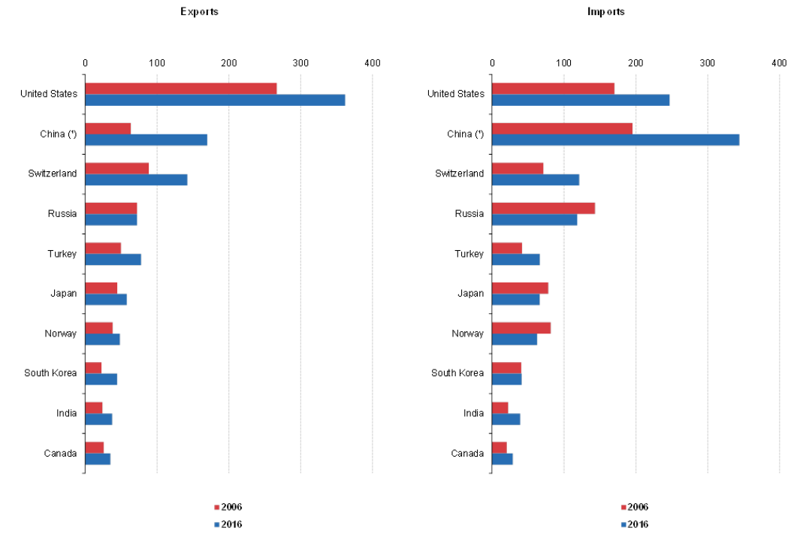
European Union
US is the biggest trade partner of EU
Source: Eurostat

Slide 8
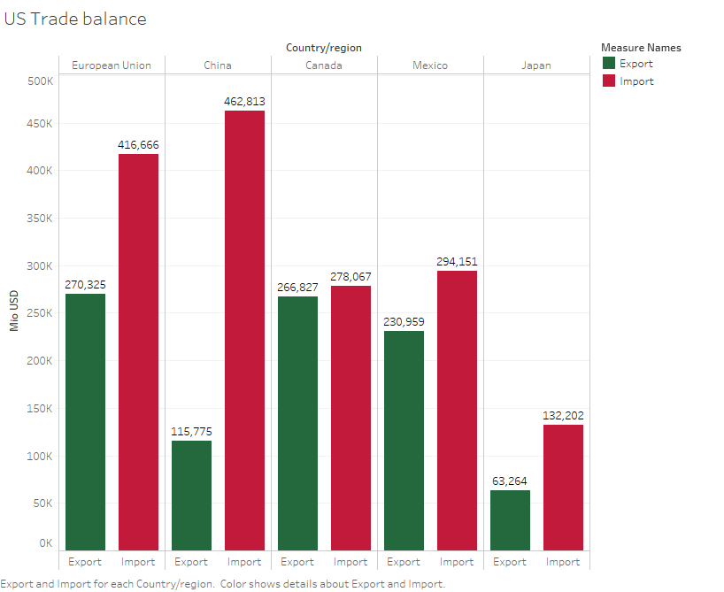
European Union
EU is the biggest trade partner of US
  Bigger than Canada or Mexico
Source: U.S. Department of Commerce

Slide 9
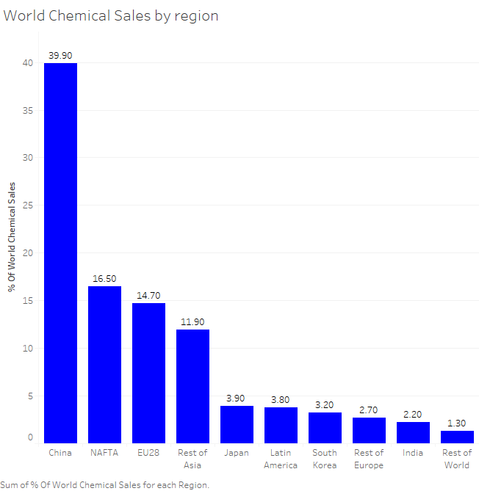
European Union
What about the Chemical Industry?
Global Chemical sale % per region
Source: CEFIC

Slide 10
Logistic challenges you have to deal with in EU
Country specific weight restrictions
Country specific vehicle dimensions regulation
Customs
VAT (value added tax)
  Differs from 17% to 25%
Driving time restrictions
  Germany: from 00:00 to 10PM on Sundays and public holidays
  Spain: Hazmat goods transports banned on Sundays and public holidays from 08am till midnight
  Netherlands / Belgium: no restrictions

Slide 11
Logistic challenges you have to deal within EU
Some countries apply Road tax for trucks
  e.g. Belgium, Germany, France
Fuel prices differ per country
  A gallon Diesel in US: $ 2.60
  A gallon Diesel in Poland: $ 4.40
  A gallon Diesel in NL: $ 5.80
  A gallon Diesel in Sweden: $ 6.20
Some major cities start a ban on polluting trucks & cars
  e.g. London, Milan, Munich, Paris, Oslo

Slide 12
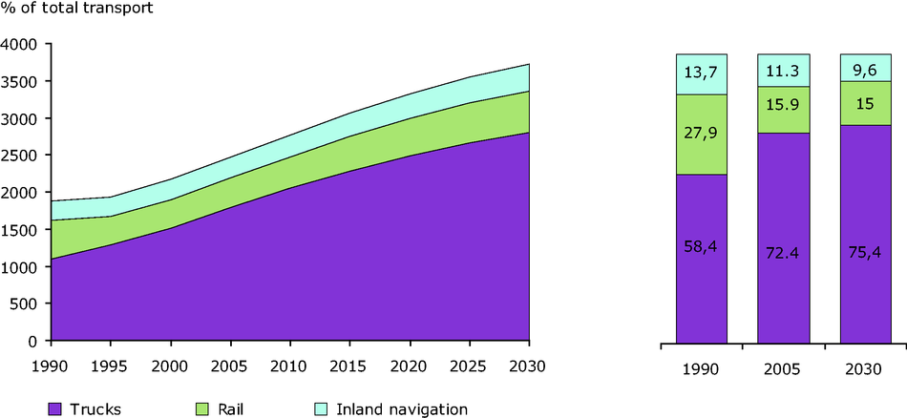
European Market situation
Road transport is still dominating mode of transport and this is projected to continue
European freight transport growth
2017
Source: European Environment Agency

Slide 13
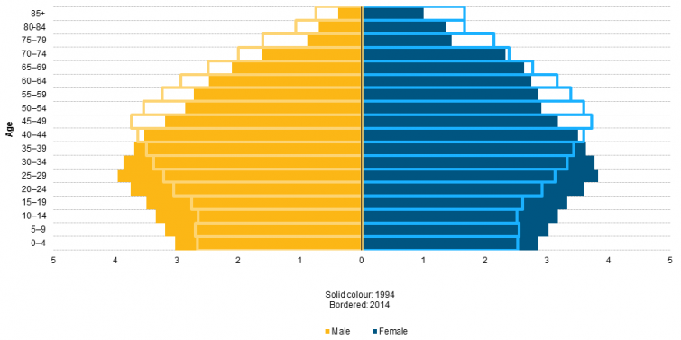
European Market situation
Junior/medior workforce population reduced
Education level of current workforce has increased
    => Not truck (equipment) shortage, but drivers!
2017
Source: European Environment Agency

Slide 14
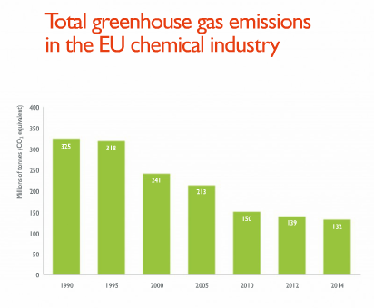
European Market situation
Green Logistics / Sustainability remains a serious topic
Paris 2020 agreement
President Trump stepping out
European Industry is still focusing on Green / Sustainability
Transportation is and will definitely be included in the (further) reduction programs
2017
Source: CEFIC

Slide 15
Current Transport Market
  Transport rates are dropping, but expectation is that this will come to a end
    Pan-European road rates especially
  Less service providers went bankrupt last couple of years
  The margin / profitability of Logistic service providers is still low
  Increasing number of mergers in transport companies
  Further deployment of the ‘Silk route’
    By train from Asia to Europe
    More major cities are connected
Source: CEFIC

Slide 16
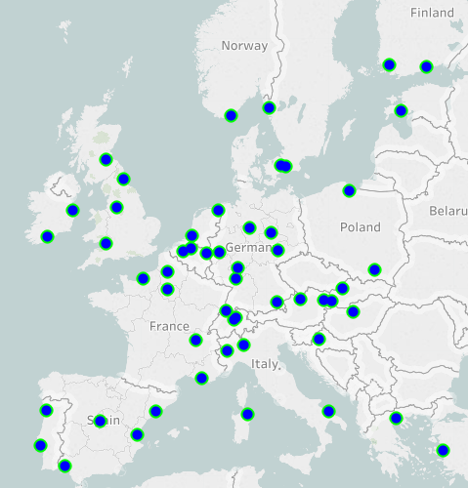
CLX Logistics Europe
Over 20 years in business
  Focus: execution, tactics & strategy
  Solid relationships
Chemical hotspots overview
Benchmark
  Valid rates: > 120 shippers
  Database: > USD 5.1 B spend
  Special Chemical transport modes
  Qualitative insights
  Gartner recognition

Slide 17
CLX Logistics Europe
Benchmark example

Slide 18
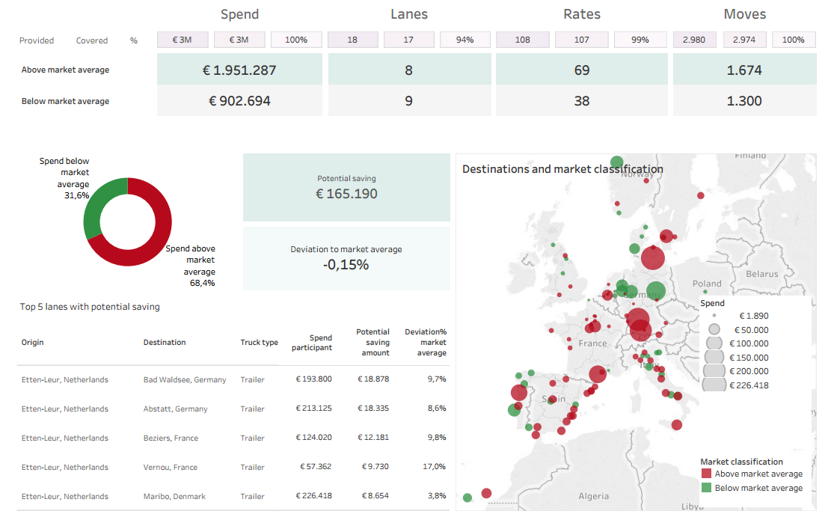
Management summary

Slide 19
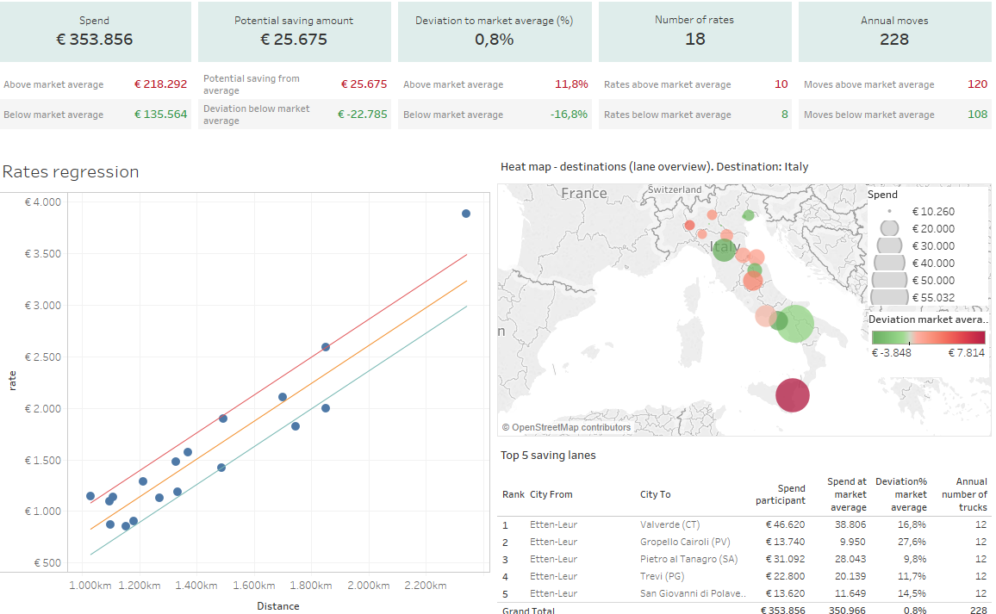
Netherlands - Italy, Equipment: Intermodal

Slide 20
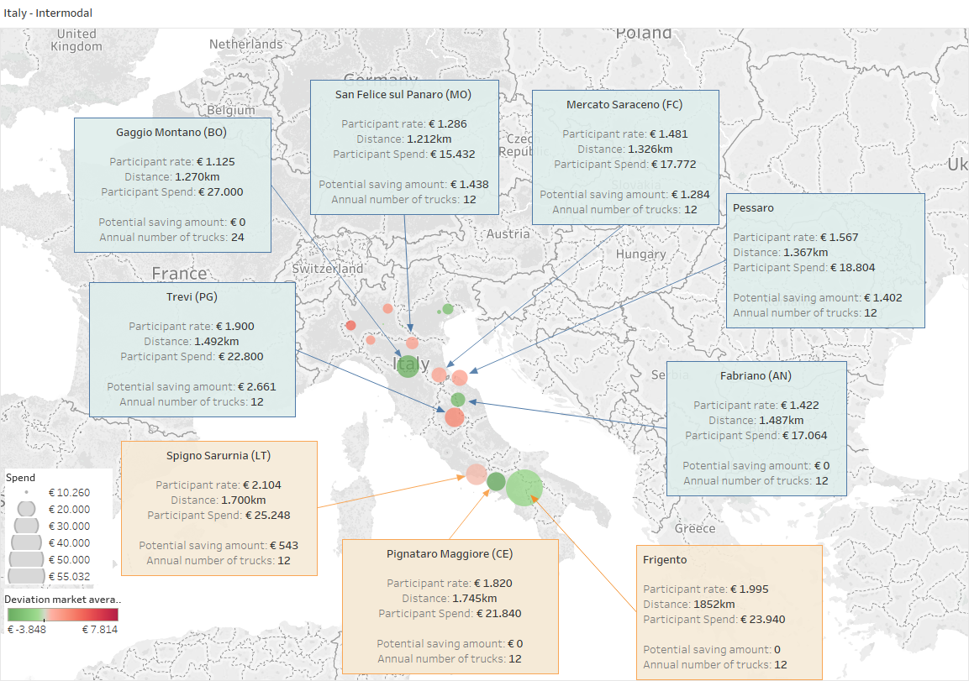
Zoom in

Slide 21
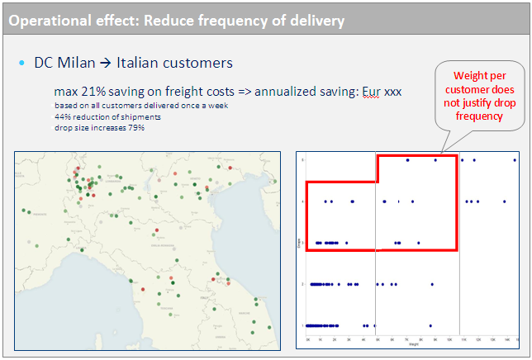
Recent CLX projects
Logistics strategy assessment
  Determine current state of transport management execution
  Check logistics competitiveness
  Routing guide compliance
  Cost savings opportunities

Slide 22
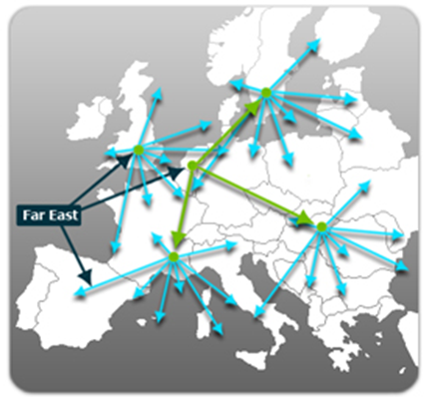
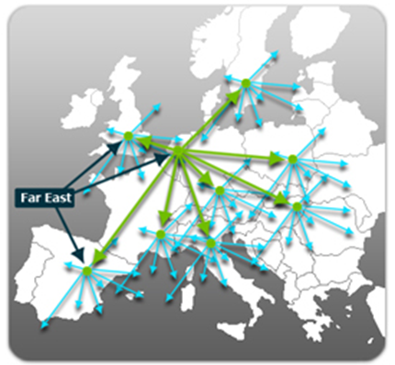
Recent CLX projects
Several RFx / Bids
  Different modes of transport warehousing
  Savings delivered from 4 – 16%
Network study
  Optimize warehouse / drumming & production locations
  Determine best port to enter EU for imports

Slide 23
Thank You

